Slide 1


CEIS301
Final Project Portfolio
Luis E. Lugo Jr.
02/25/2023

Slide 2
Introduction
In this course I learned the basics of Excel and how to utilize it in an engineering aspect for the purpose of unit conversion and analyzing results.

Slide 3
Introduction to Excel
Input values
Perform calculations using excel
Copy calculation formula to multiple cells
Referencing Cells
Creating Graphs

Slide 4
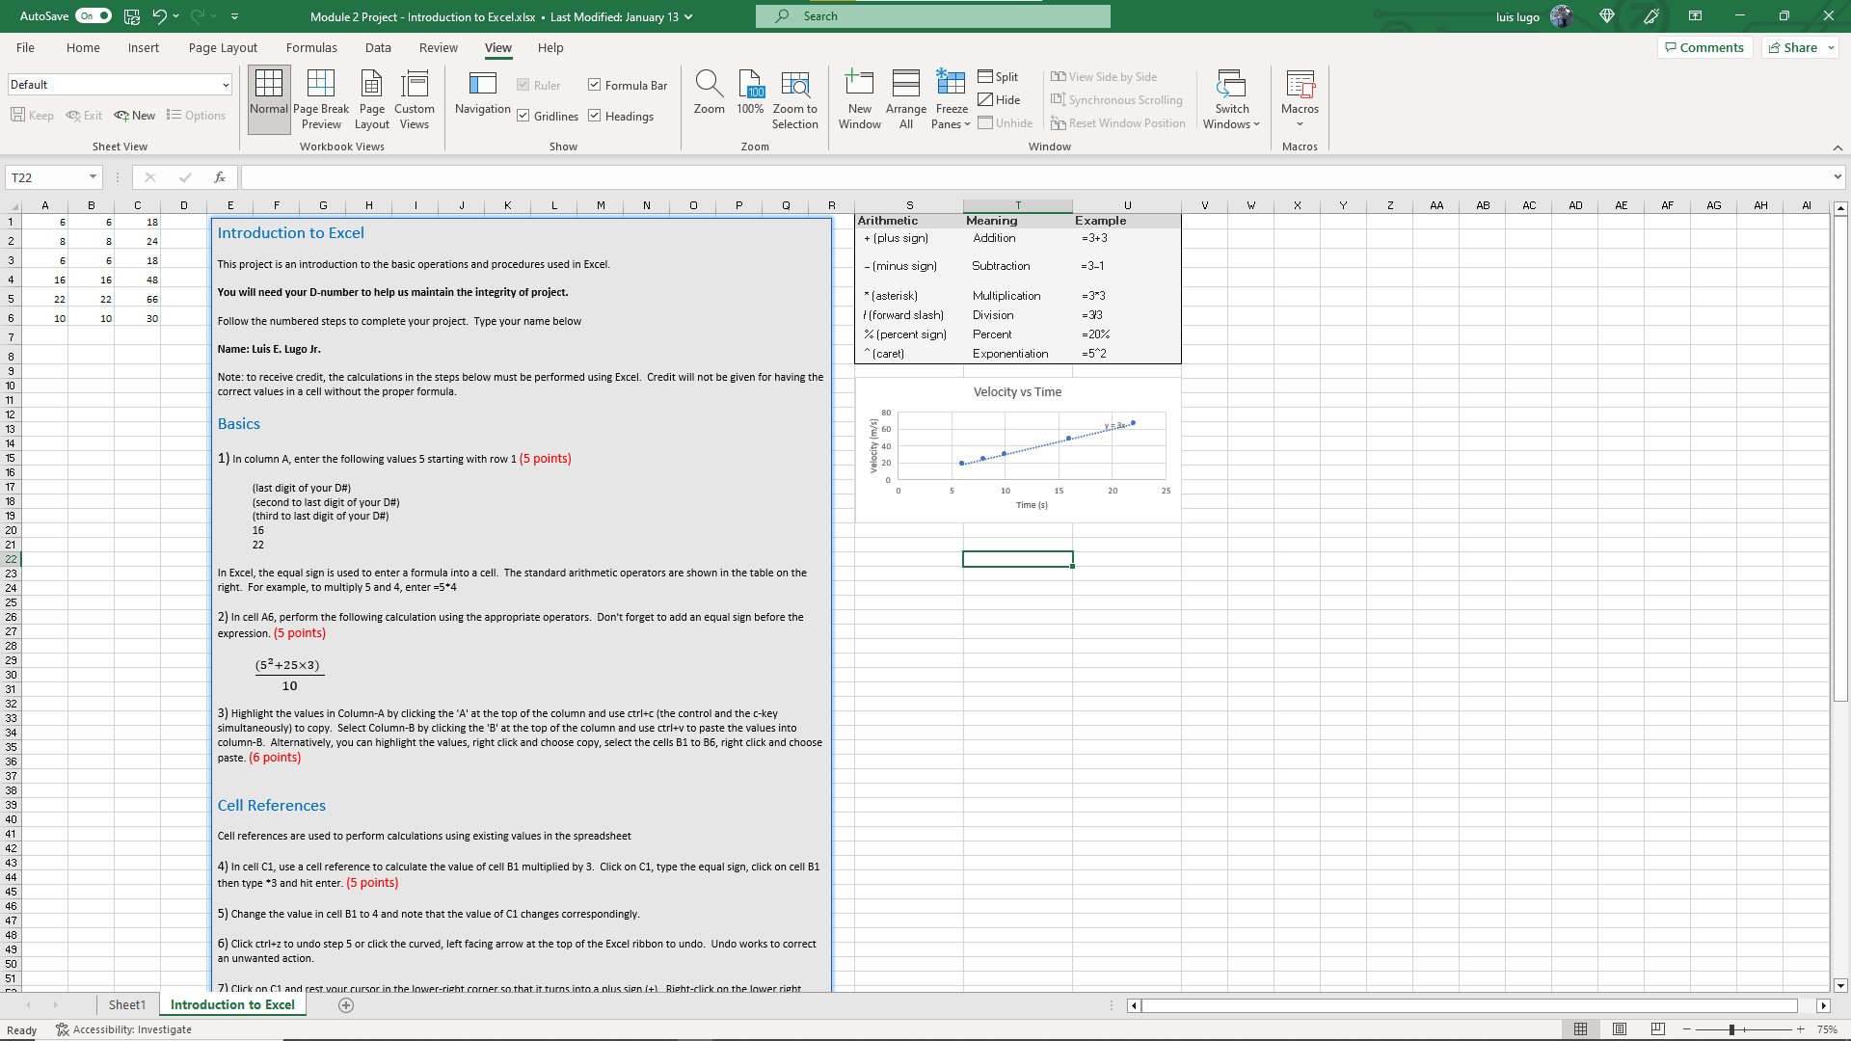
Screenshot of Excel Spreadsheet

Slide 5

Conclusion for Introduction to Excel
Learned how utilize Excel for mathematical purposes and to perform operations in an efficient manner.

Slide 6


Unit Conversion
Converting units of various fundamental measurements

Slide 7
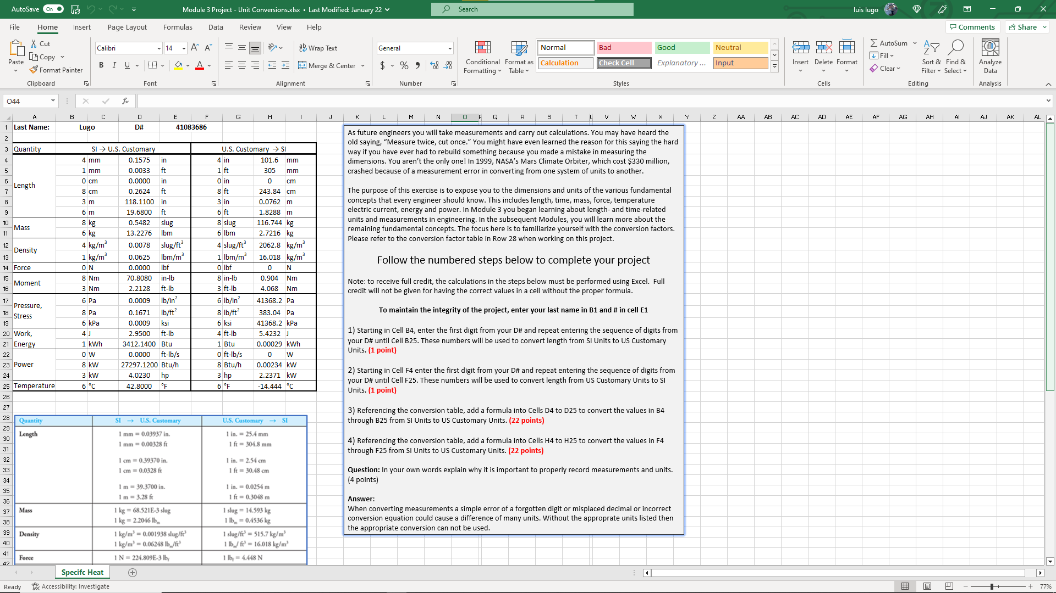
Unit Conversions Screenshot

Slide 8
Conclusion for Unit Conversions
This project introduced me to basic units that are used in the engineering field and how to convert them using excel.

Slide 9
Specific Heat
Introduction to temperature conversion
Introduction to Specific Heat of different materials

Slide 10
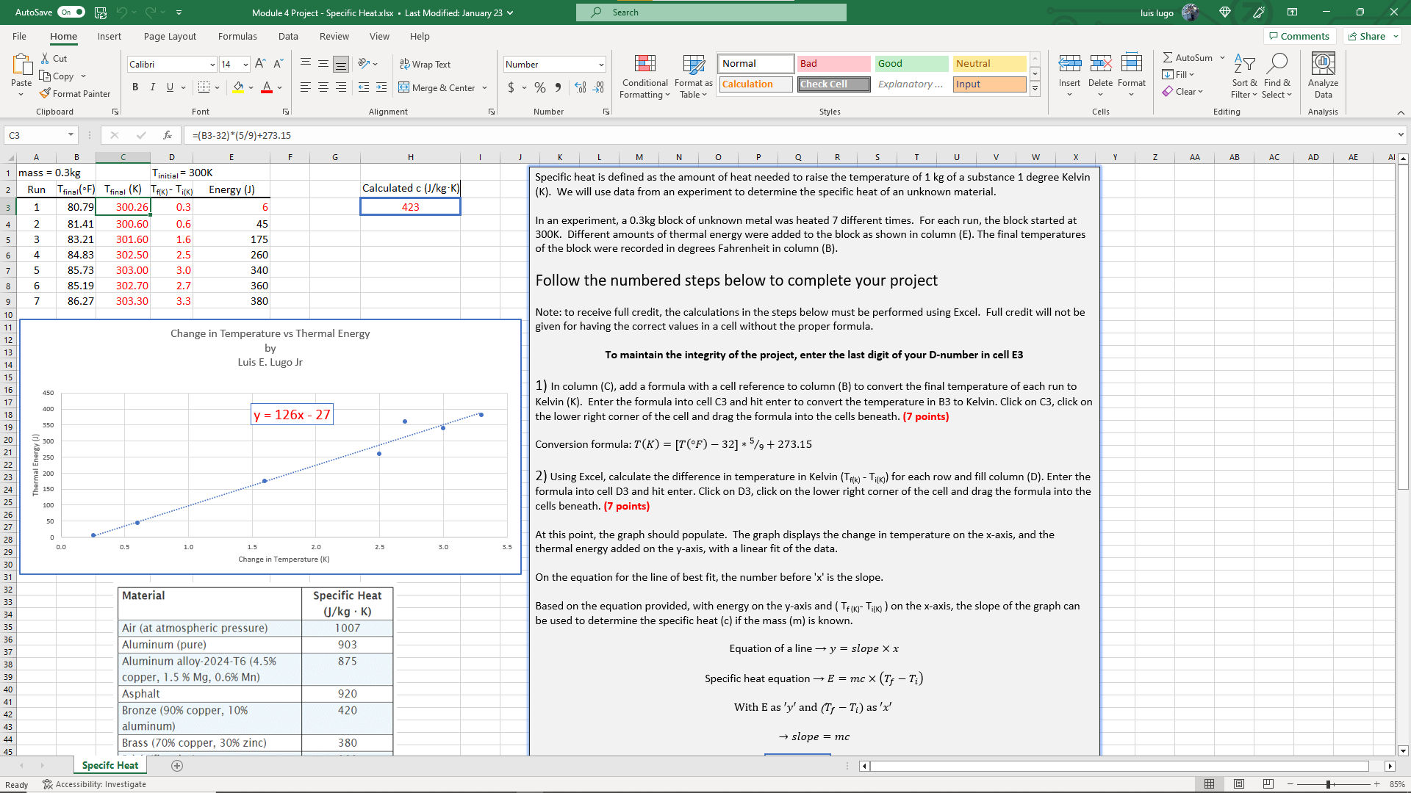
Screenshot of Specific Heat

Slide 11
Conclusion for Specific Heat
Learned to convert from Fahrenheit to Kelvin
Evaluated the specific heat of different materials

Slide 12
Energy and Power
Calculate the resistance of different wire

Slide 13
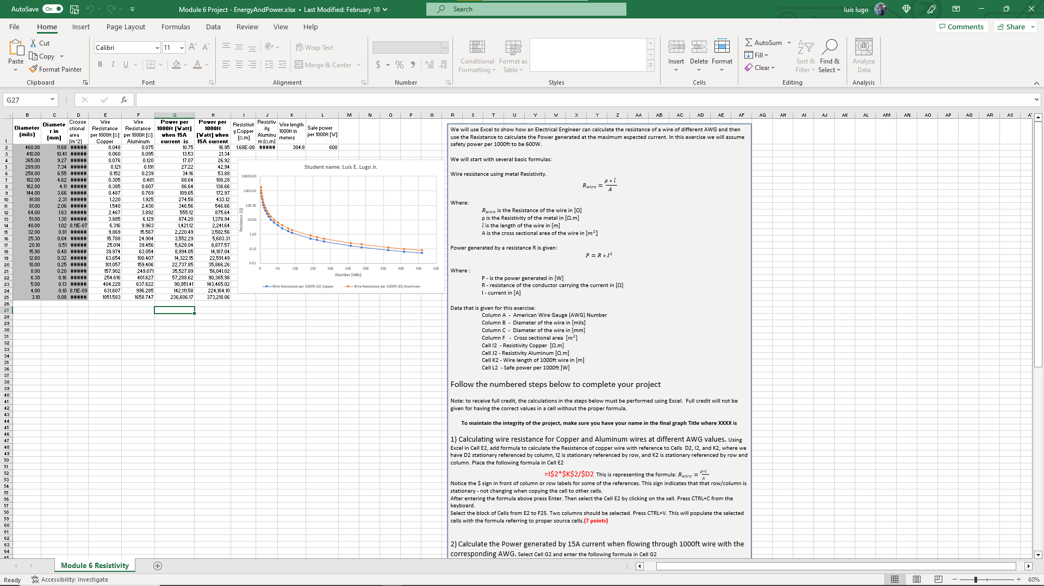
Screenshot of Energy and Power

Slide 14
Conclusion for Energy and Power
Calculated the resistance for different wire
Evaluated the results
Provided Solutions based on evaluations

Slide 15


Career Skills
Basic Excel Use
Converting Units of measurement
Evaluating Engineering Data

Slide 16
Challenges
Editing Excel spreadsheet, at times
Reverting to original spreadsheet to
Correct editing errors

Slide 17
Conclusion
Excel is a powerful tool and necessary within the engineering profession. Using the correct unit of measurement is vital for proper evaluations and conversions of data.

