Slide 1

Fundamentals of Information Technology and Networking
Netw191
Professor Hassan Marzouk
Final Assignment by
Luis E. Lugo Jr.

Slide 2
Project Objective
In this project I will be implementing a small network that supports both IPv4 and IPv6 between a Host computer, Virtual Machine, travel router and a wireless device.

Slide 3

IPv4 and IPv6 Addressing
Here I will be implementing a IPv4 and IPv6 addressing scheme for my network. Using a small travel router, I configured the IPv4 and IPv6.

Slide 4
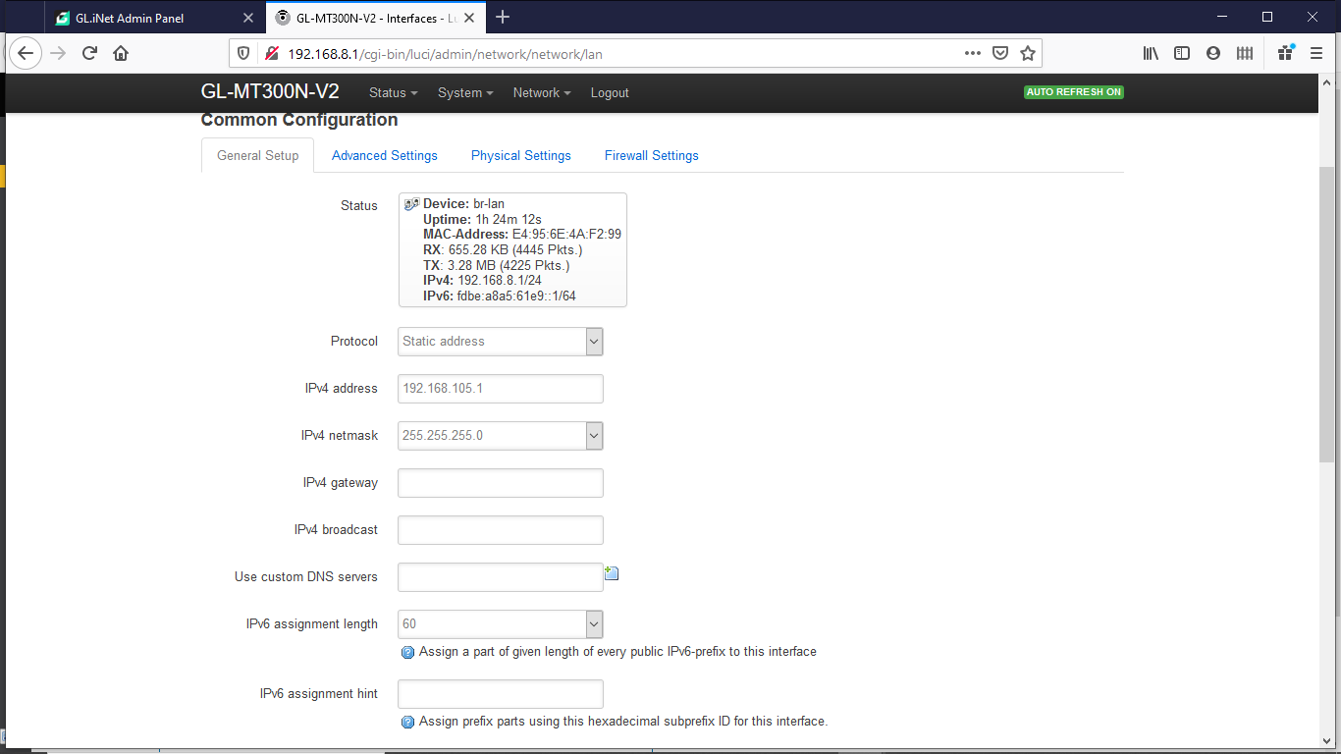
IPv4 address
IPv4 netmask
IPv4 Address Assignment of the Travel Router

Slide 5
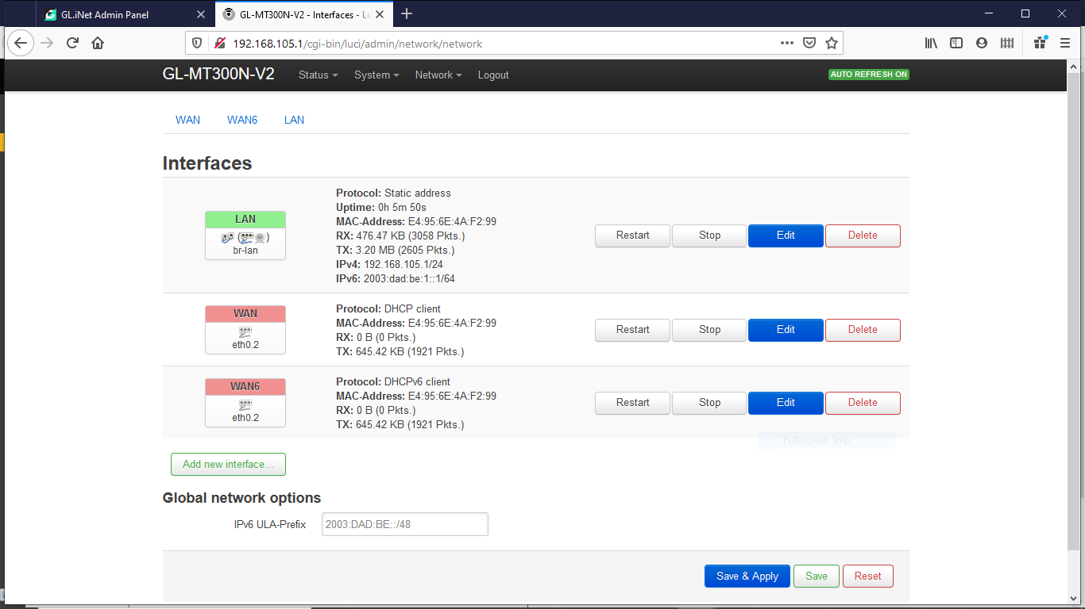
IPv6 address
IPv6 prefix
IPv6 Address Assignment of the Travel Router

Slide 6
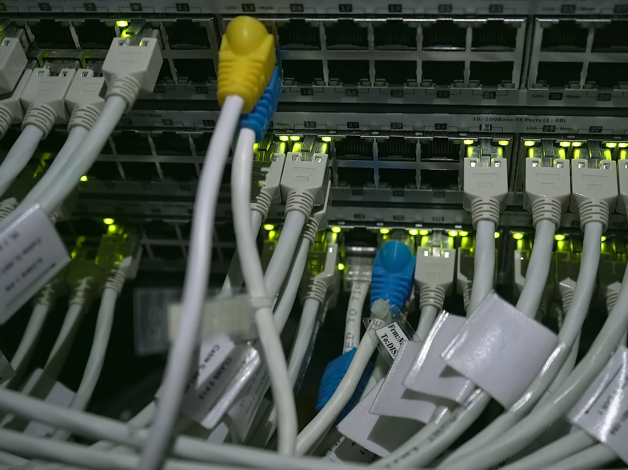
Virtual Machine (VM) Dynamic IP
What I did here is configured the Virtual machine to communicate with the travel router and host computer.

Slide 7
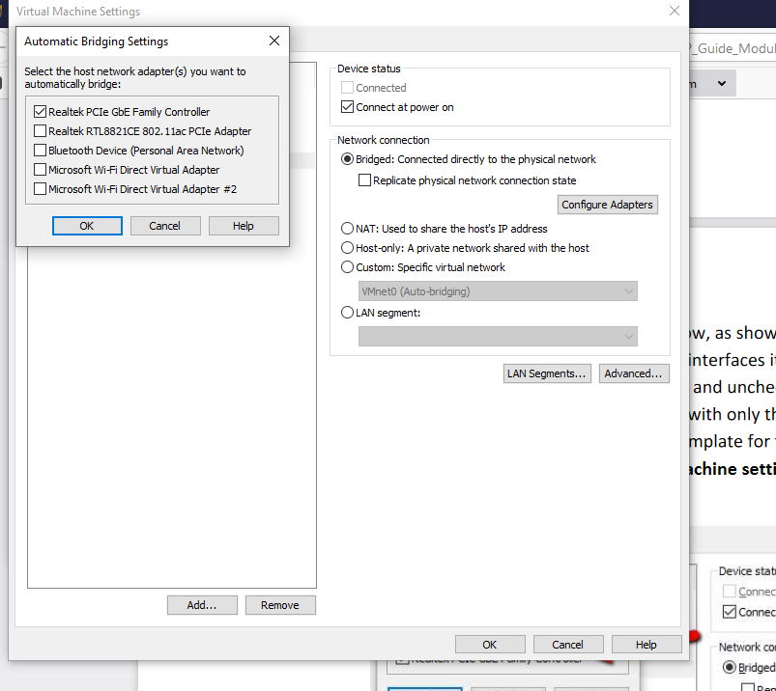
VM Bridging Settings
This screenshot shows the host computer network adaptor that will be automatically bridged.

Slide 8
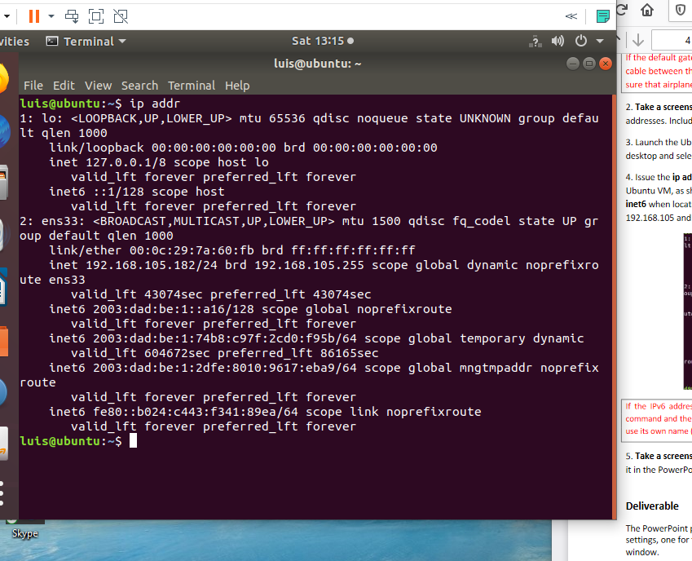
Ubuntu VM Dynamic IP Assignment
This screenshot shows correct IPv4 and IPv6 addresses of the Ubuntu VM.

Slide 9
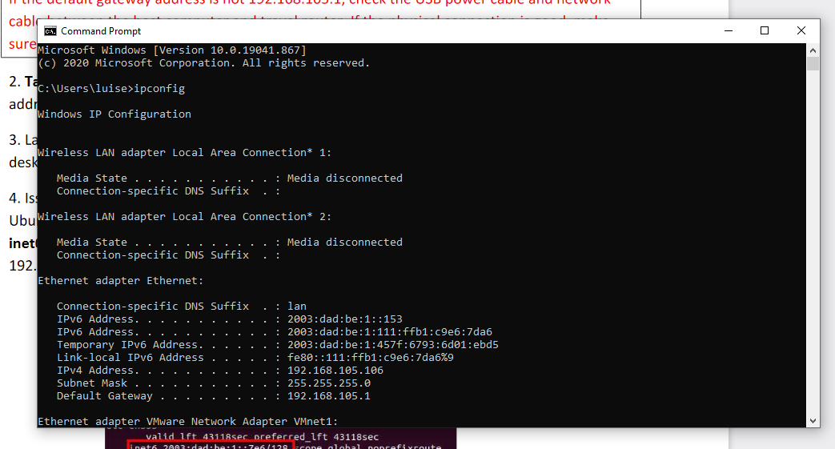
Host Computer Dynamic IP Assignment
This screenshot shows correct IPv4 and IPv6 addresses of the Windows host computer.

Slide 10
Connectivity Test and Visio Network Diagram
Next I did a ping test to all devices connected on the network and present a visio diagram of the network.

Slide 11
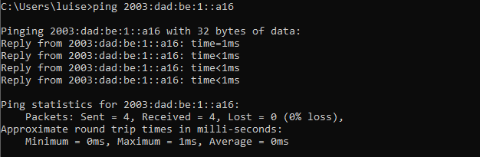
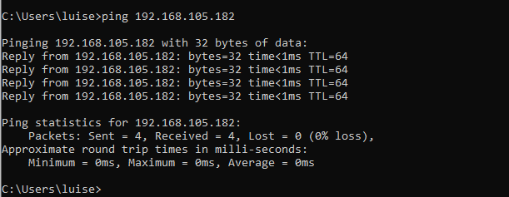
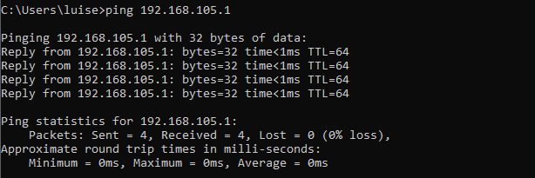
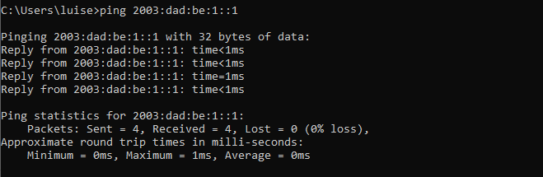
Host to VMV4
Connectivity Test From the Host Computer to all Other Devices
Host to VMV6
This screenshot shows four successful ping tests.
Host to RouterV4
Host to Router V6

Slide 12
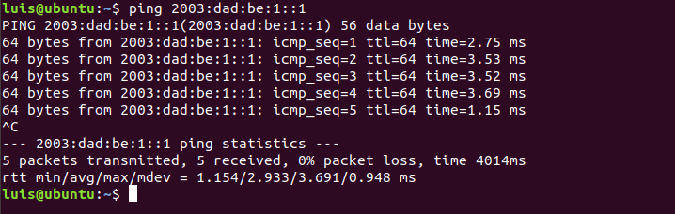
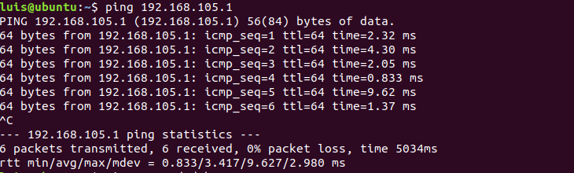
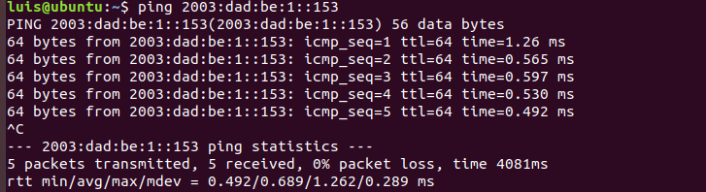
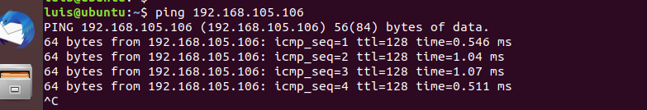
Connectivity Test From the Ubuntu VM to all Other Devices
VM to RouterV6
VM to RouterV4
This screenshot shows four successful ping tests.
VM to HostV6
VM to HostV4

Slide 13
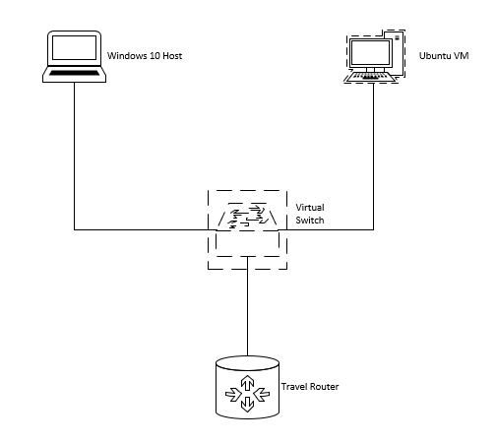
This diagram depicts the interconnection of the host computer, Ubuntu VM, and travel router.
Microsoft Visio Network Diagram

Slide 14
Subnetting and Loopback Interfaces
Here I created two subnets and configured two loopback interfaces.

Slide 15
Subnetting Table
This table includes two /25 subnets, including the network address, first usable host address, last usable host address, and broadcast address for each subnet.
 | Subnet Notation (x.x.x.x/x) | Network Address (1st IP Address) | First Usable Host Address (2nd IP Address) | Last Usable Host Address (2nd from the last IP Address) | Broadcast Address (the last IP address)
The First Subnet | 255.255.255.128 | 192.168.5.0 | 192.168.5.1 | 192.168.5.126 | 192.168.5.127
The Second Subnet | 255.255.255.128 | 192.168.5.128 | 192.168.5.129 | 192.168.5.254 | 192.168.5.255

Slide 16
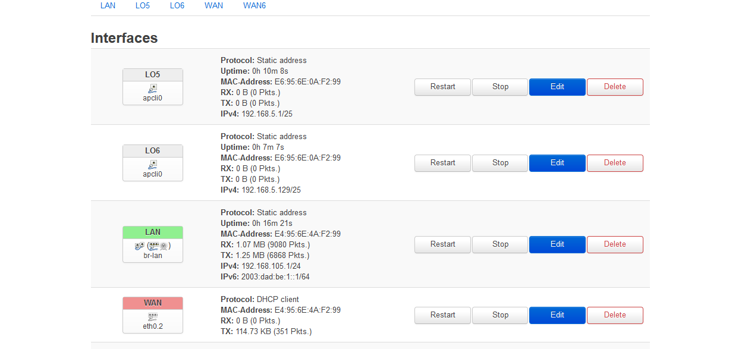
This screenshot shows both Lo5 and Lo6 loopback interfaces and their correct IPv4 addresses.
Loopback Interfaces

Slide 17
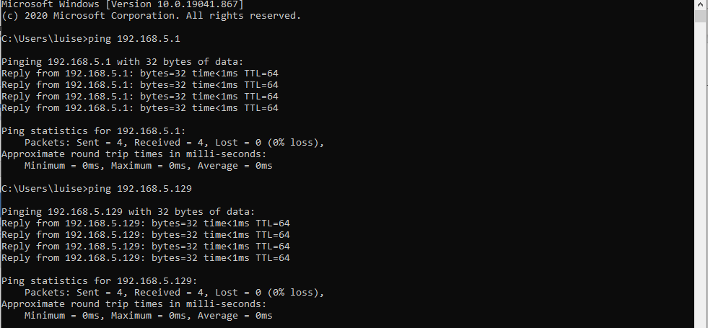
Ping Tests
This screenshot shows two successful ping tests from the host computer to the Lo5 and Lo6 interfaces.

Slide 18
WLAN Implementation
Here I implemented the WLAN function of the network and linked the travel router to my cell phone and conducted a ping test from host computer to cell phone.

Slide 19
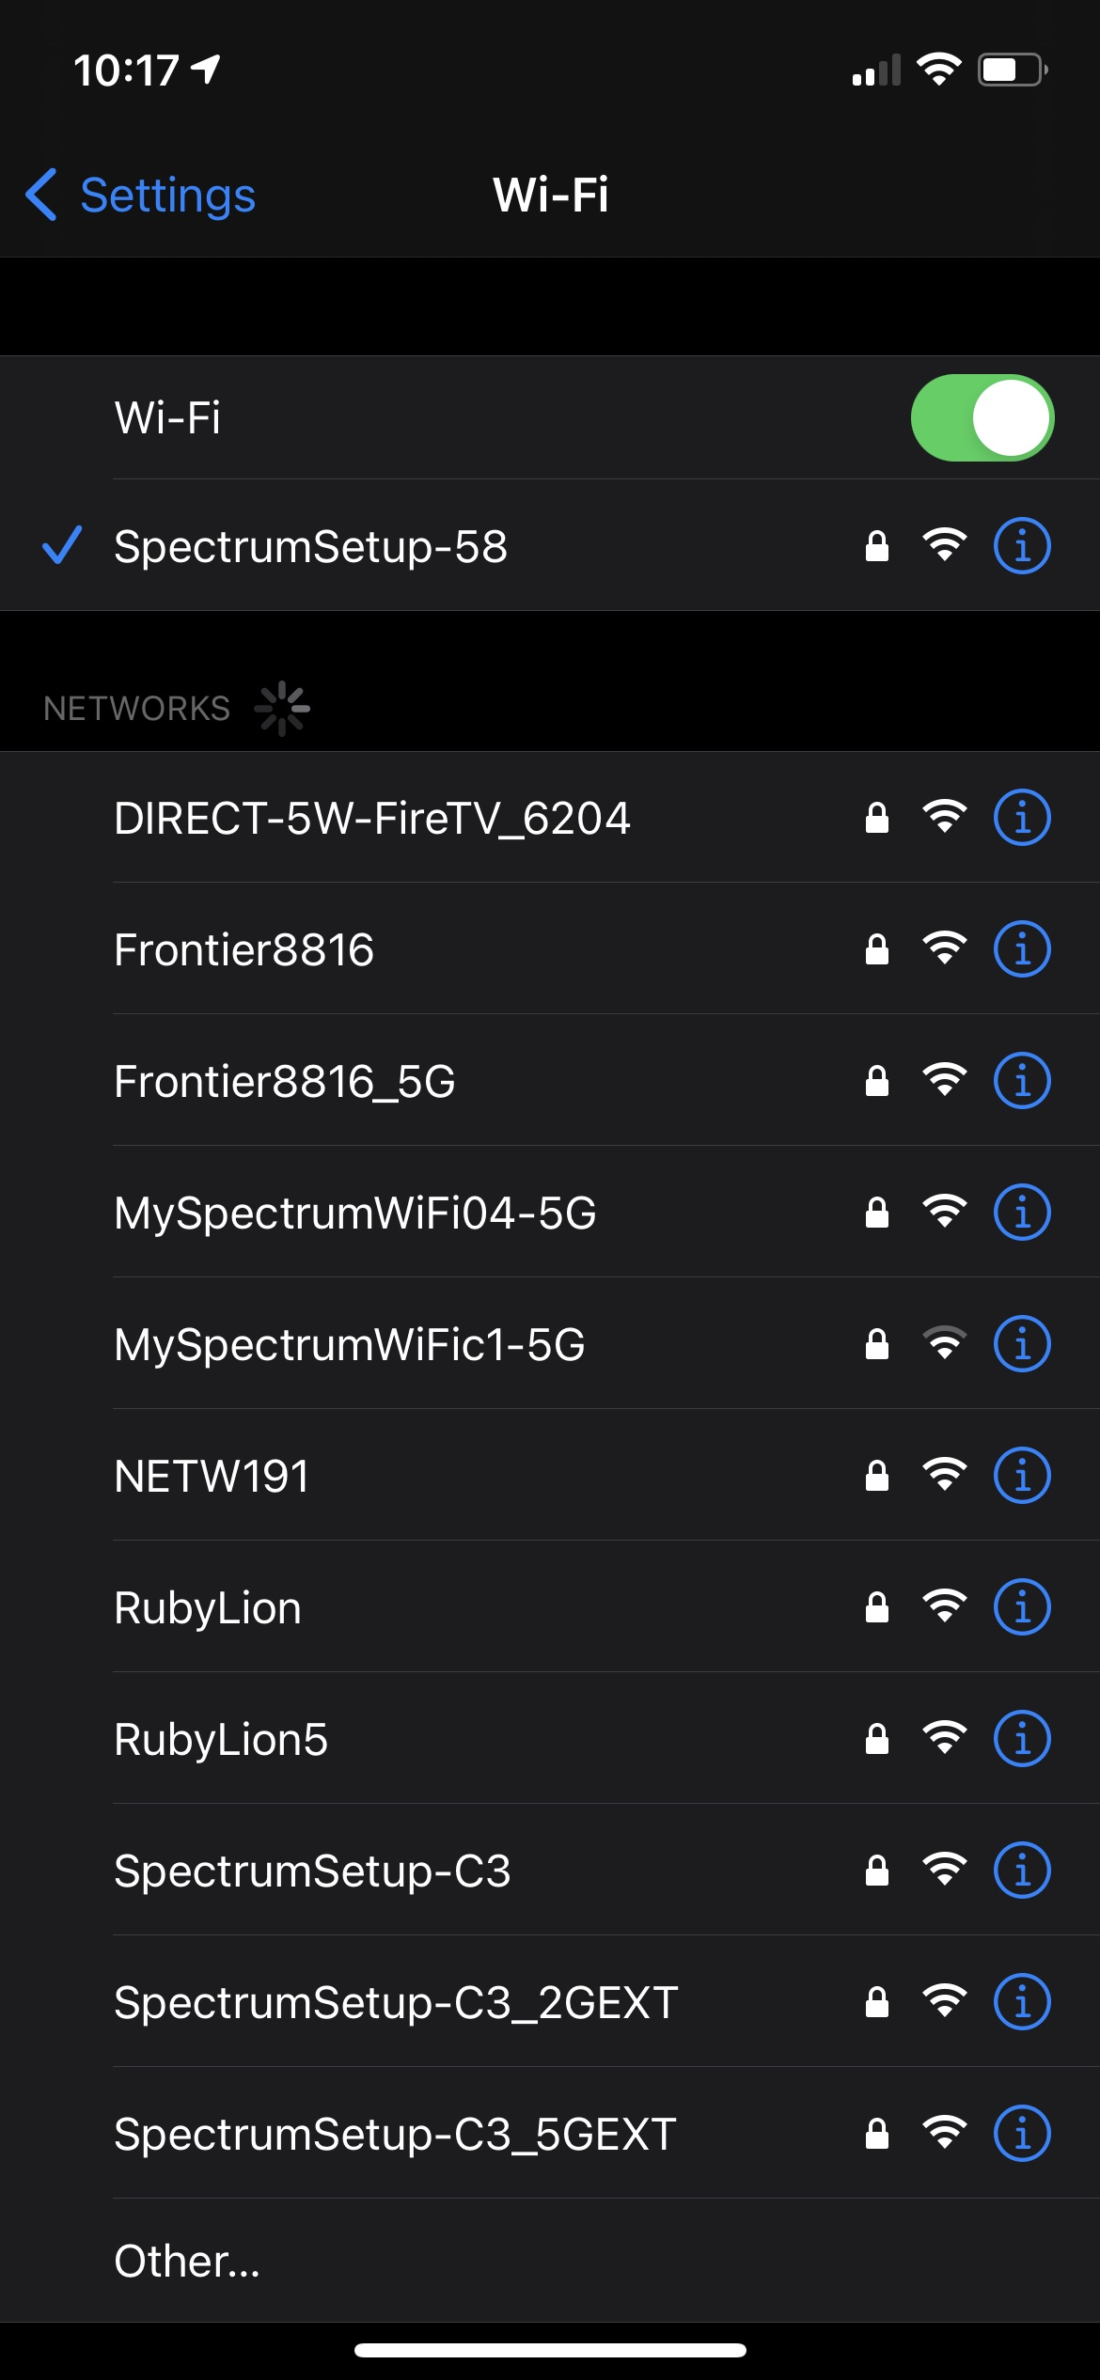
List of SSID Names
screenshot shows the newly configured NETW191 SSID.

Slide 20
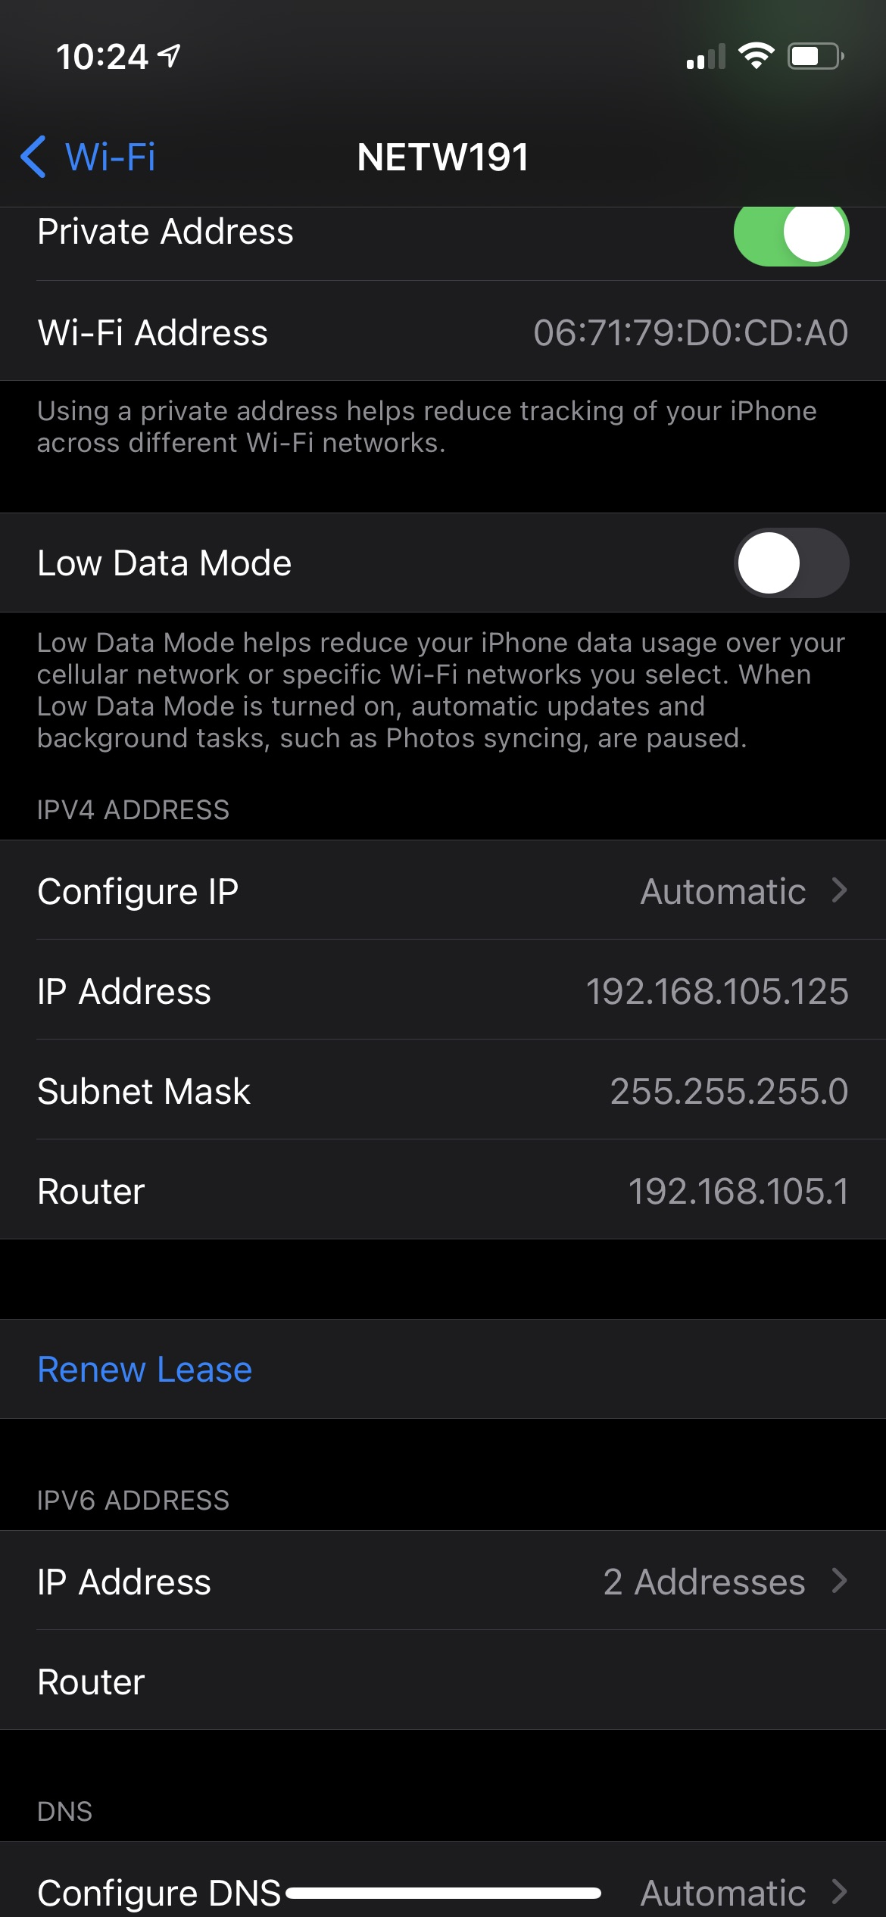
Wi-Fi Client
IP Address
This screenshot shows the IP address of my Wi-Fi device (Cell Phone) that’s associated with the NETW191 network.

Slide 21
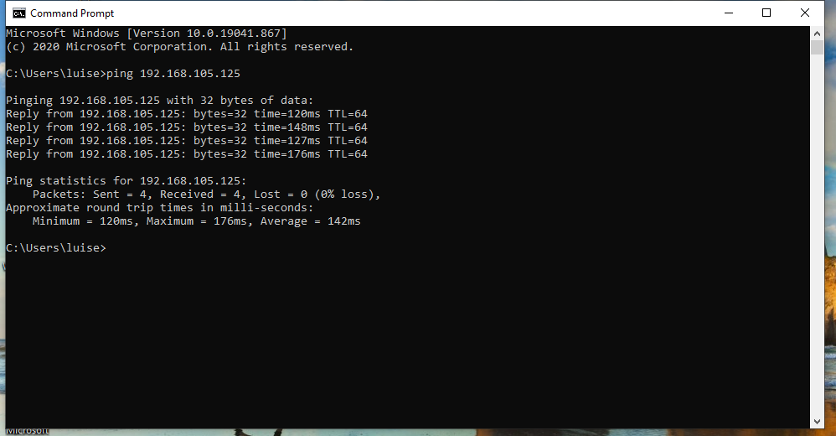
This screenshot shows a successful ping test from the host computer to the Wi-Fi device (cell phone) that’s associated with the NETW191 network.
Ping Test

Slide 22
Conclusion
Security is something as simple as configuring subnets
A network can compose of multiple devices both physical and virtual
You can verify connection using ping tests to any of the devices on a network
At any point can you run into problems but with the correct tools and troubleshooting methods can the problems be solved.

