Slide 1


Building a network in Amazon Web Service
NEWT211 – Final Project
Luis E. Lugo Jr.

Slide 2

Virtual Machine (VM) Instances

Slide 3
Tasks
Launching an EC2 Instance
Connecting to the Instance
Terminating the Instance

Slide 4
Launching an EC2 Instance
Using Amazon Web Service (AWS) I created an EC2 Instance (a virtual server) to begin the project. AWS offers a wide variety of selections in virtual hardware to create our server, I selected the first available free options to create this.

Slide 5
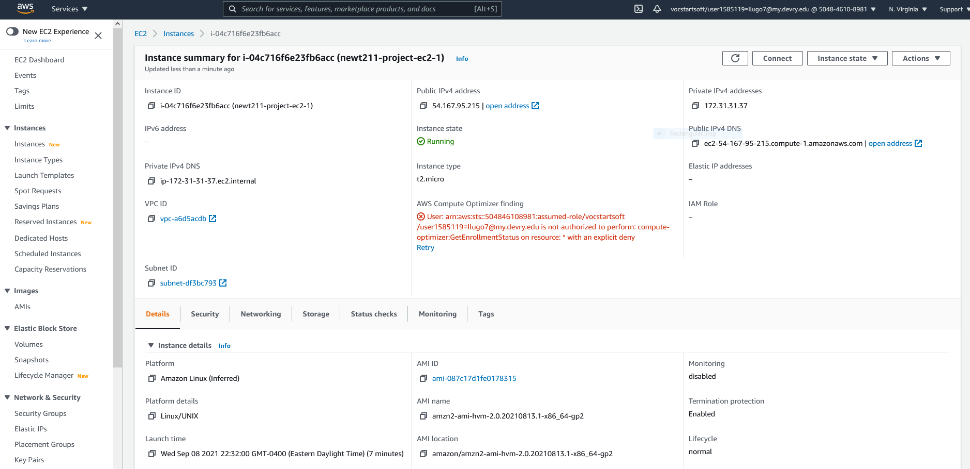
Launching an EC2 instance
This screenshot shows the instance summary page with the information about the instance.

Slide 6
Connect to the Instance
Next slide will show the Command Prompt Window, opened on my physical PC and show me connecting to the EC2 through the IPv4 address.

Slide 7
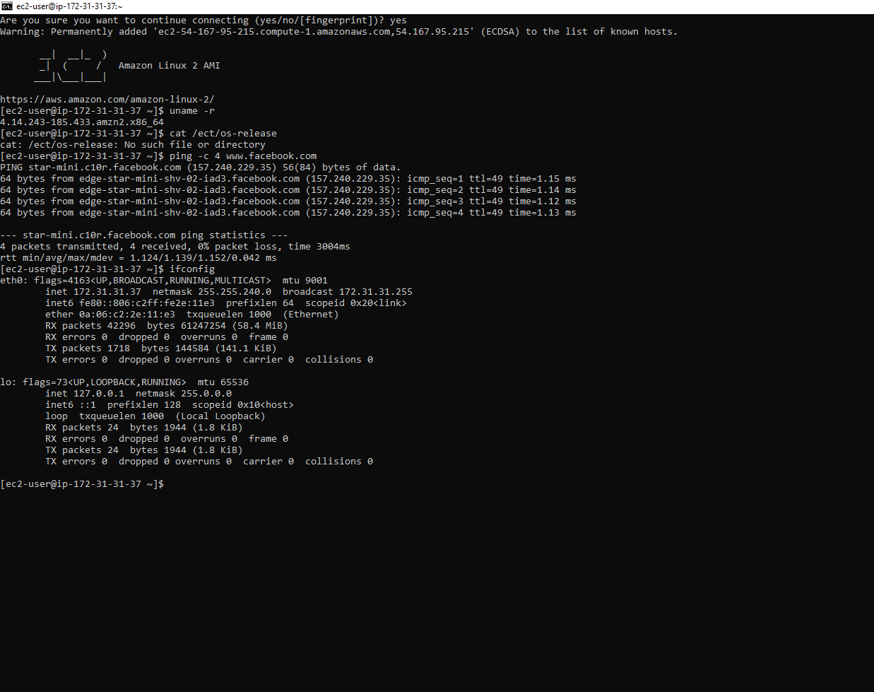
Connecting to the instance
This screenshot shows the Command Prompt window with the instance’s IPv4 address being displayed.

Slide 8
Terminating the Instance
Next slide will show the Instance Summary Page with the highlighted Instance as showing the status of Terminated, it’s important to terminate Instances when not being used in AWS as they will continue to run and cost will continue with it’s use.

Slide 9
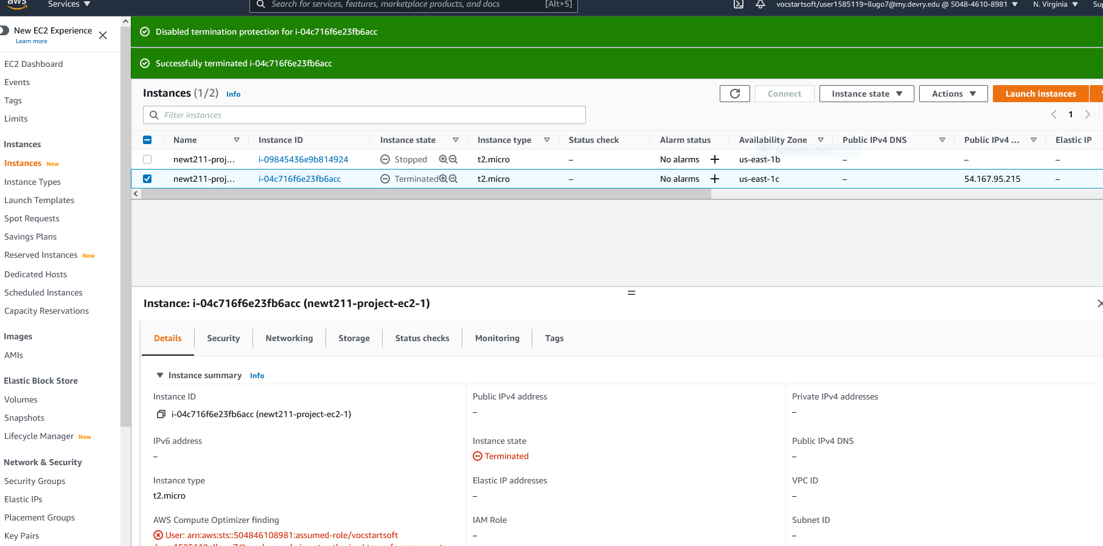
Terminating the instance
This screenshot shows the Instances page with the instance name and its state as terminated.

Slide 10

Virtual Private Cloud (VCP)

Slide 11
Tasks
Launching a Virtual Private Cloud (VPC) with a single subnet
Viewing subnets and route tables
Adding another subnet

Slide 12
Launching a Virtual Private Cloud (VPC) with a single subnet
Following slide will show information of the virtual private cloud that I initiated with a single subnet.

Slide 13
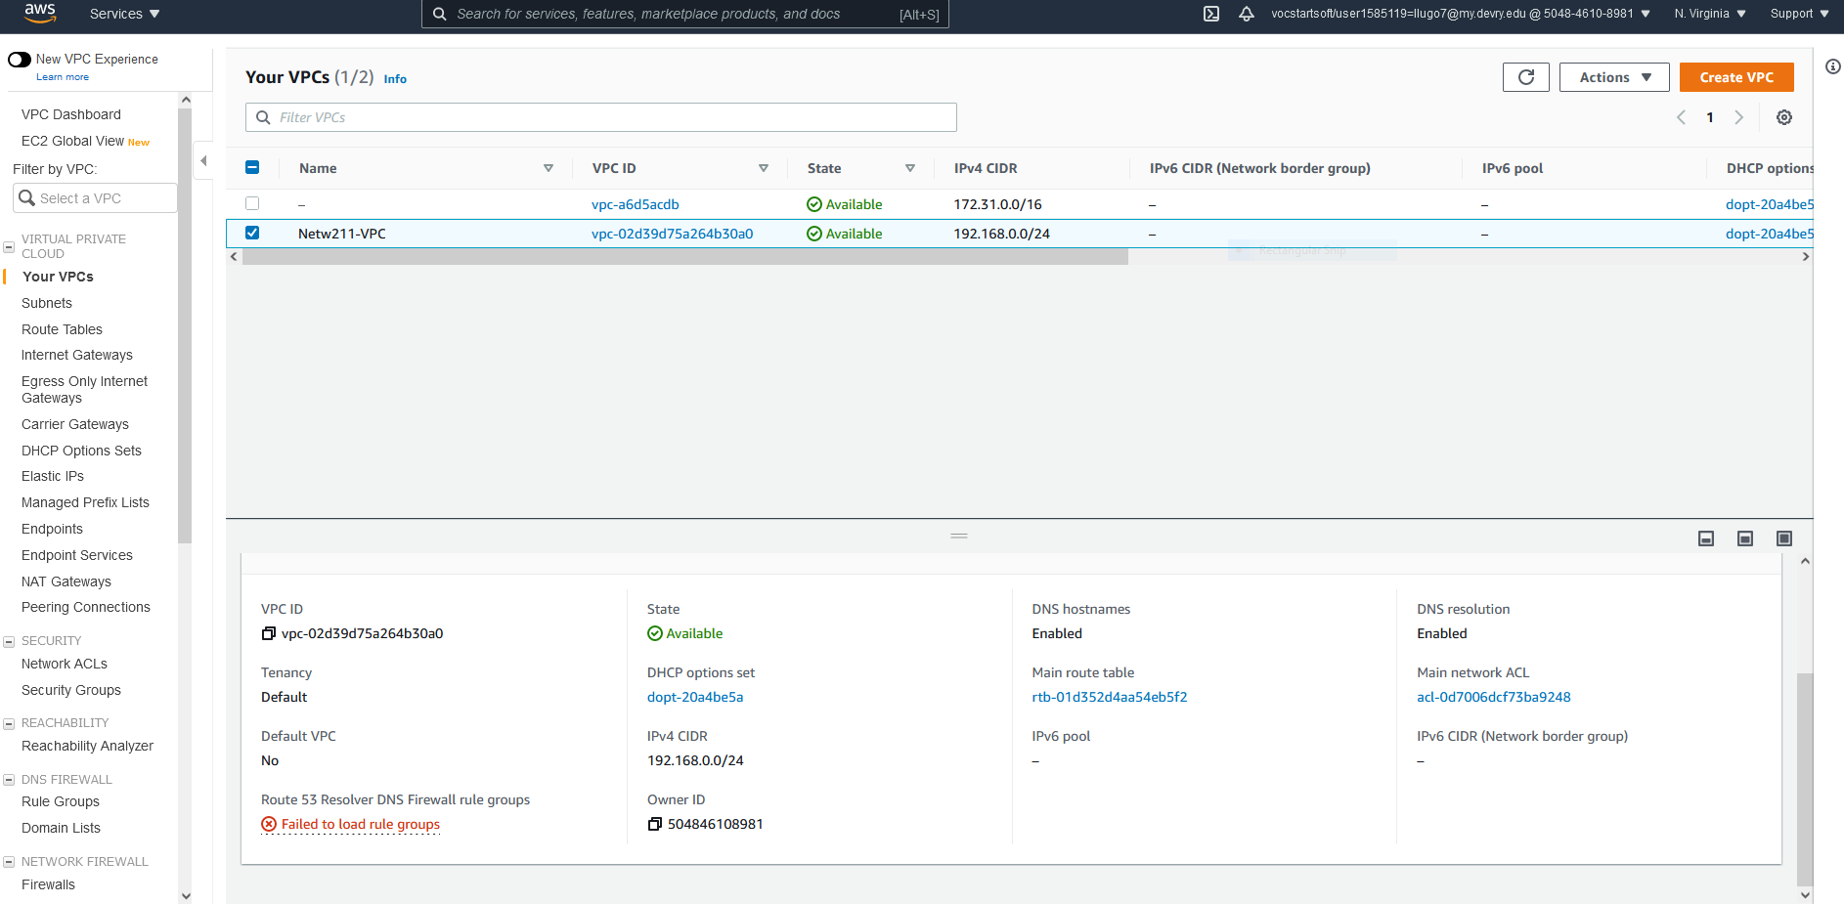
Launching a VPC with a single subnet
This screenshot shows the dashboard with the information about the VPC.

Slide 14
Questions
With a /26 network prefix, how many usable IPv4 addresses are there?
  59
Why is the number of available IPv4 addresses HERE shown as 59?
  There would be 62 addresses available but there are 3 being used. The reason being that AWS uses three IPv4 addresses: One for the router, the other for the DNS server and last is reserved for future use.
2. What’s the role of an Internet Gateway?
The internet gateway allows information to flow out into the internet, it’s a node in the network to properly direct the data in and out with attached networks.

Slide 15
Adding a second subnet
Following slide will show two subnets, the default one and an added one labeled public subnet 2. Having a second subnet is useful when one availability zone fails, the second subnet can be used to take over.

Slide 16
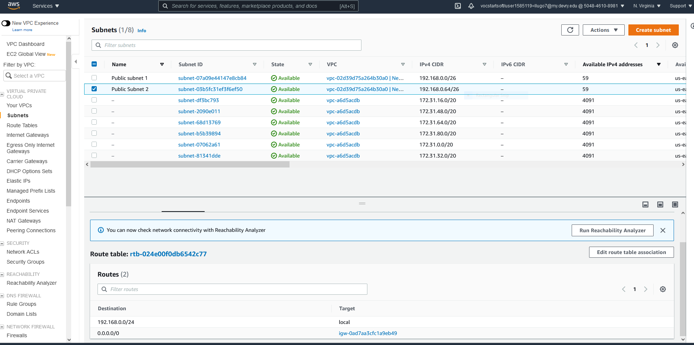
Adding another subnet
This screenshot shows the dashboard with two subnets and the route table of public subnet 2.

Slide 17

Virtual Machine (VM) Instance Security

Slide 18
Tasks
Launching an EC2 instance
Setting up a security group

Slide 19
Lauching EC2 in a Virtual Private Cloud (VCP)
Following slide will show a screenshot of the EC2 Instance launched and the details page which shows the IPv4 address, the VCP ID and Subnet ID

Slide 20
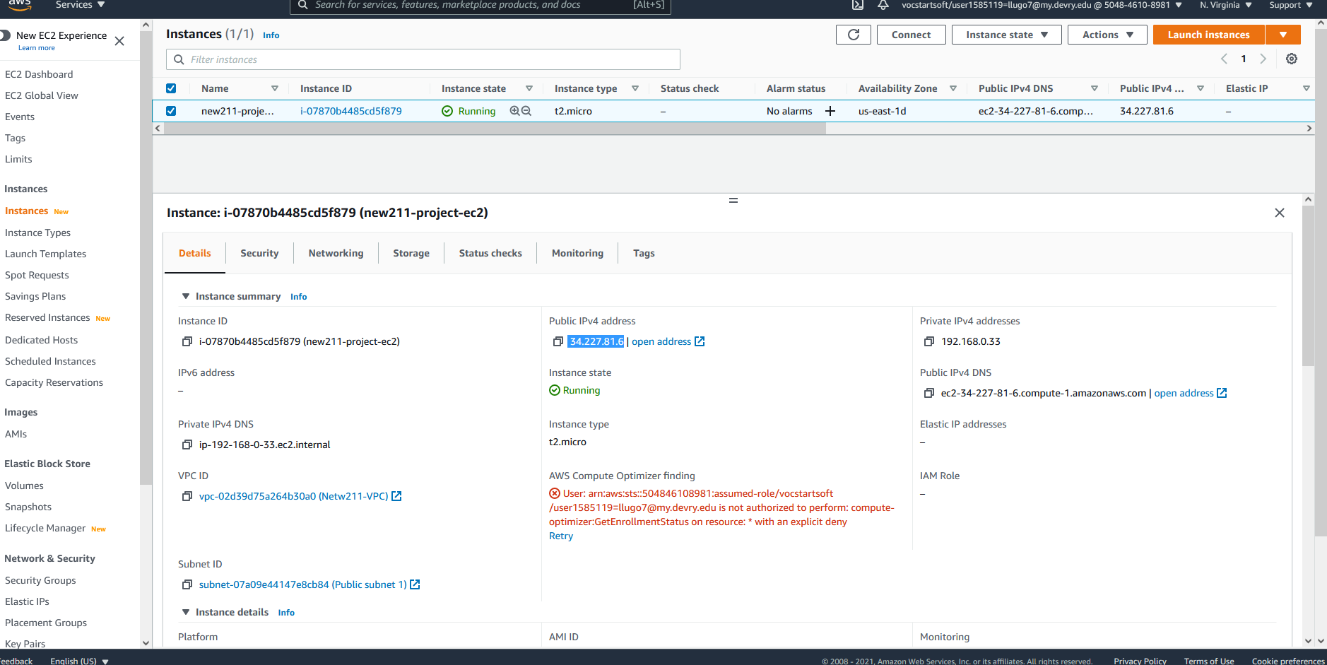
Launching an EC2 instance
This screenshot shows the Details section of the EC2 instance.

Slide 21
Setting up a security group
The following slide shows successful pings to the network. Before adjusting the security settings, successful pings was not possible as the security group did not allow pings or ICMP traffic.

Slide 22
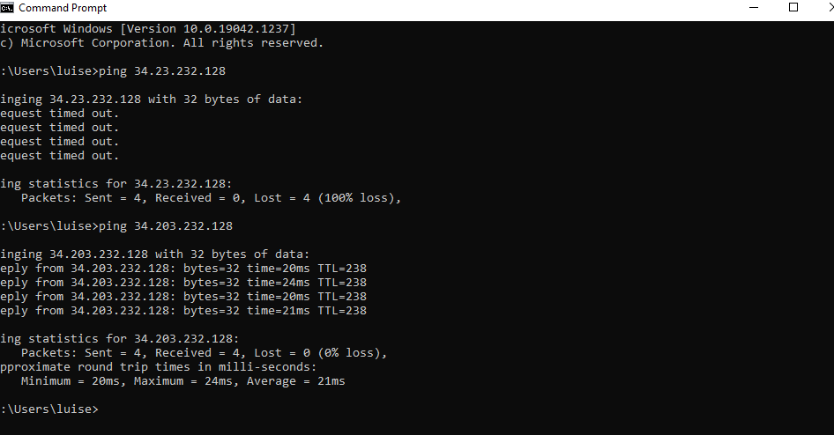
Setting up a security group
This screenshot shows the successful ping from your computer to the instance in the cloud.

Slide 23
Challenge question:
After completing Part 2, could you connect to the EC2 instance via an SSH client on your
computer? Why or why not?
I was not able to connect to my EC2 via an SSH, I receive an error stating that port 22 must be open in order to connect through ssh. It was not possible due to my security protocol not allowing a port 22 connection.

Slide 24

Cloud Storage

Slide 25
Tasks
Create an S3 bucket
Upload a file
Change file and bucket permissions
Remove file

Slide 26
Question
What does the default encryption do?
Answer here: It encrypts an object before saving it to disk and decrypts the object when it is downloaded. Helps save on encryption cost using server based encryption.
References:
1. https://docs.aws.amazon.com/AmazonS3/latest/userguide/bucket-encryption.html
2. https://www.amazonaws.cn/en/kms/faqs/

Slide 27
Uploading a file
Next two slides will show the failure of accessing a file that was uploaded due to default permissions which do not allow outside access. Then the new bucket with changed permissions to access the file.

Slide 28
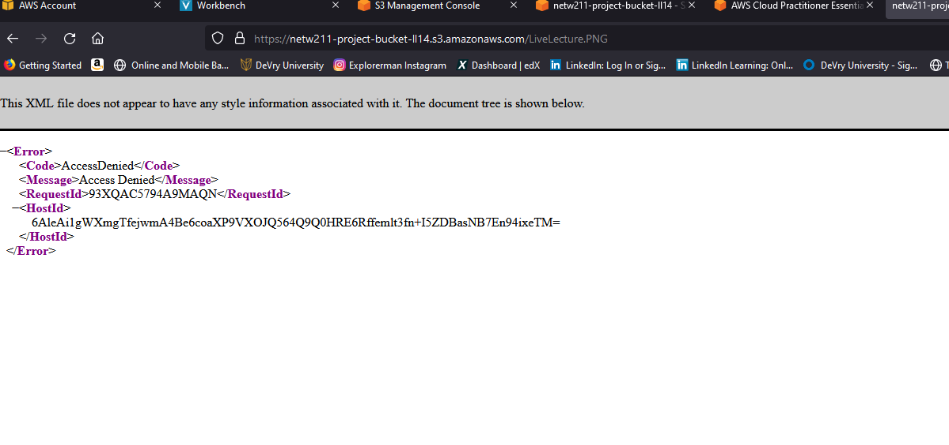
Uploading a file
This screenshot shows the Access Denied error message in a browser window.

Slide 29
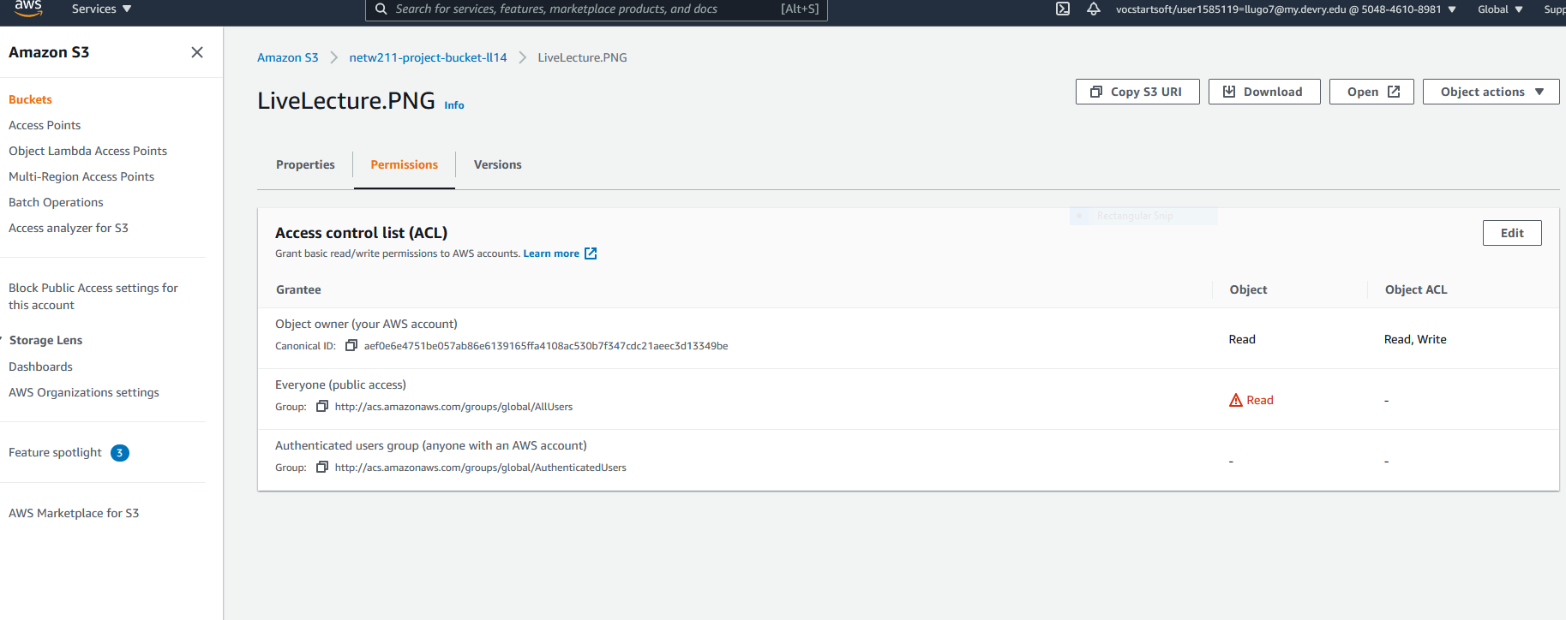
Changing permissions
This screenshot should show the permissions or access control list (ACL) information of the uploaded file.

Slide 30
Challenge Question
If permissions were not changed for both bucket and file, would you have access?
  My answer is no, if the bucket was not made public then only authorized users would be able to access it, if the file was not made public then only files that are public can be viewed.

Slide 31

Cloud Monitoring

Slide 32
Tasks
Launching an EC2 instance
Setting up SNS notification and subscription
Setting up a CloudWatch alarm

Slide 33
Next three slides shows the setting up and subscribing confirmation of an SNS notification system, the CloudWatch alarm and it’s metrics.

Slide 34
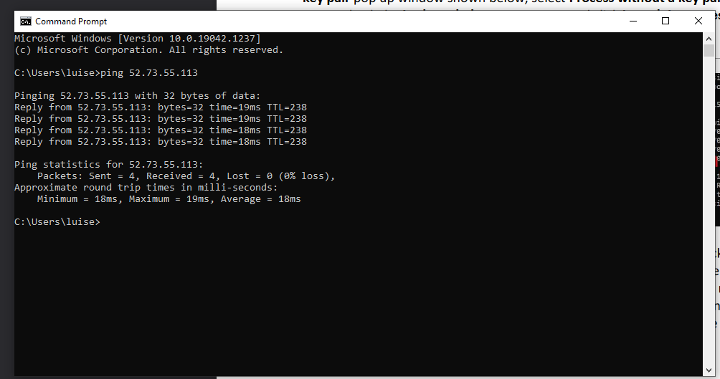
Launching an EC2 instance
This screenshot shows the successful ping from your local computer to the EC2 instance.

Slide 35
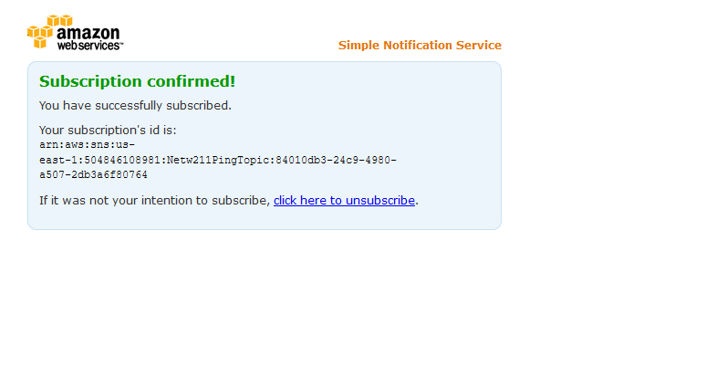
Setting up SNS notification and subscription
This screenshot shows the browser window with the “Subscription confirmed!” message.

Slide 36
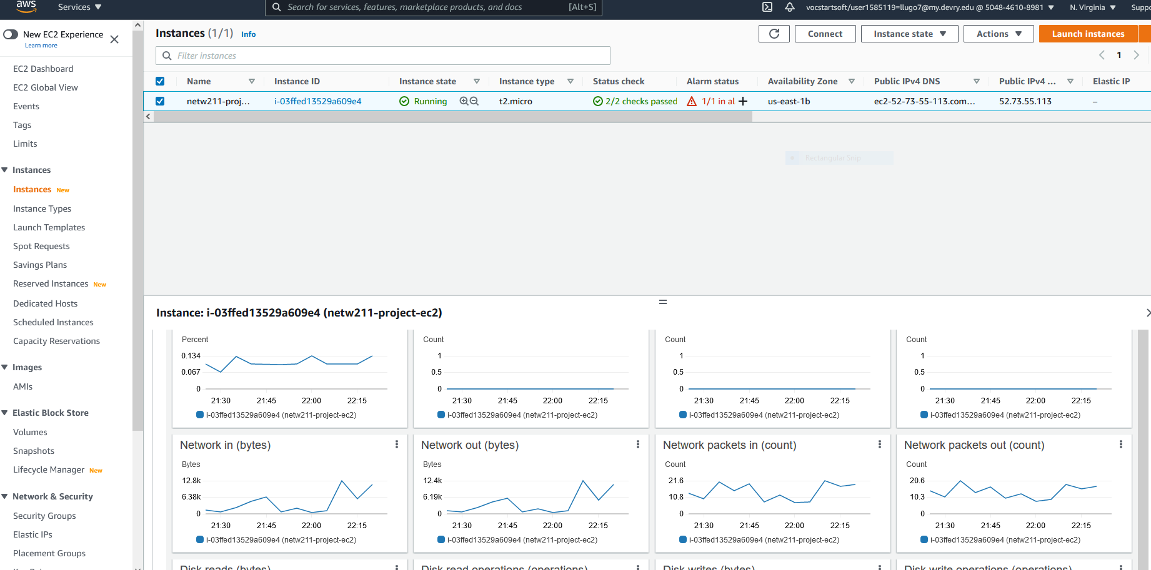
Setting up a CloudWatch alarm
This screenshot shows the EC2 dashboard with several CloudWatch metrics.

Slide 37
Challenges
My biggest challenge was getting the proper amount of data to be pinged to the EC2 after setting up the CloudWatch, when I tried to send 1500 bytes of data the system would time out but with 1400 bytes of data I was successful every time. To get a successful ping with the most data I trialed and errored starting with a small amount of data then gradually raising it until failure.

Slide 38
Skills Obtained
Trouble shooting with AWS
Changing Security settings for EC2s
Establishing a bucket for file upload
Setting SNS notifications
Using CloudWatch

Slide 39
Conclusion
AWS is a very powerful tool for cloud computing. There are a lot of parameters that can be adjusted and customized for any need.

