Slide 1

Sensors, Lights, and Display…OH my!
Luis E. Lugo Jr.
CEIS114
Final Project

Slide 2
The best journeys are those that are properly thought out
What you’re about to see is thinking in action, please hold applause till the end of the 3rd slide.
There will be Inventory, there will be expectation for the input – process – and output, and last but not least there will be a project flowchart!

Slide 3
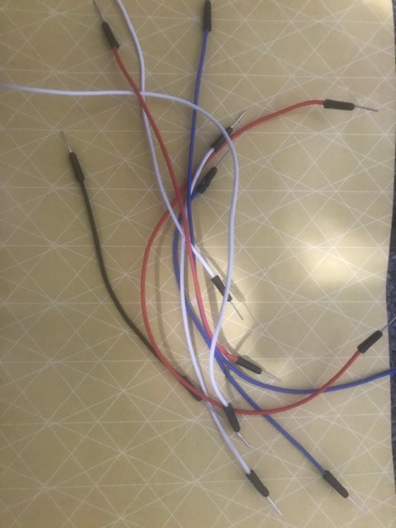
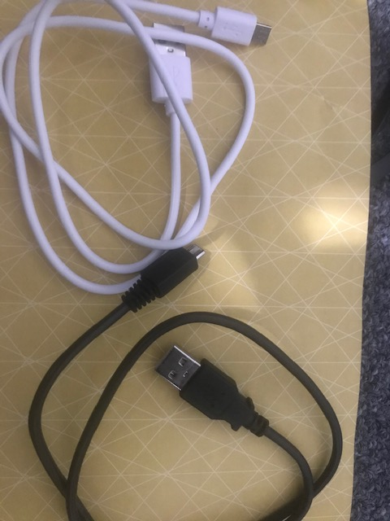
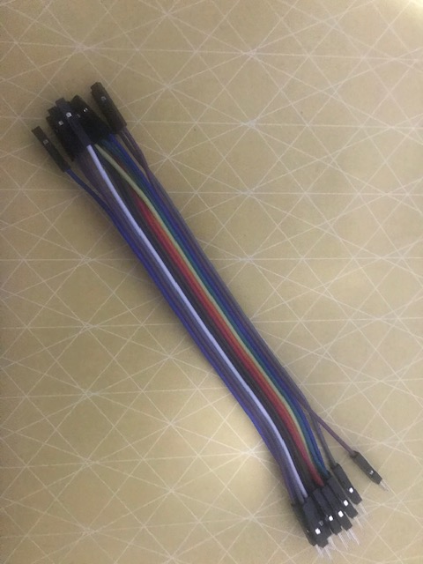
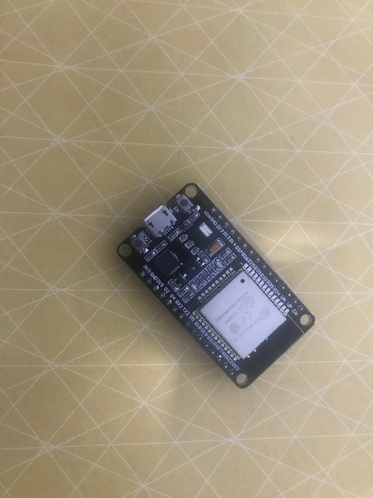
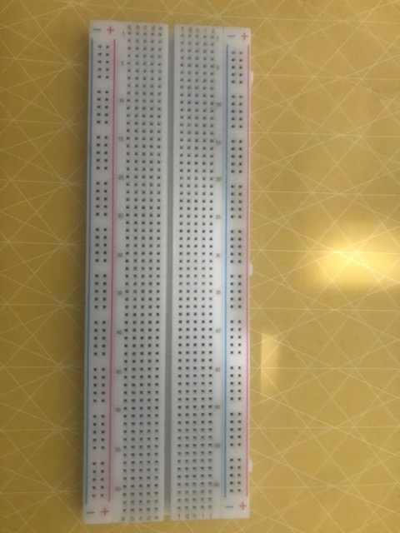
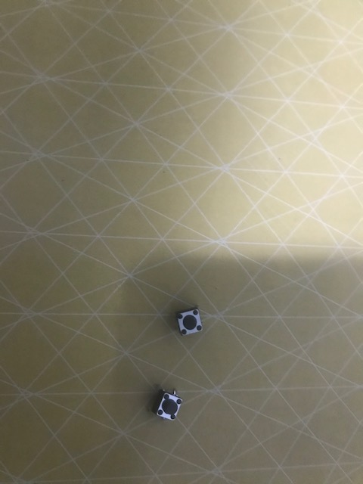
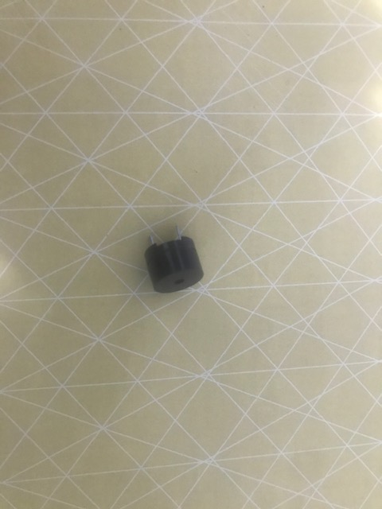
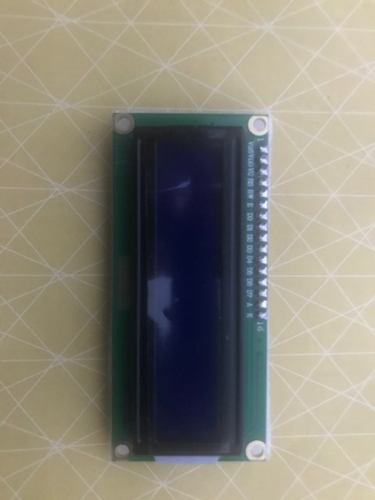
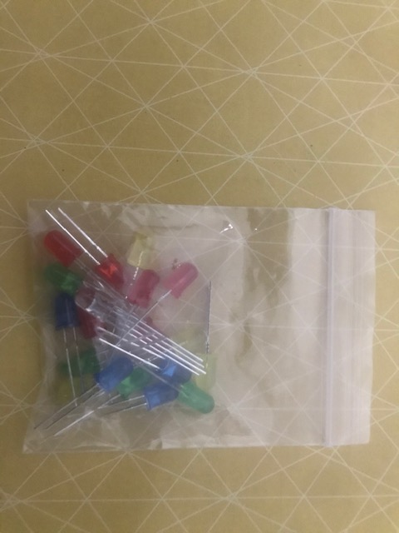
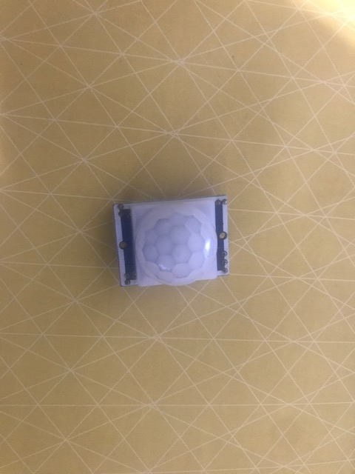
Inventory
Breadboard
Wires
ESP32 Board
ESP32 Board
LCD Unit
Breadboard
Wires
Push Buttons x2
Buzzer
Motion Detector
Colored LEDs: Red, Yellow, Green, and Blue
Push Buttons – 2
LCD Unit
Buzzer
Colored LEDs: Red, Yellow, Green, and Blue
Motion Detector

Slide 4
Input – Processing - Output
Fill out the following chart for the course project option you selected
Input | Process | Output
Emergency Pedestrian Crosswalk Motion on minor street | Change Lights to Red Change Light for Pedestrian Change Lights | Walk/Do Not Walk

Slide 5
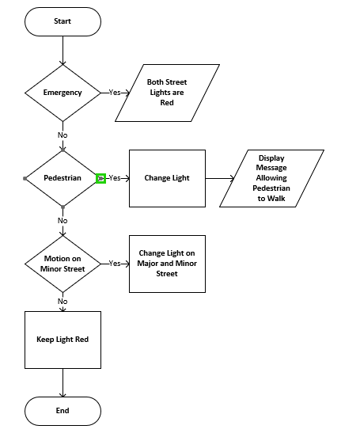
Project Flowchart

Slide 6
Why Plan
Finding inventory was quite simple but if I did not first pull and set aside all that I would need, I would of ended up spending more time trying to figure out what pieces were required or when a piece breaks down, finding a replacement would of hindered the flow process.
Setting expectations for what the input, process, and output was going to be, helped in what I was going expect for the flow.
No project can really be done properly without a good Flowchart, the flowchart help keep me on track of expectations for what I wanted to ultimately do. Had I not have a flowchart, there could have been a time where I would of forgotten what my plans were.

Slide 7
First Laid Bricks
Creating the Traffic Controller

Slide 8
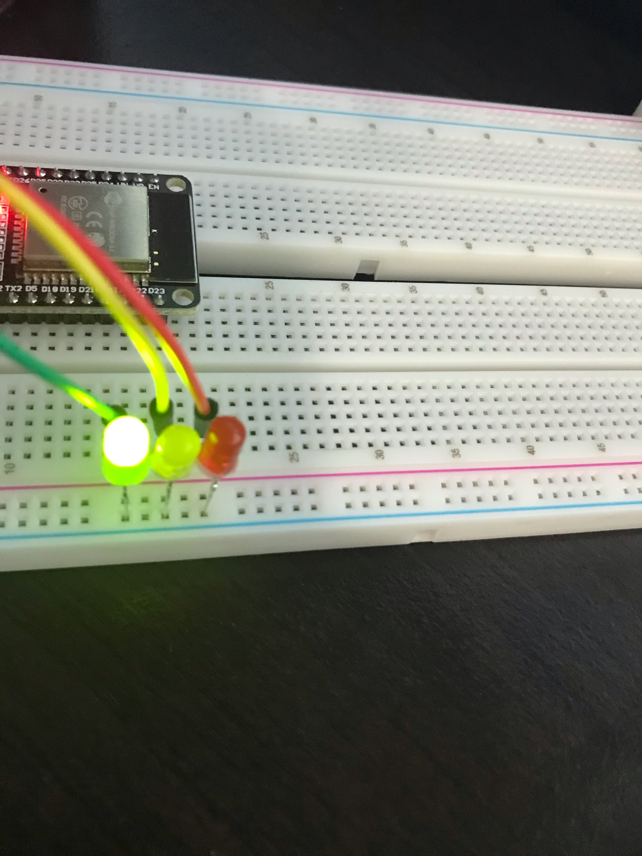
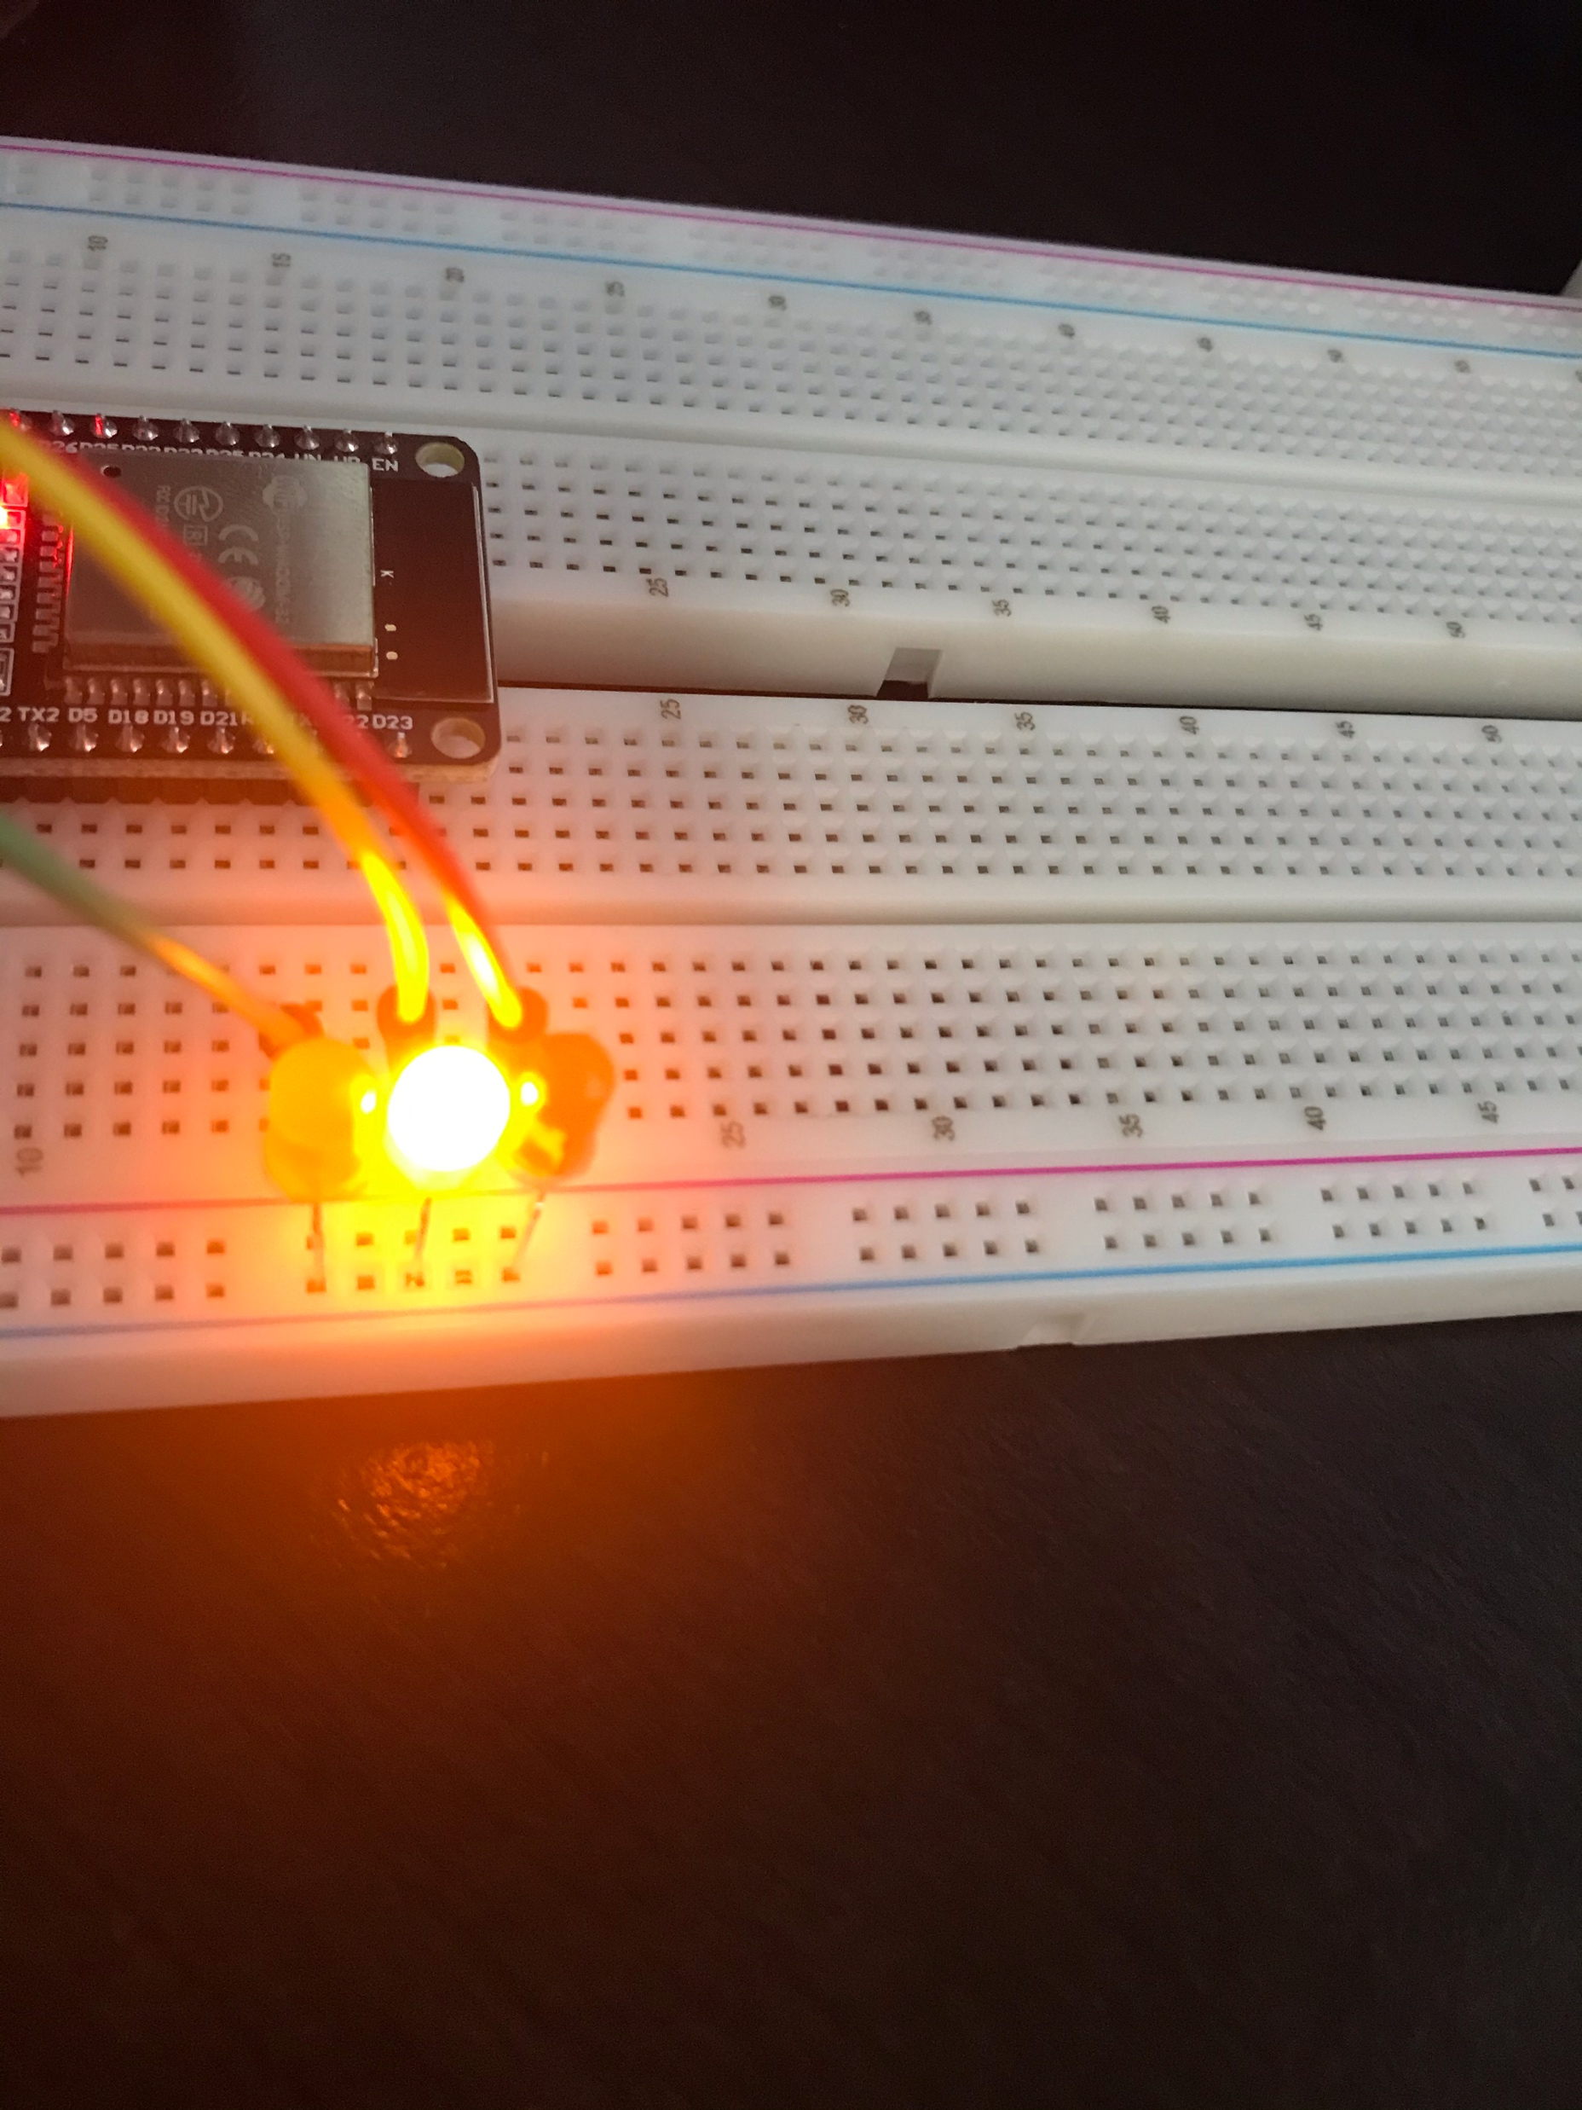
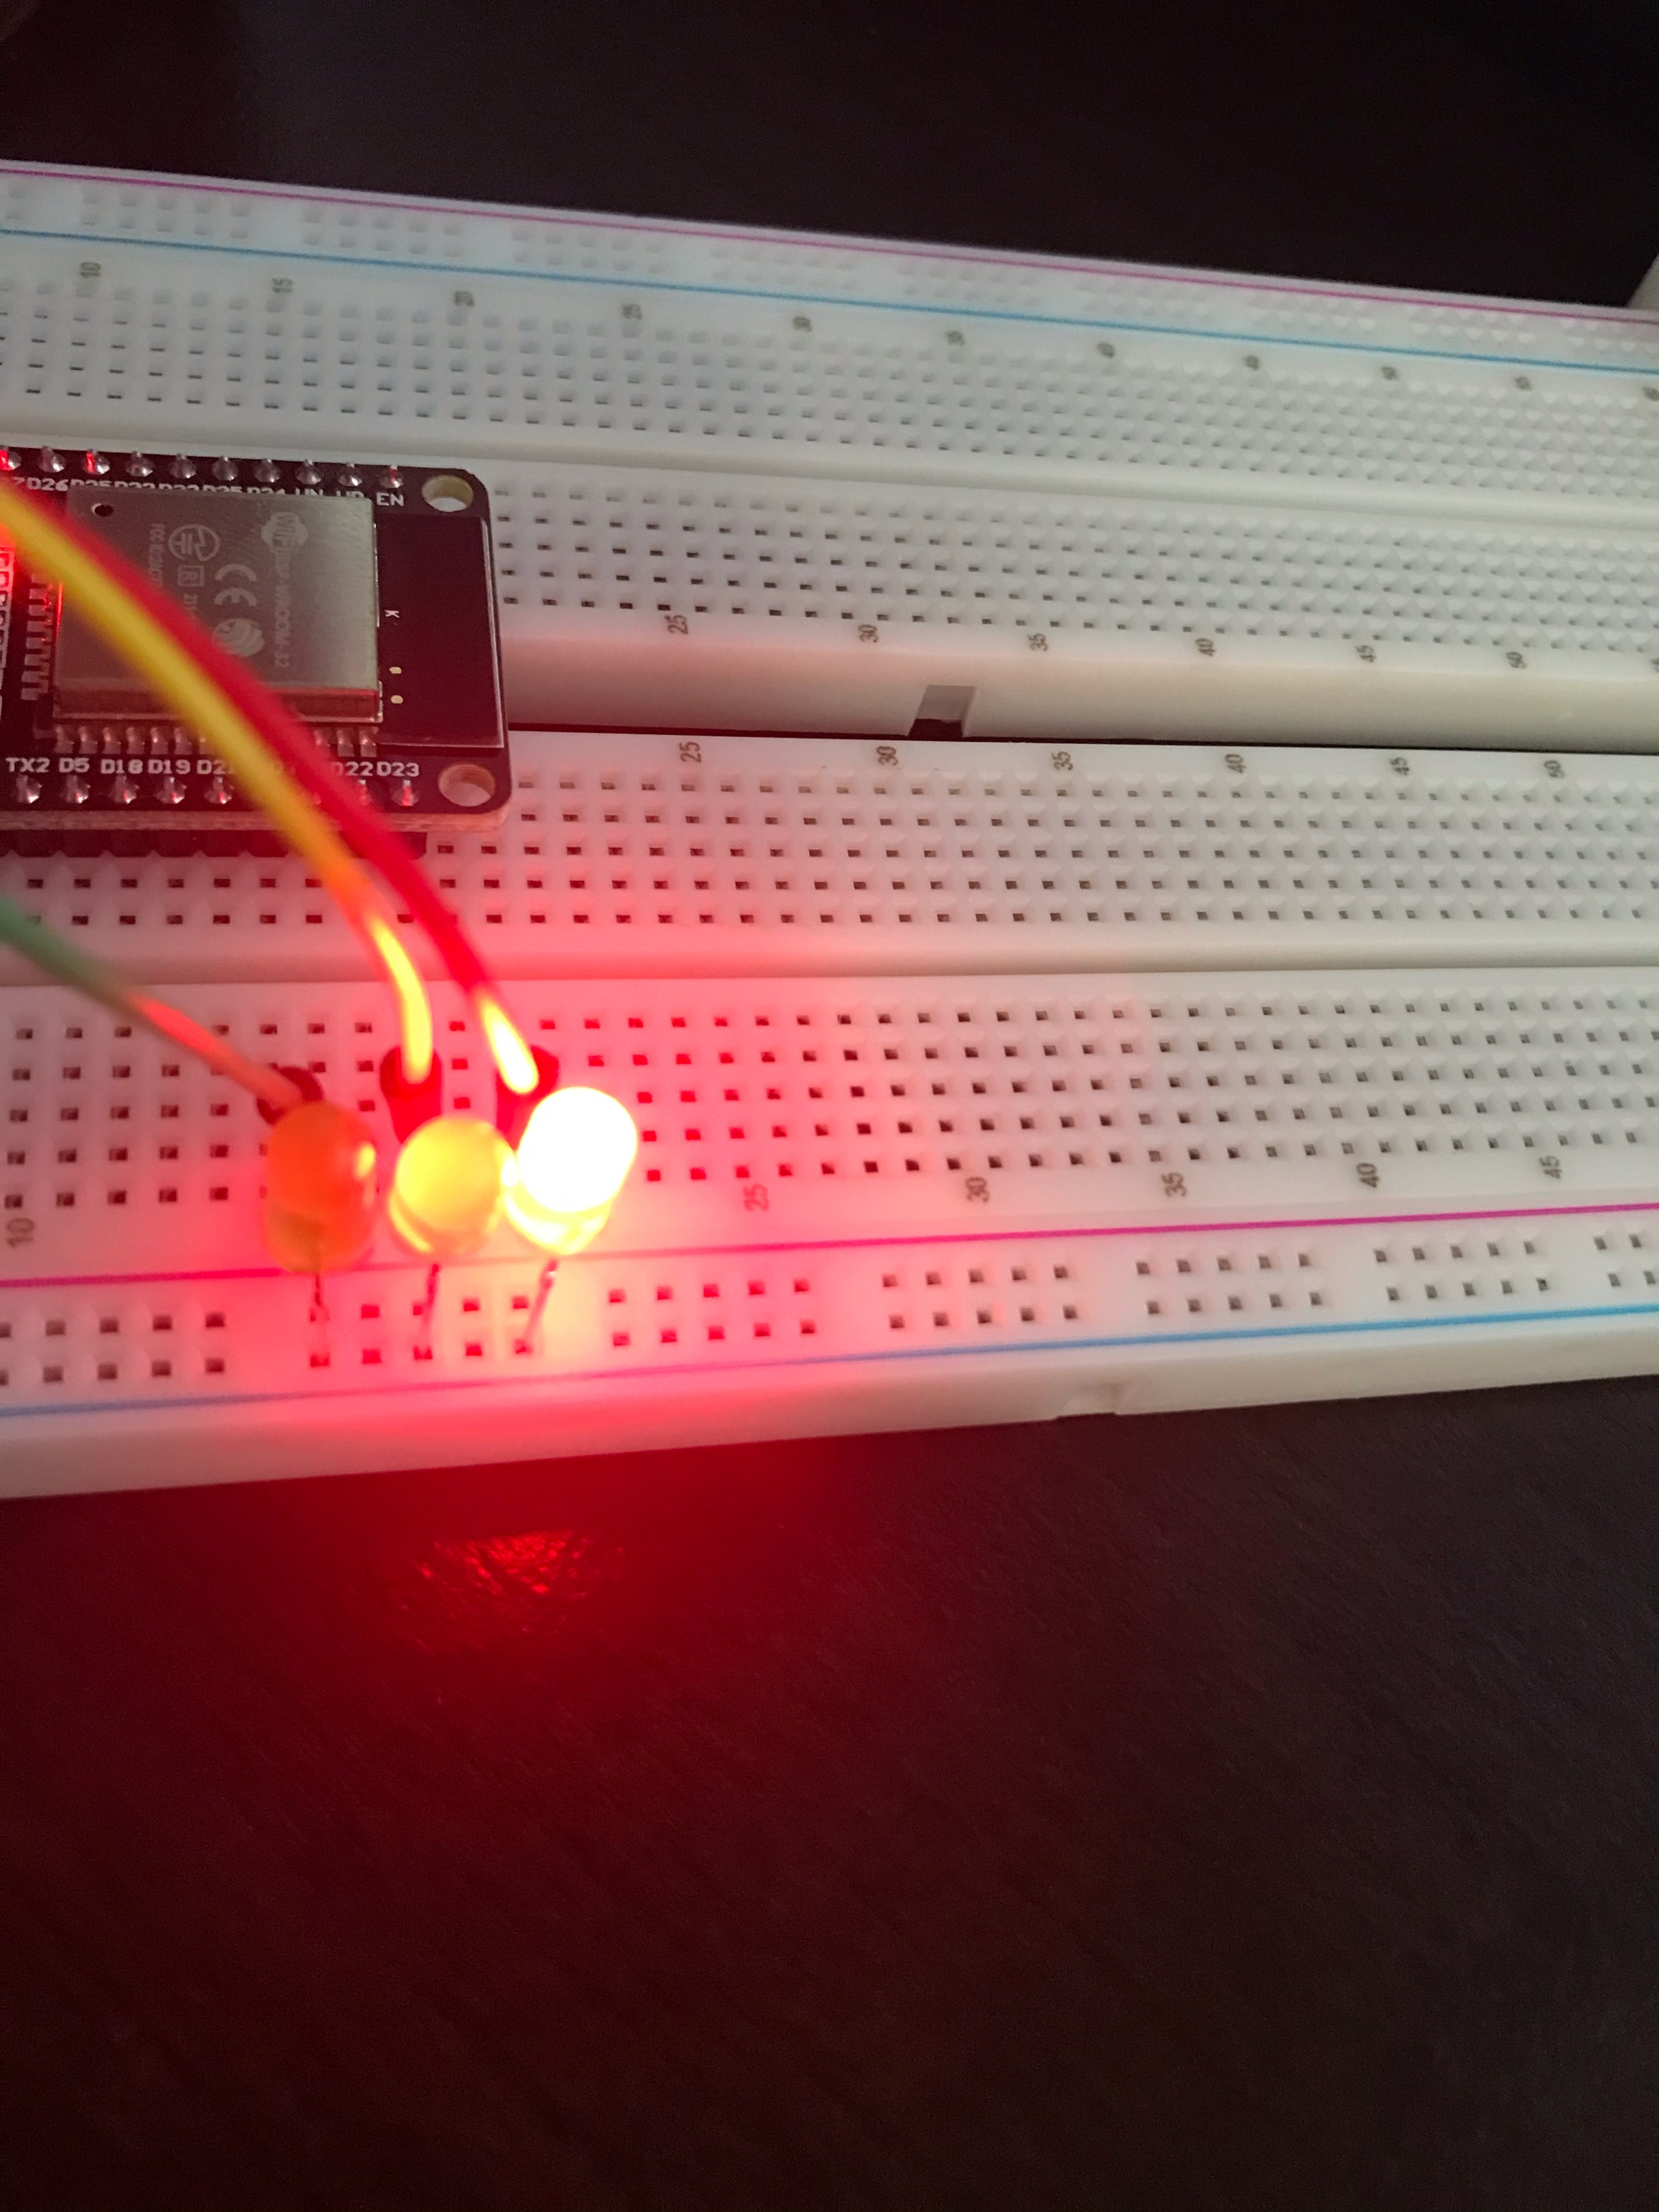
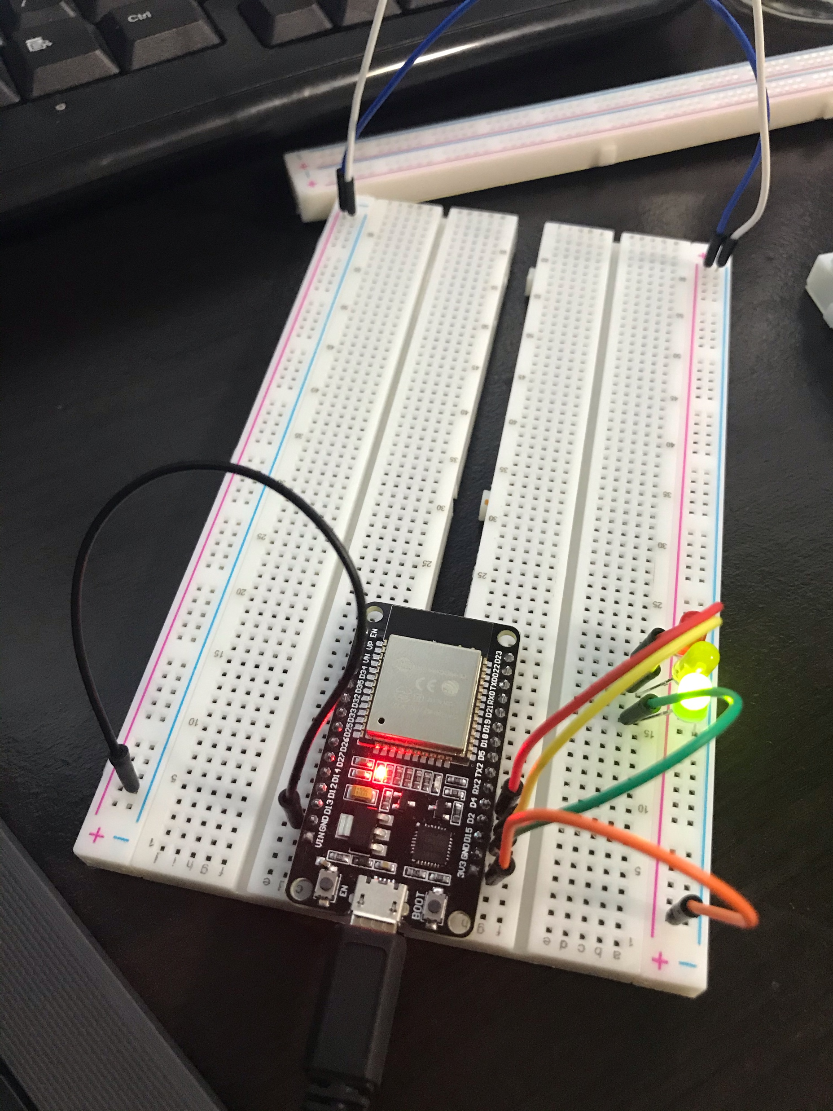
The first laid bricks
What Is This Stuff
What’s Going On
ESP 32 Board
Colored LEDs: Red, Yellow and Green
Wires
Breadboard
This is the beginning of the design, first added three LEDs, a green, yellow, and red and uploaded code to have them cycle in a continuous loop.

Slide 9
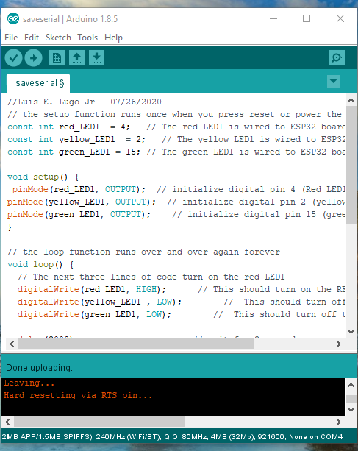
Screenshot of the code used
PC running Arduino IDE
Screen shot of the program

Slide 10
Are there two or am I seeing double
Creating a Multiple Traffic Light Controller

Slide 11
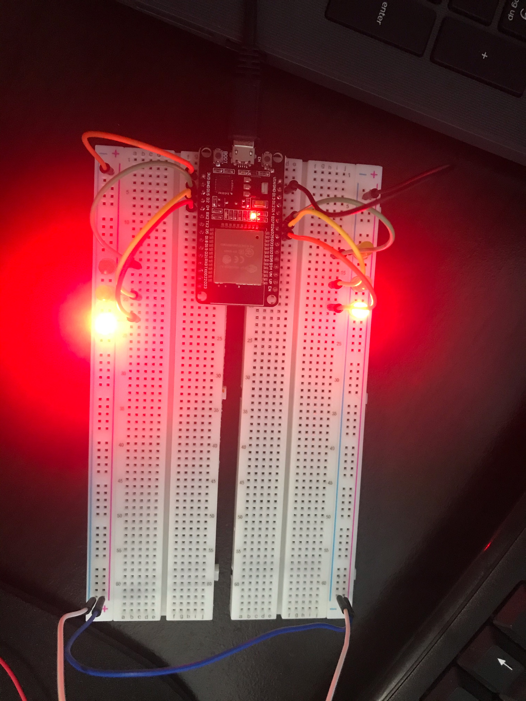
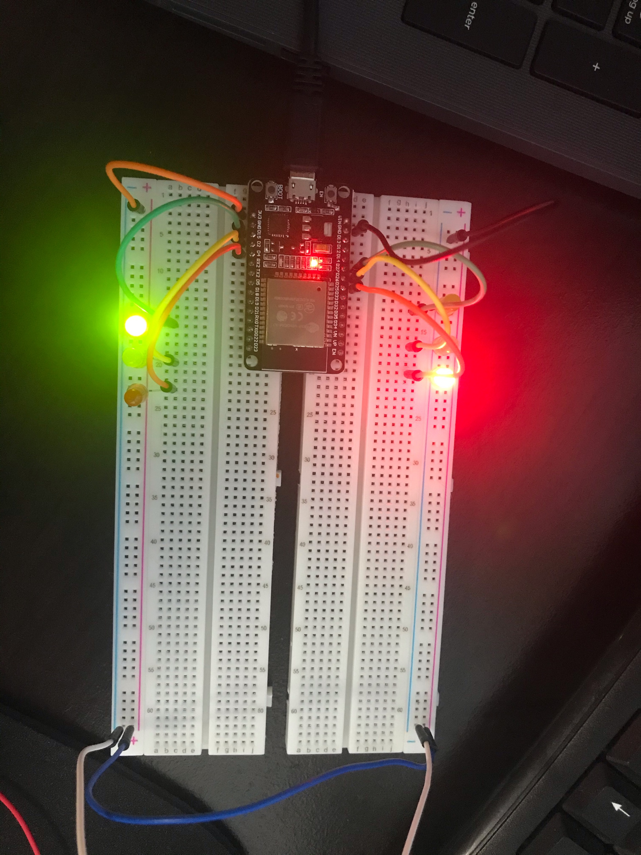
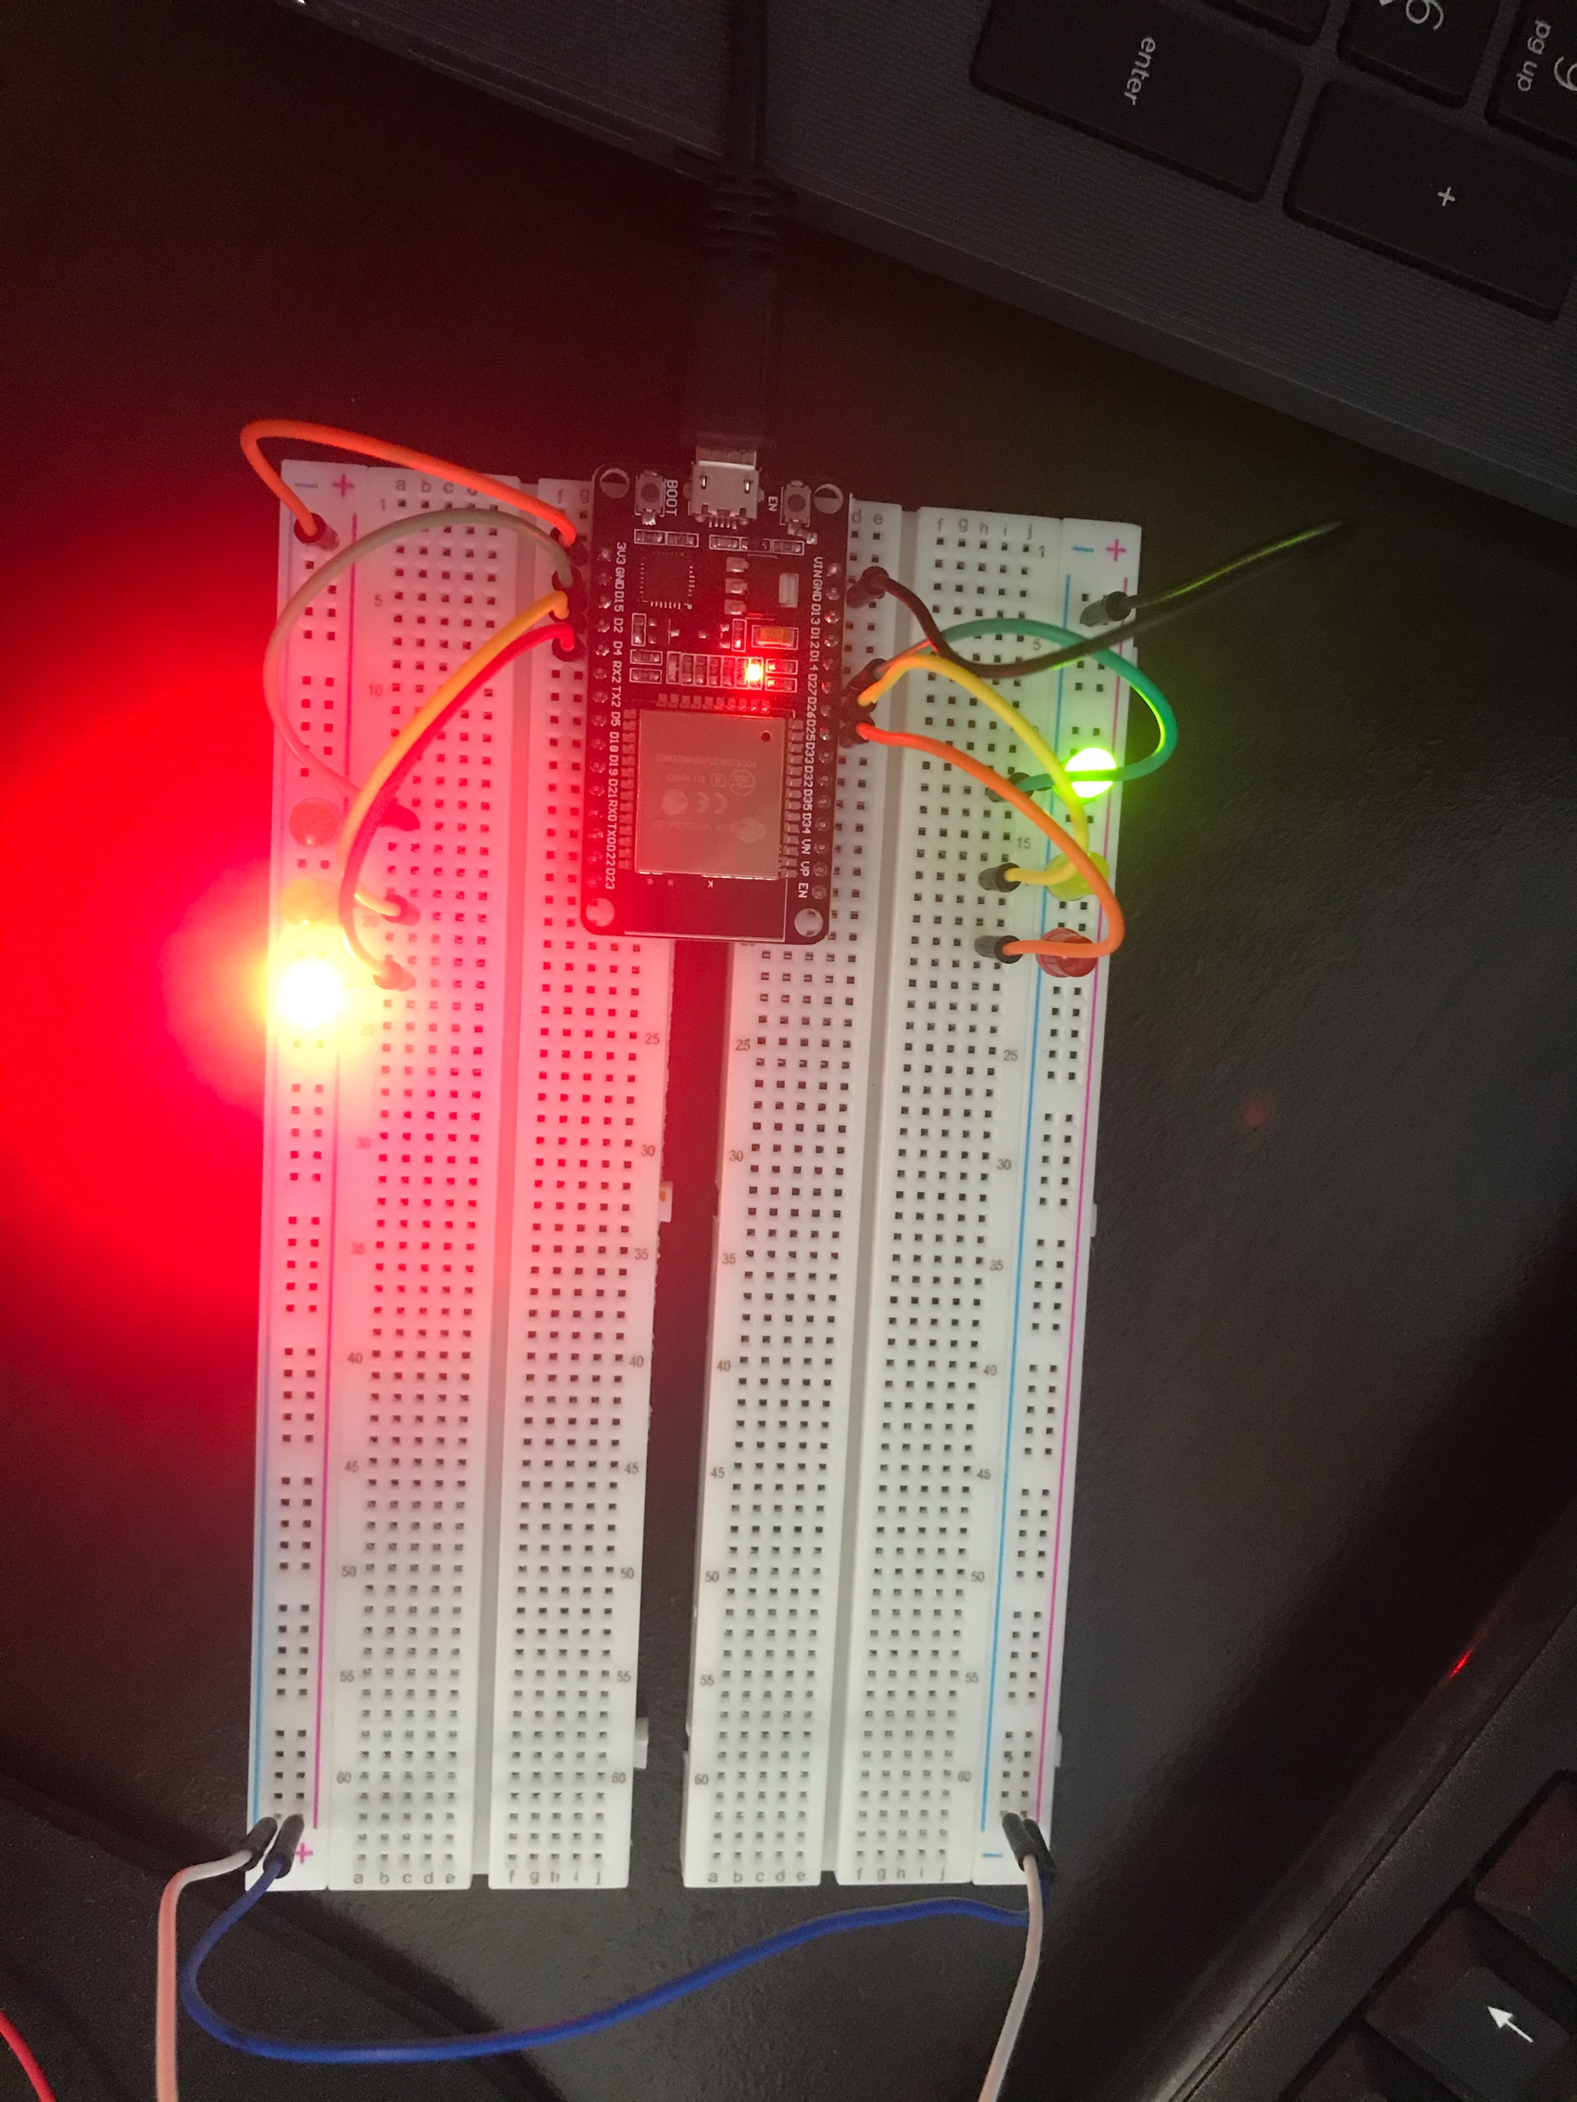
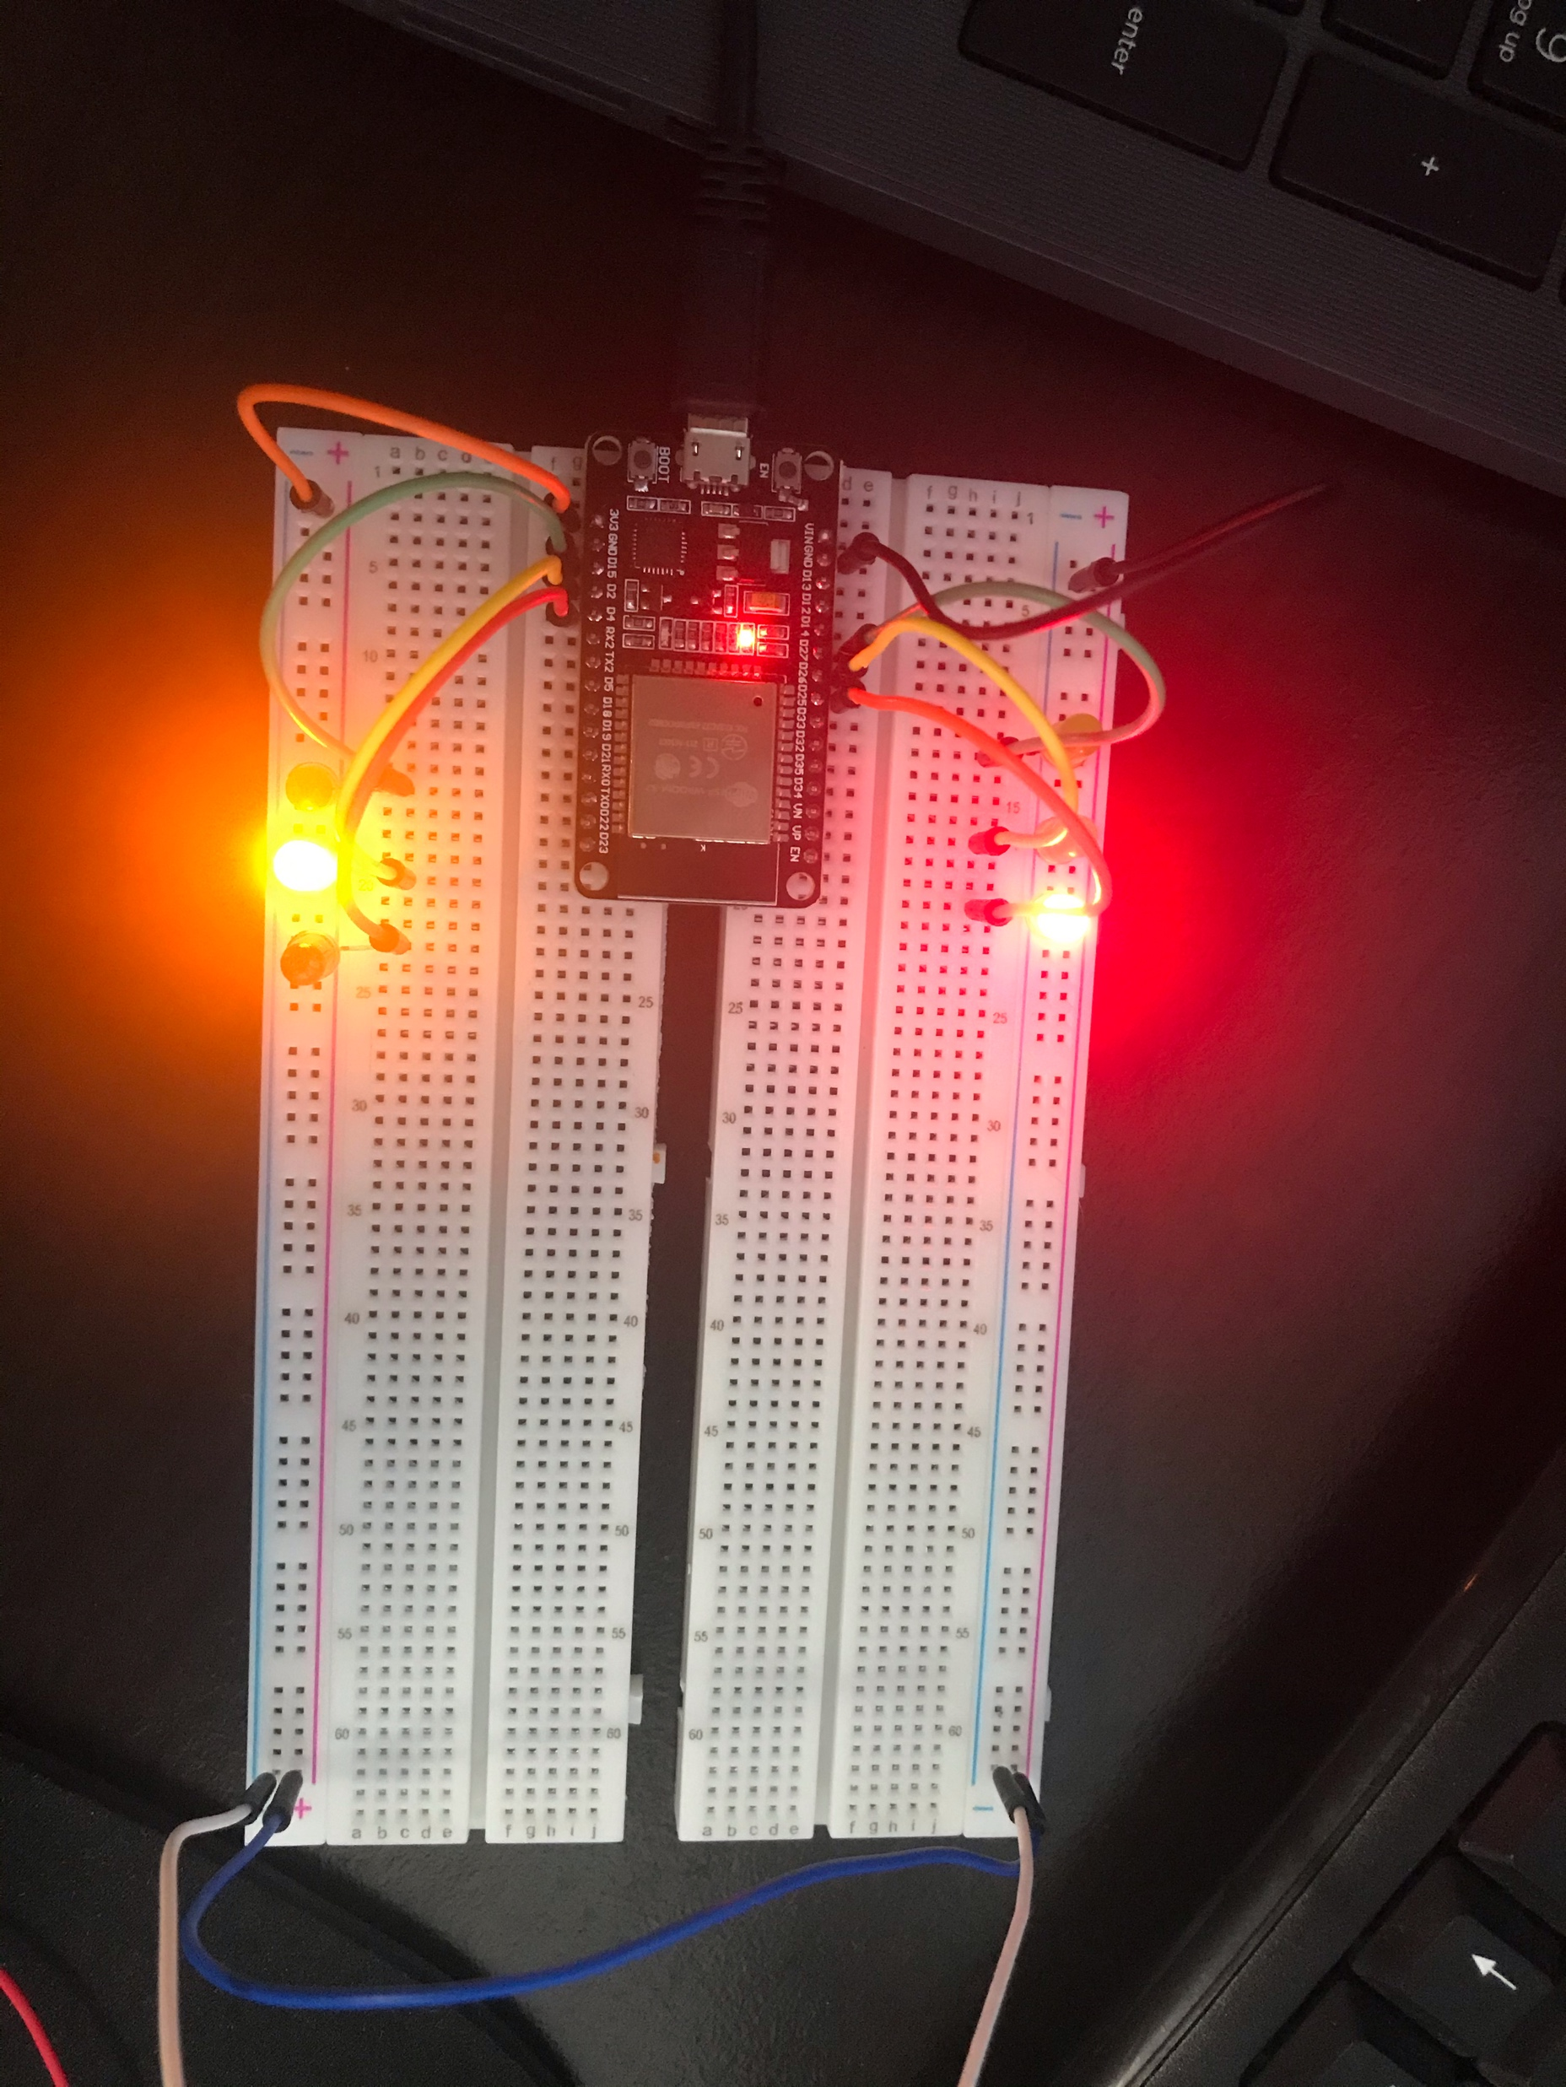
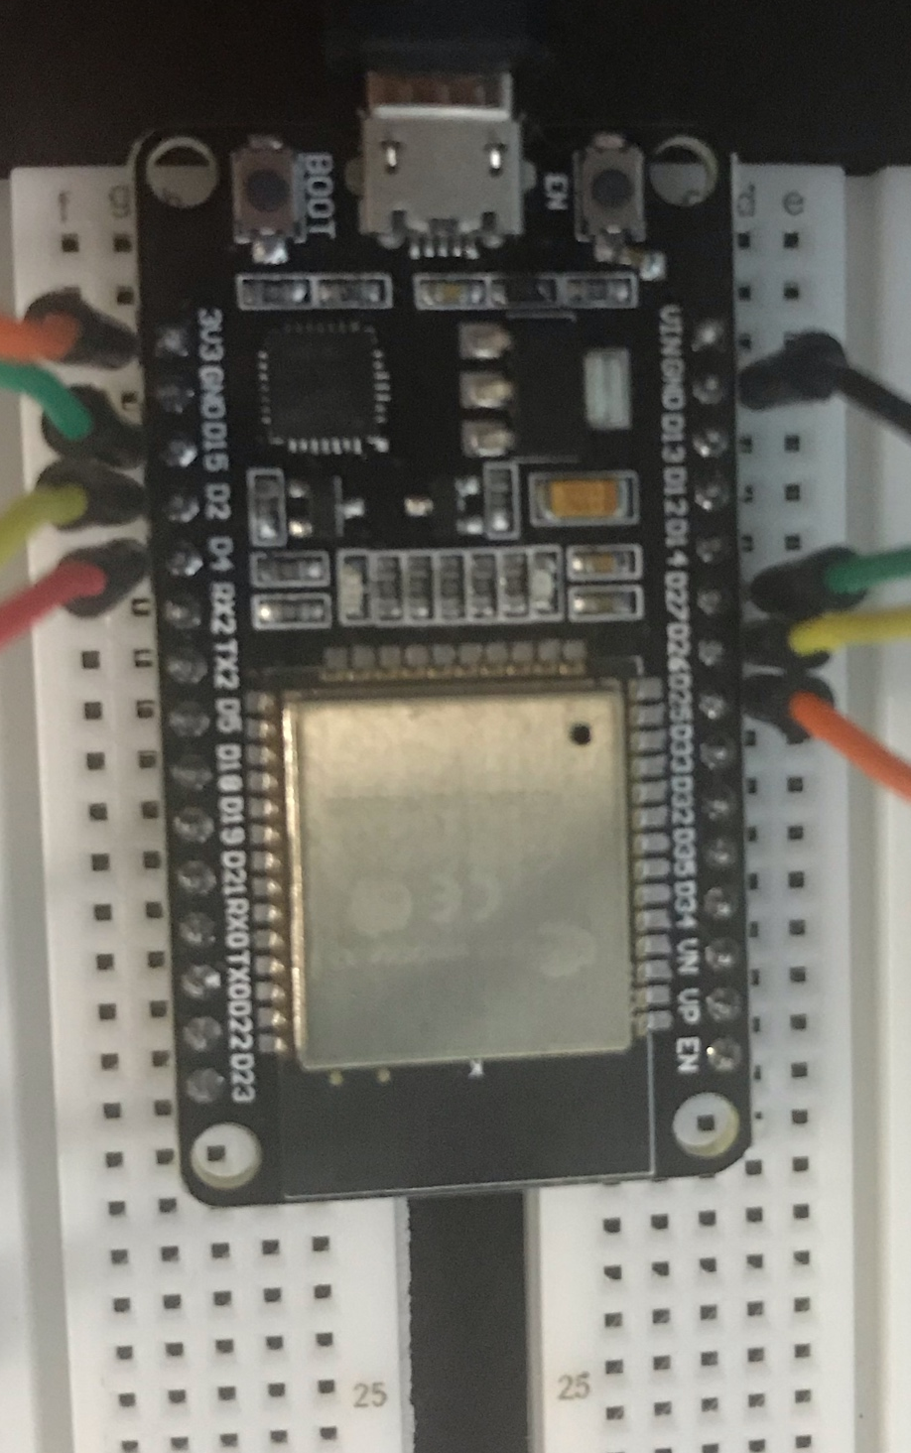
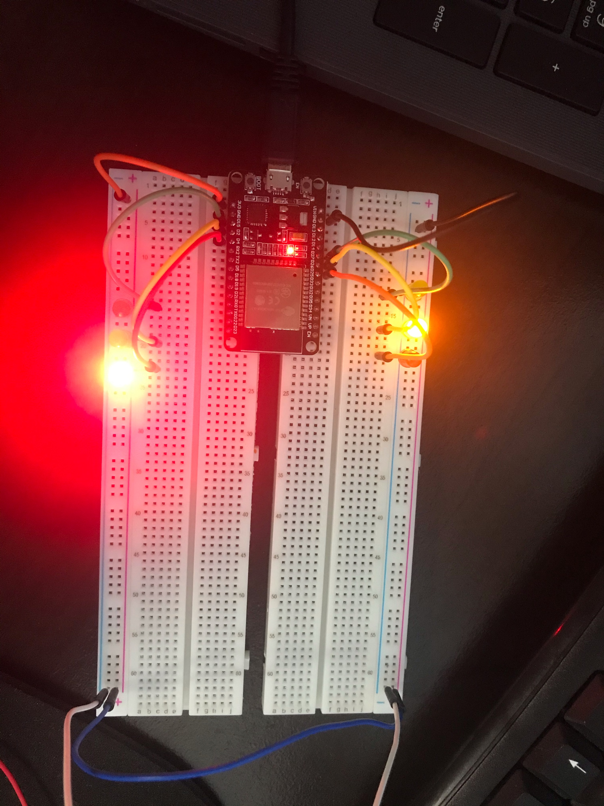
Pictures of
Circuit
ESP32 Board
Two sets of colored LEDs: Red, Yellow and Green
Wires
Breadboard

Slide 12
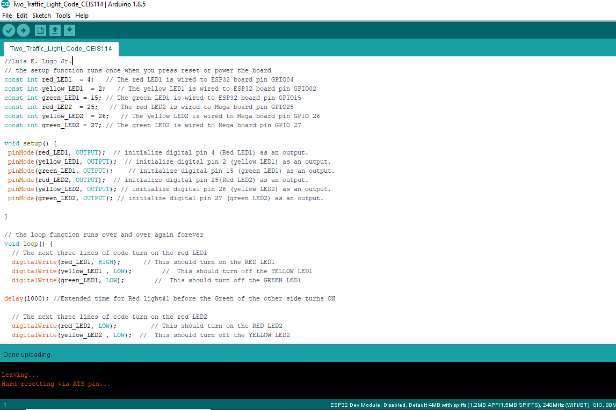
Screenshot of Arduino IDE

Slide 13
It’s a touching sensation
Creating a Multiple Traffic Light Controller with a Cross Walk

Slide 14
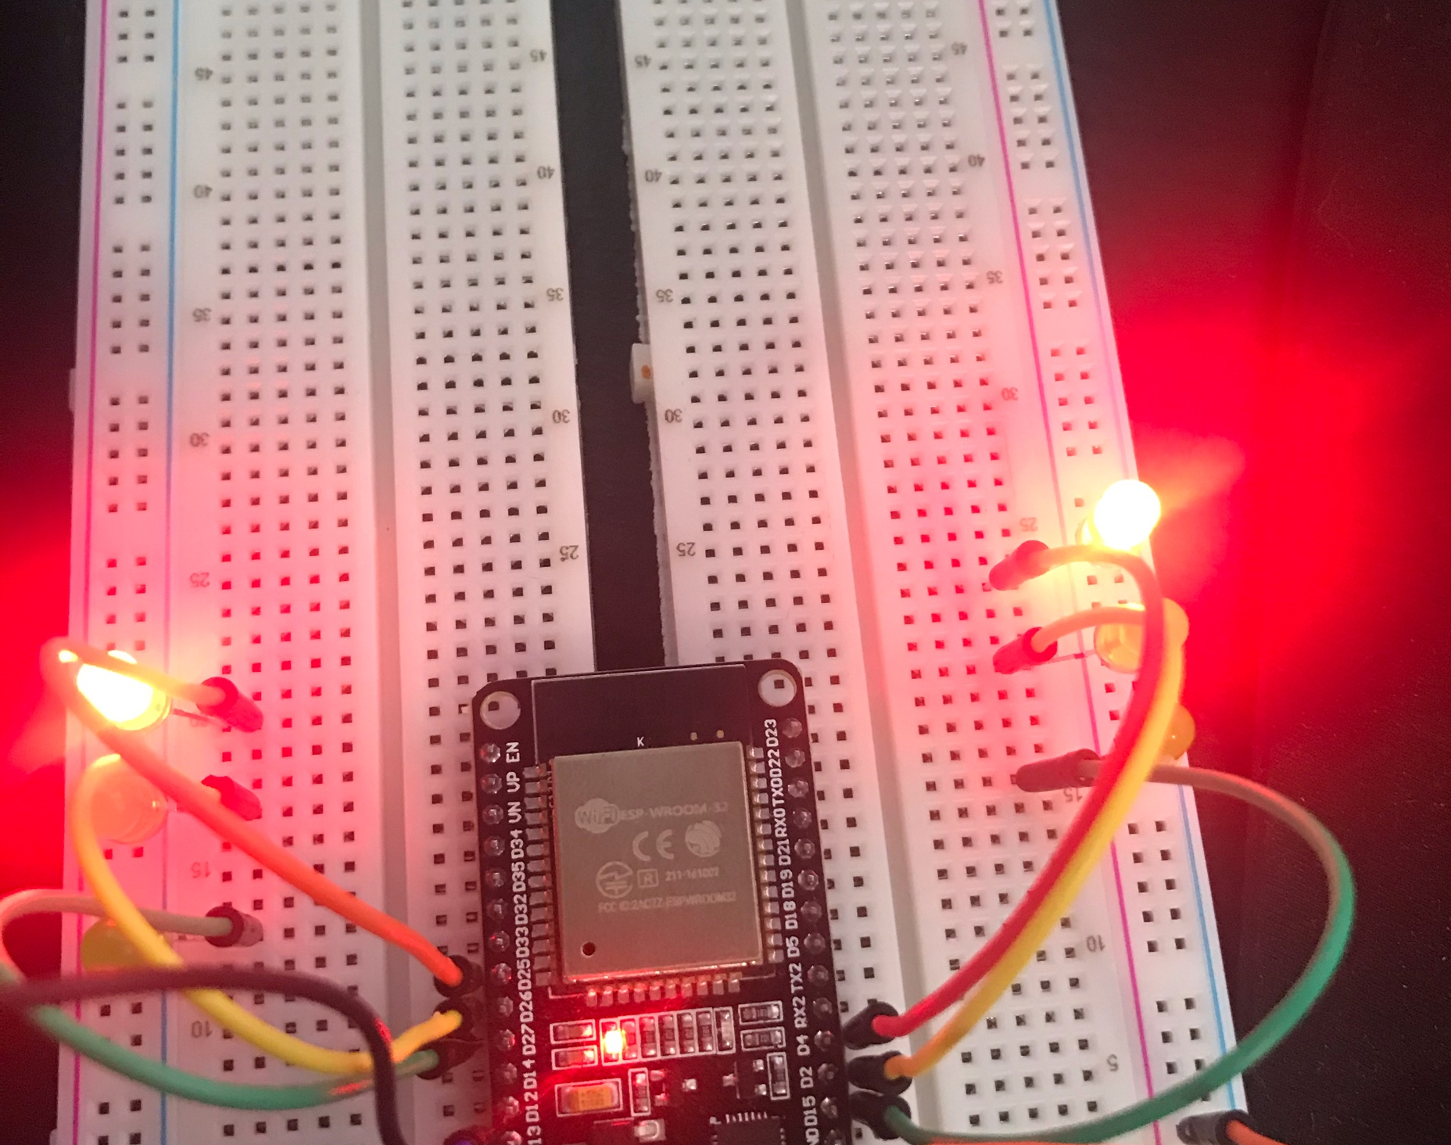
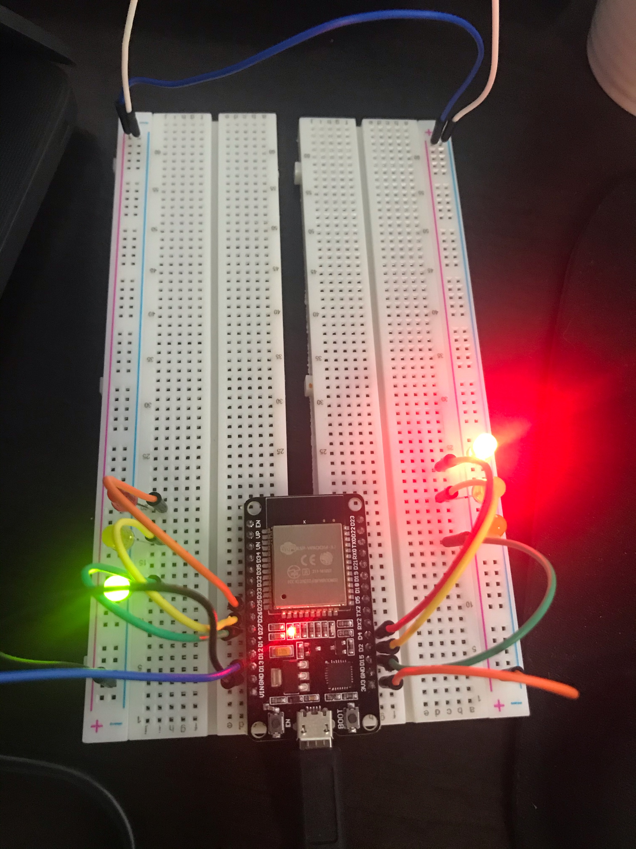
Picture of
Circuit
What was added was a sensor wire that when touched would initiate the crosswalk signal
ESP32 Board
Two sets of Colored LEDs: Red, Yellow and Green
Touch Sensor (Wire connected to GPIO 13)
Wires
Breadboard

Slide 15
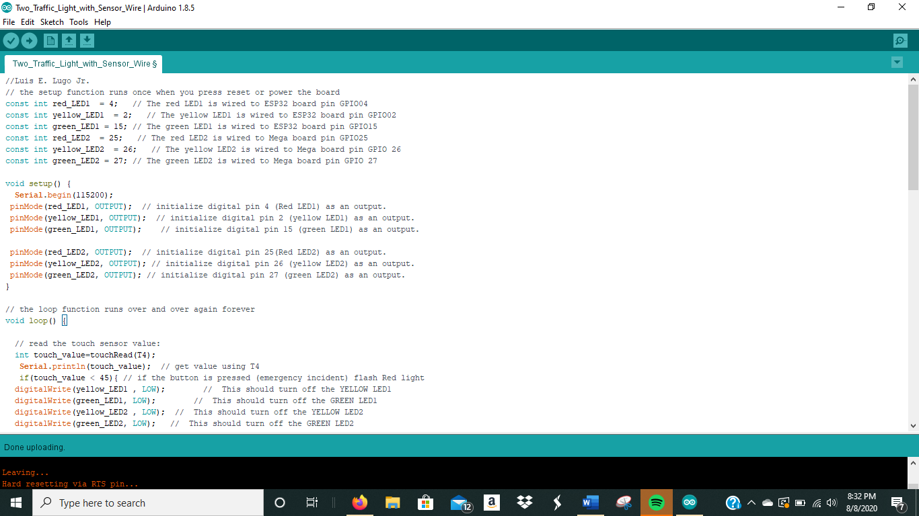
Screenshot of Arduino IDE
Screenshot of code in Arduino IDE

Slide 16
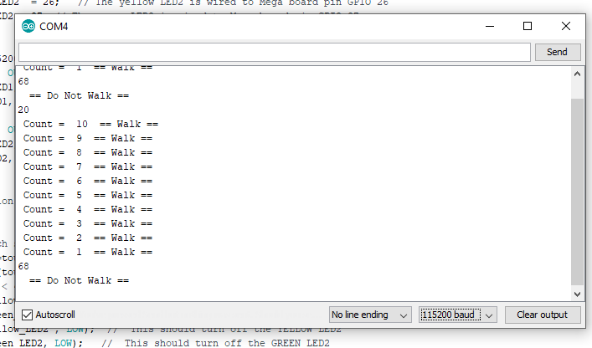
Screenshot of Serial Monitor
Screenshot of output in Serial Monitor

Slide 17
I can see it now!
Creating a Multiple Traffic Light Controller with Cross Walk and Buzzer

Slide 18
LCD Screen added
  Challenge: I was having trouble getting the LCD screen to display and lights stopped working when code was ran.
  Solution: Changed section of code from (LiquidCrystal_I2C lcd(0x3F,16,2); //set the LCD address to 0x27 for a 16 chars and 2-line display) to (LiquidCrystal_I2C lcd(0x27,16,2); //set the LCD address to 0x27 for a 16 chars and 2-line display) which fixed my LCD screen issue. For the lights, I had my one of my ground wires in the positive rail, moved it to the negative rail.

Slide 19
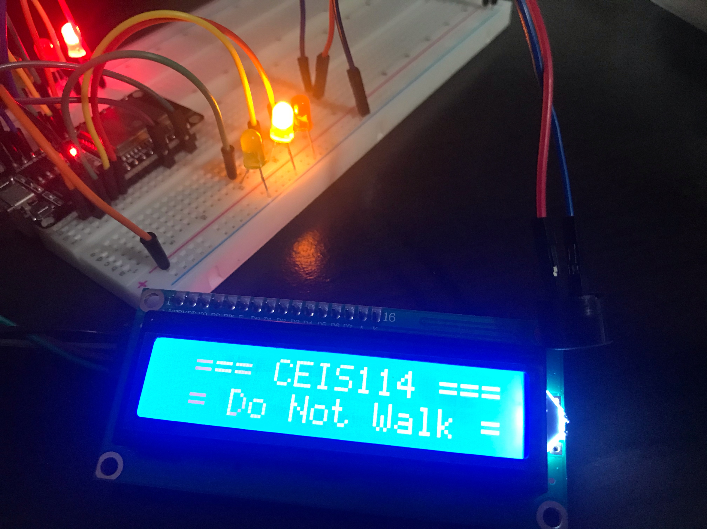
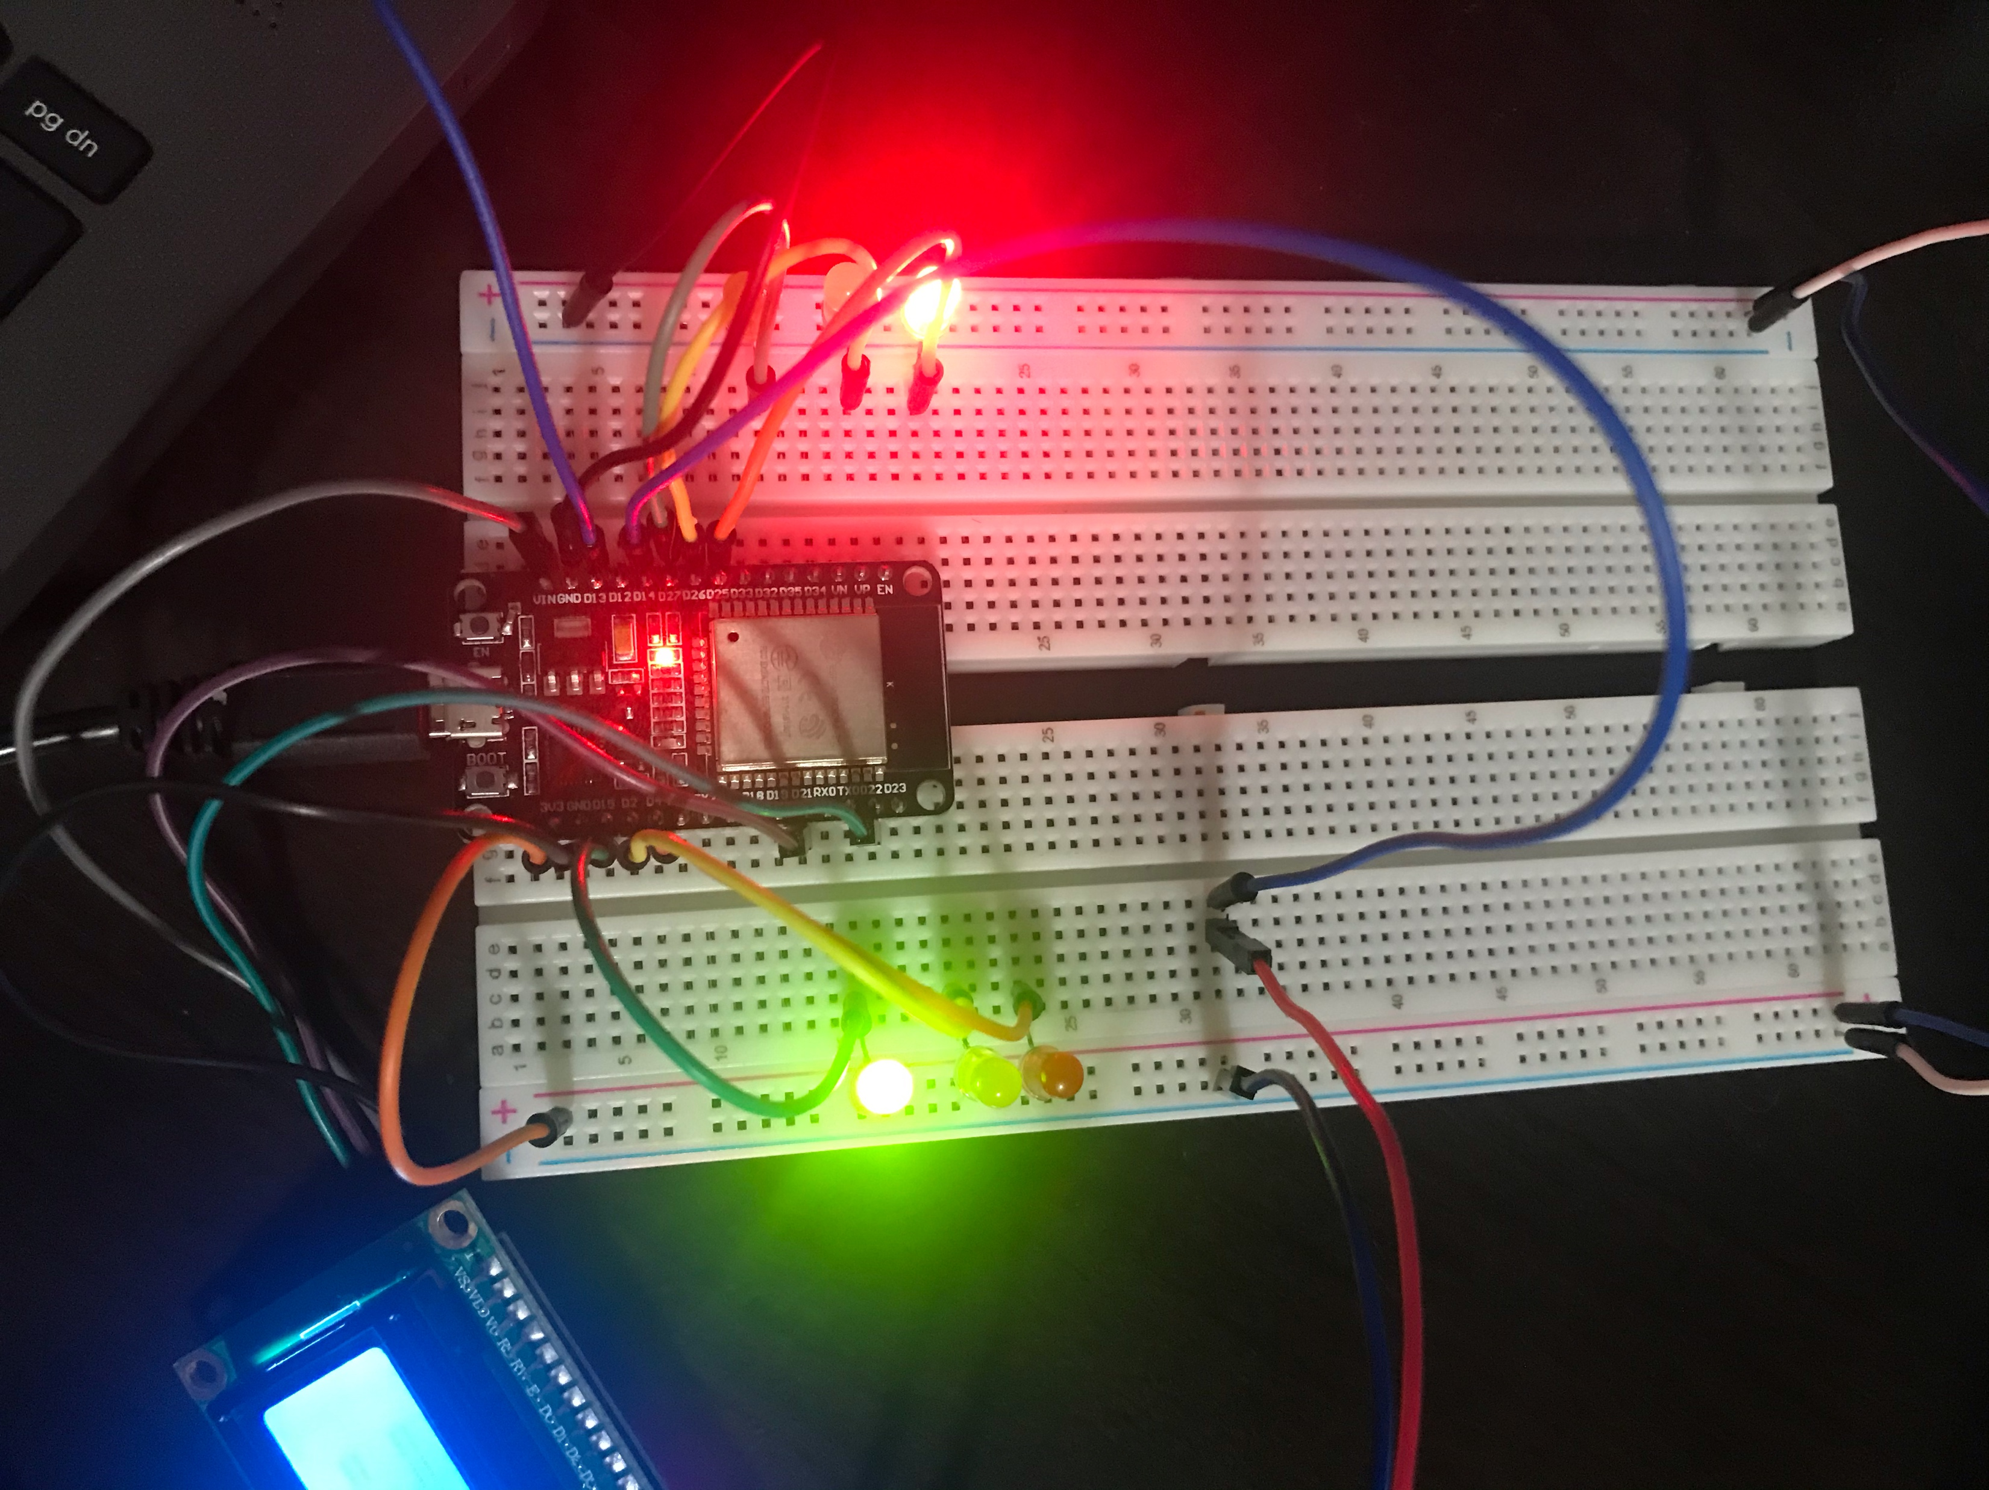
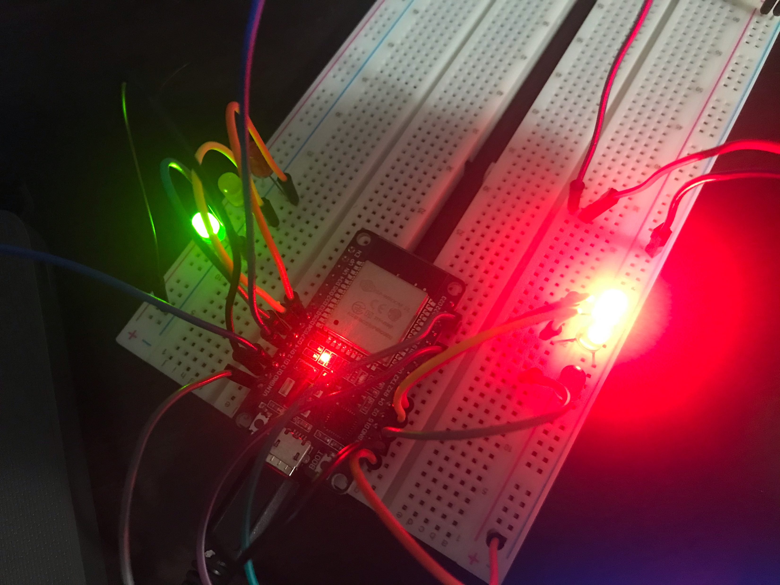
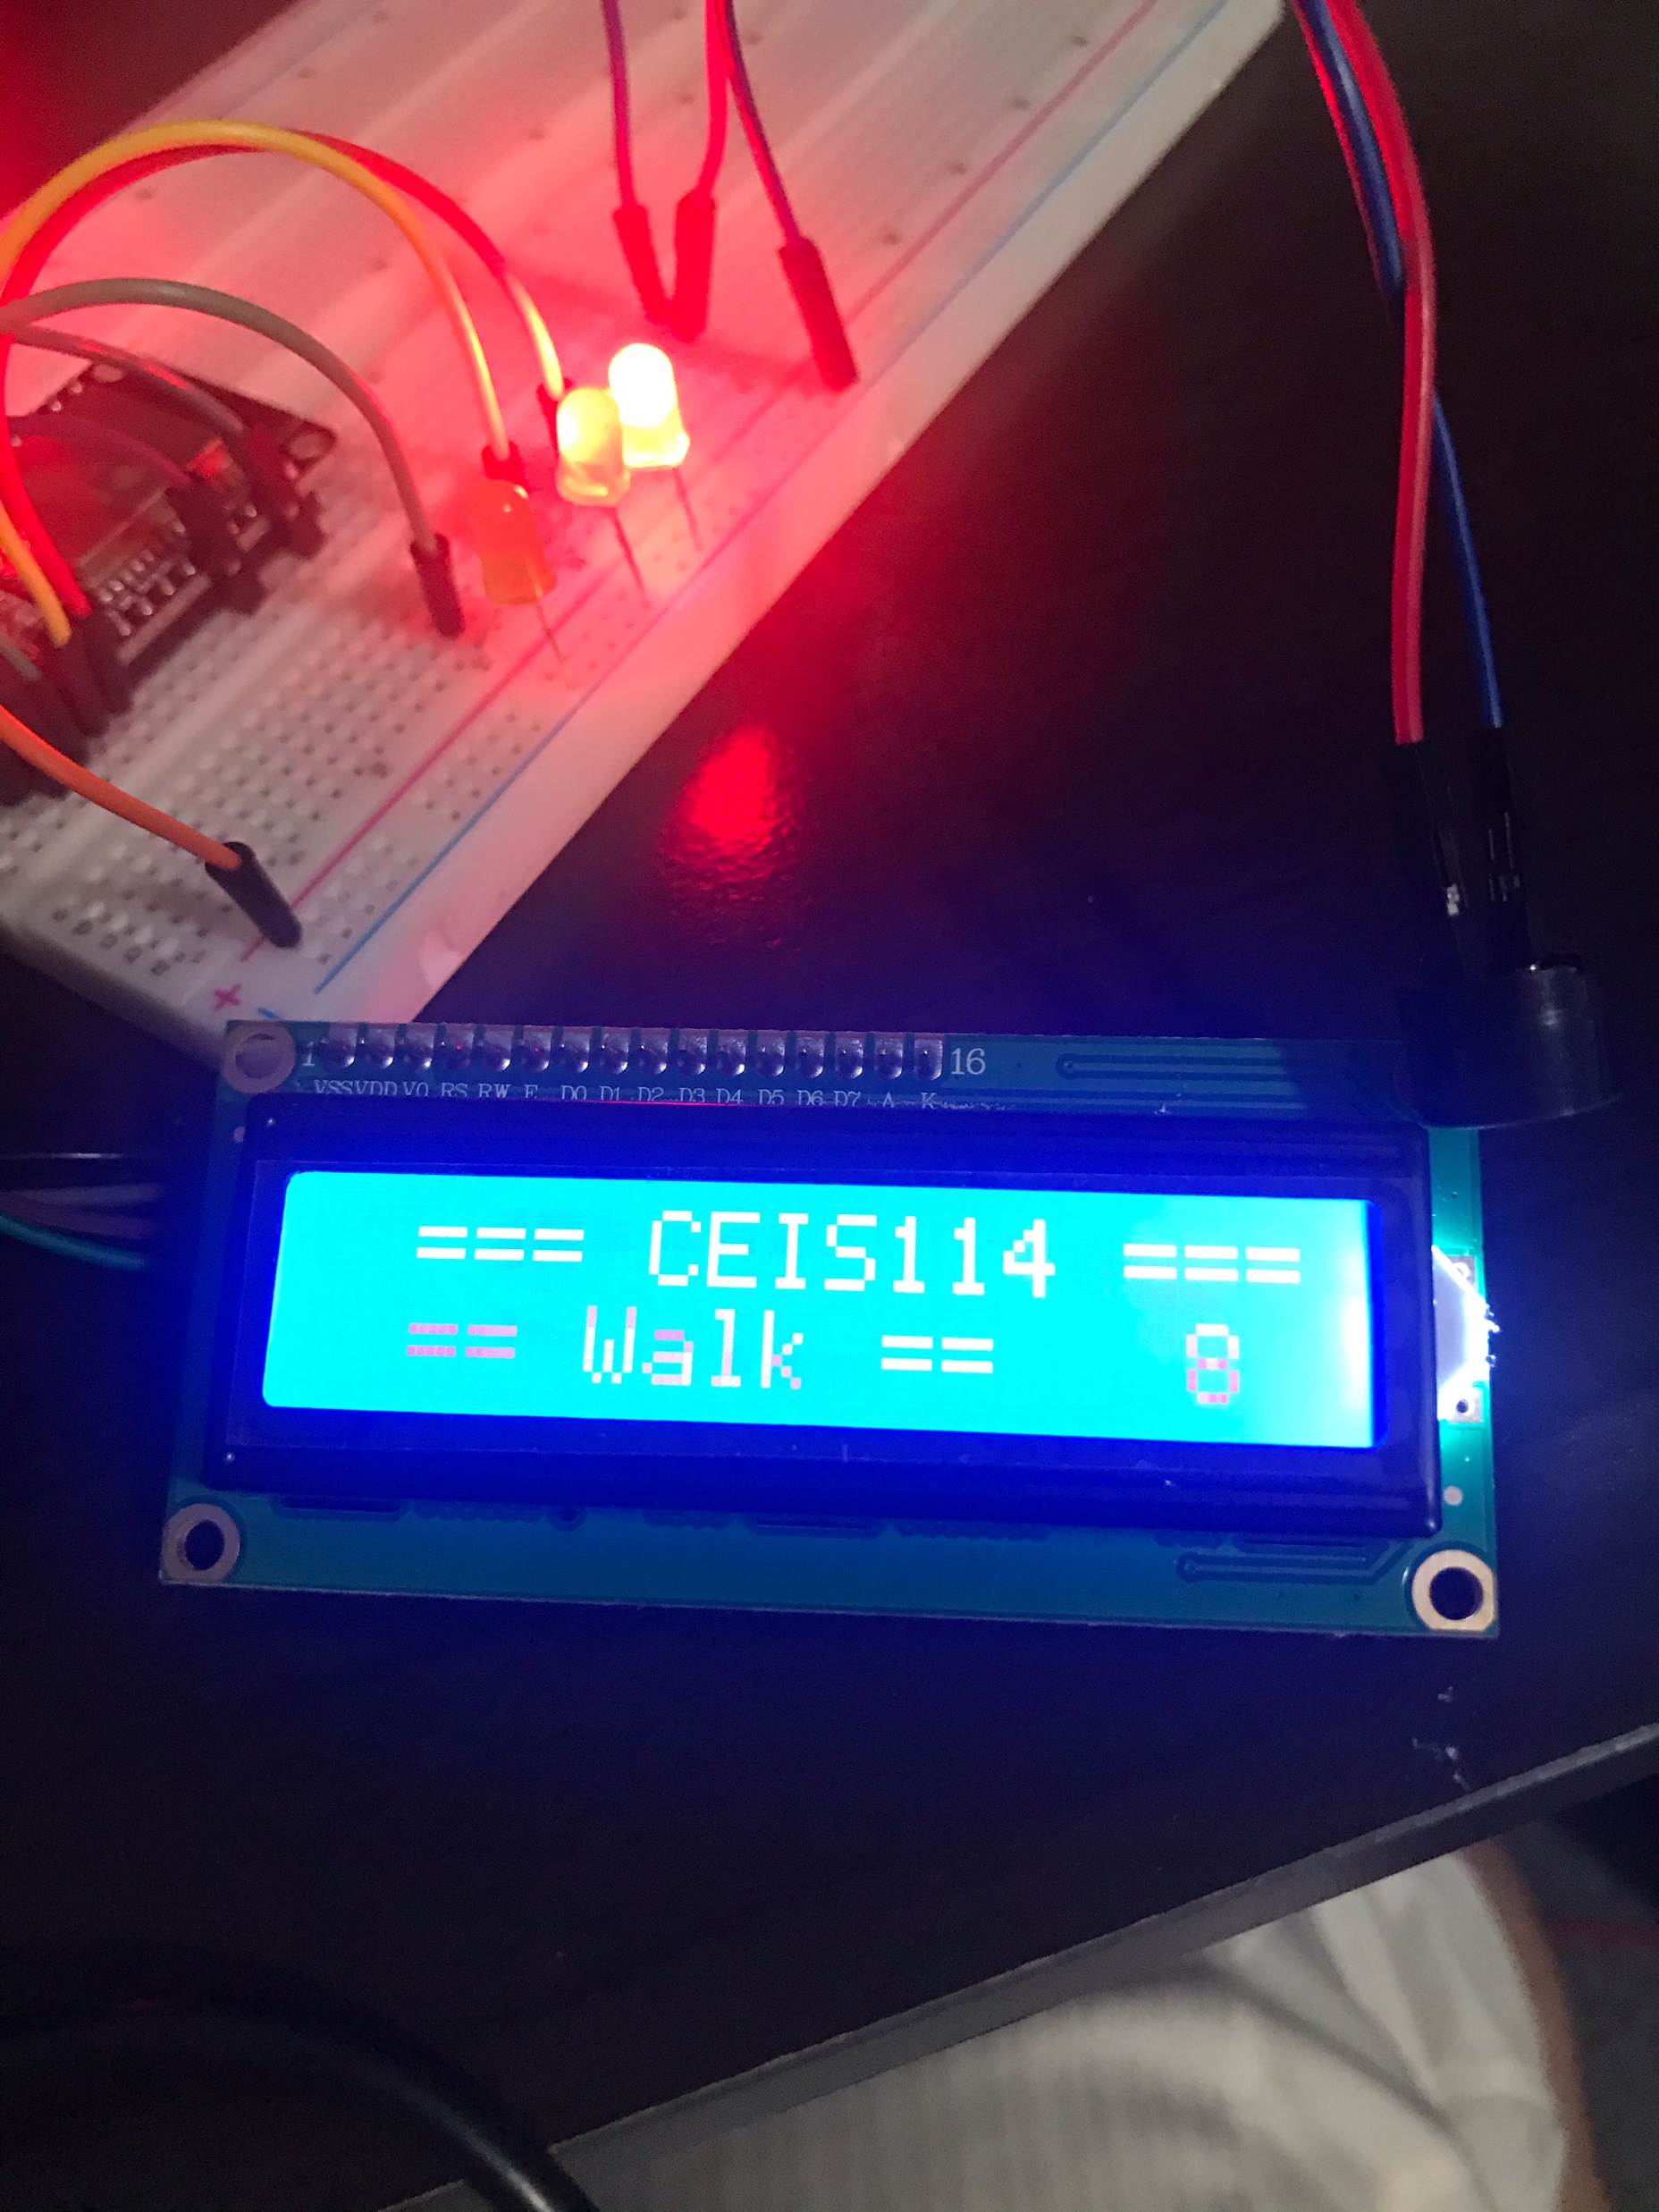
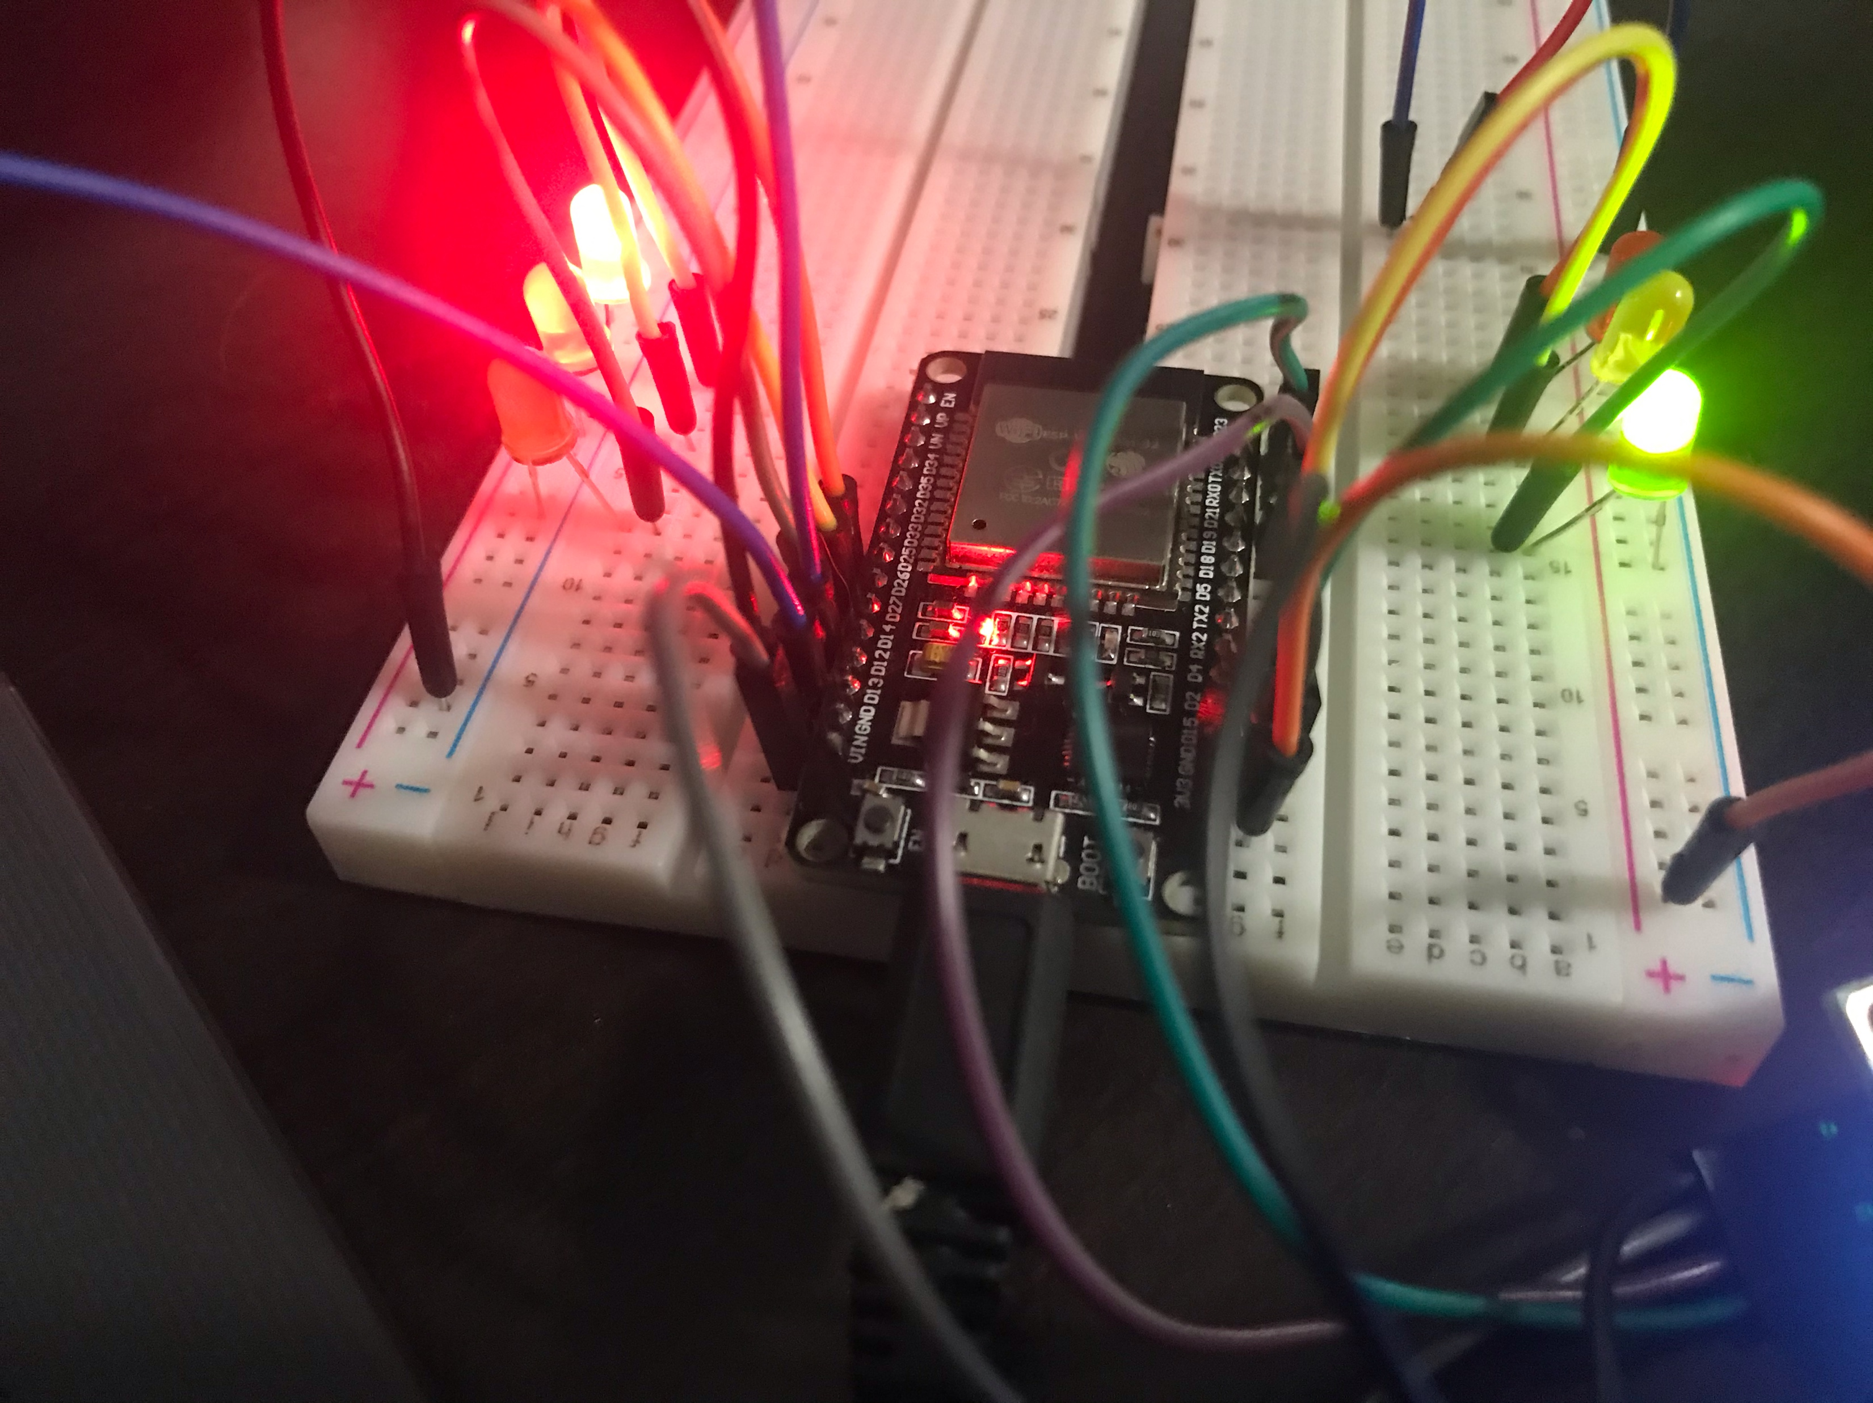
Picture of
Circuit
ESP32 Board
Two sets of Colored LEDs: Red, Yellow and Green
Touch Sensor (Wire connected to GPIO 13)
LCD Unit
Buzzer
Wires
Breadboard

Slide 20
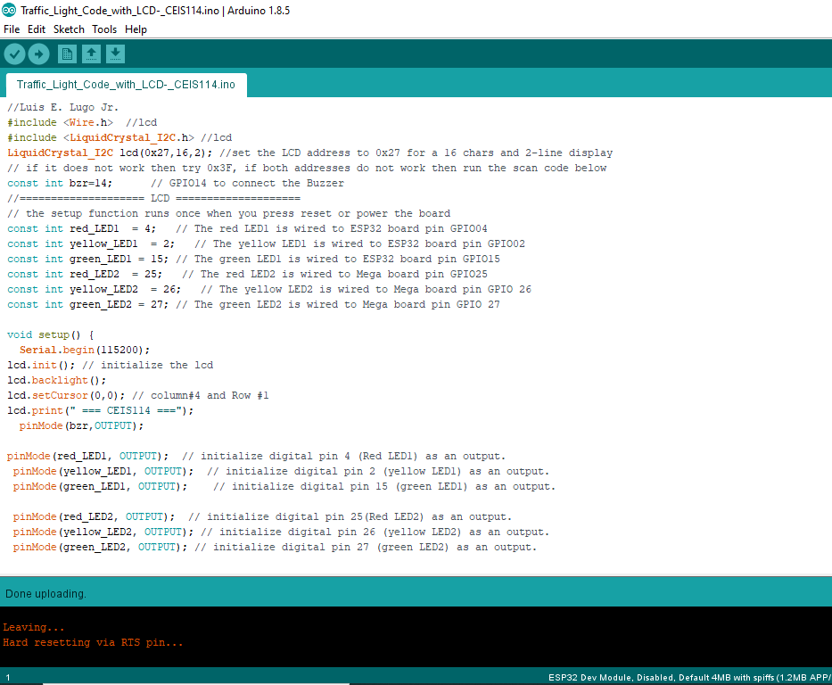
Screenshot of Arduino IDE
Screenshot of code in Arduino IDE

Slide 21
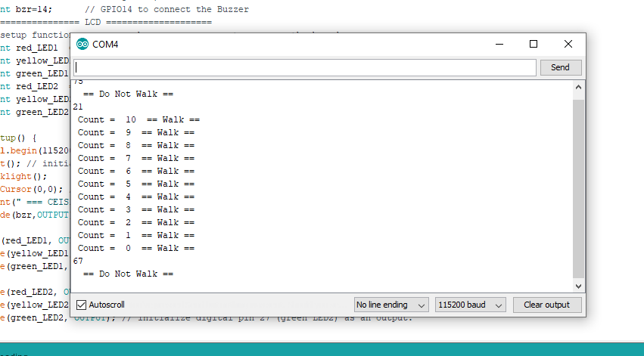
Screenshot of Serial Monitor
Screenshot of output in Serial Monitor

Slide 22
Keep pushing those buttons and sensing success
Multiple Traffic Light Controller with a Cross Walk and an Emergency Buzzer with a SMART Sensor

Slide 23
Touch sensor wire removed and replaced with motion sensor; push buttons added as well as an emergency blue light LED.

Slide 24
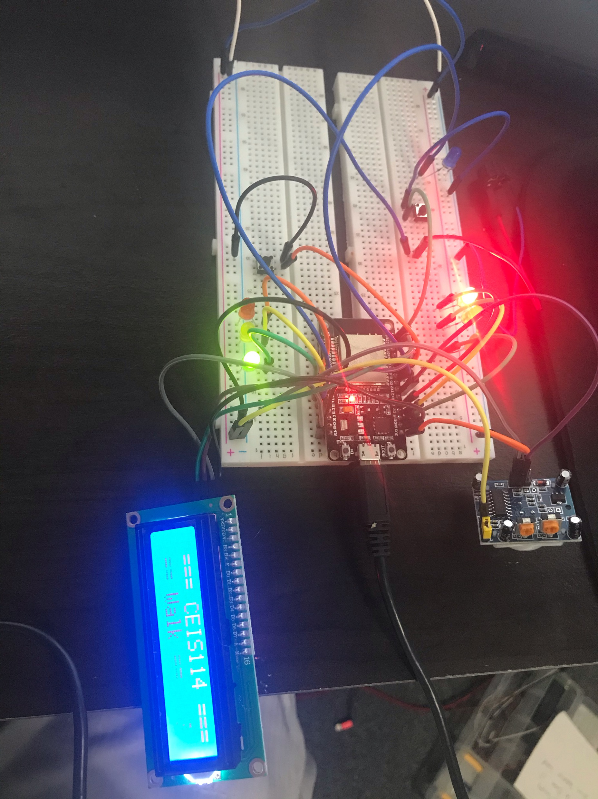
Picture of
Circuit
ESP32 Board
Two sets of Colored LEDs: Red, Yellow and Green
One Blue LED
Push Buttons
LCD Unit
Buzzer
Motion Detector
Wires
Breadboard

Slide 25
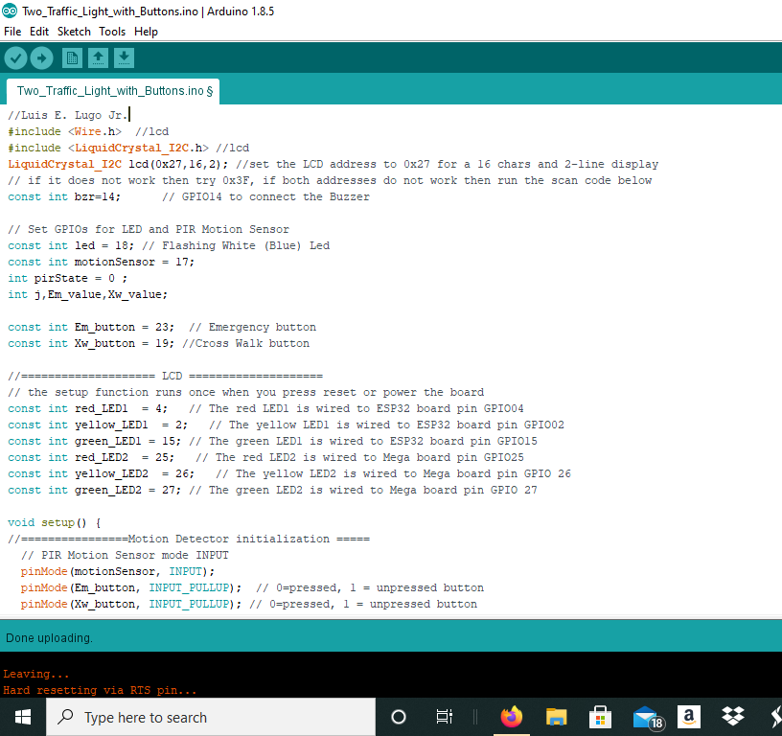
Screenshot of Arduino IDE
Screenshot of the code in Arduino IDE

Slide 26
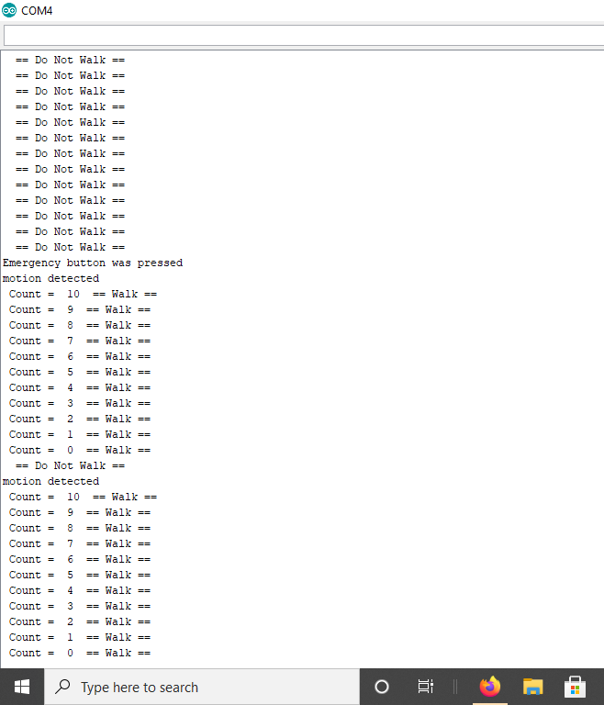
Screenshot of Serial Monitor
Screenshot of output in Serial Monitor

Slide 27
What Did I learn
I continued my learning on how to work with Arduino.
Learned more about IOT systems
Learned to problem solve through a little trial and error but mainly observing my build to find faults and inspecting the code to see that it is correct
Learned a little bit extra about breadboards by having to utilize two instead of the usual one.
Learned more about circuits

Slide 28
Conclusion
As our world continues to evolve, our dependency on technology will grow and the use of IOT will expand. Computers are calculators and everything is relatable to math, when one section of the equation is incorrect, the system may fail.

