Slide 1


CEIS 110
Luis E. Lugo Jr.

Slide 2
Preperations
First we collect our materials to build a functioning circuit for a temperature and humidity reader.
Then we install the programs that will be used to write and execute the codes.

Slide 3
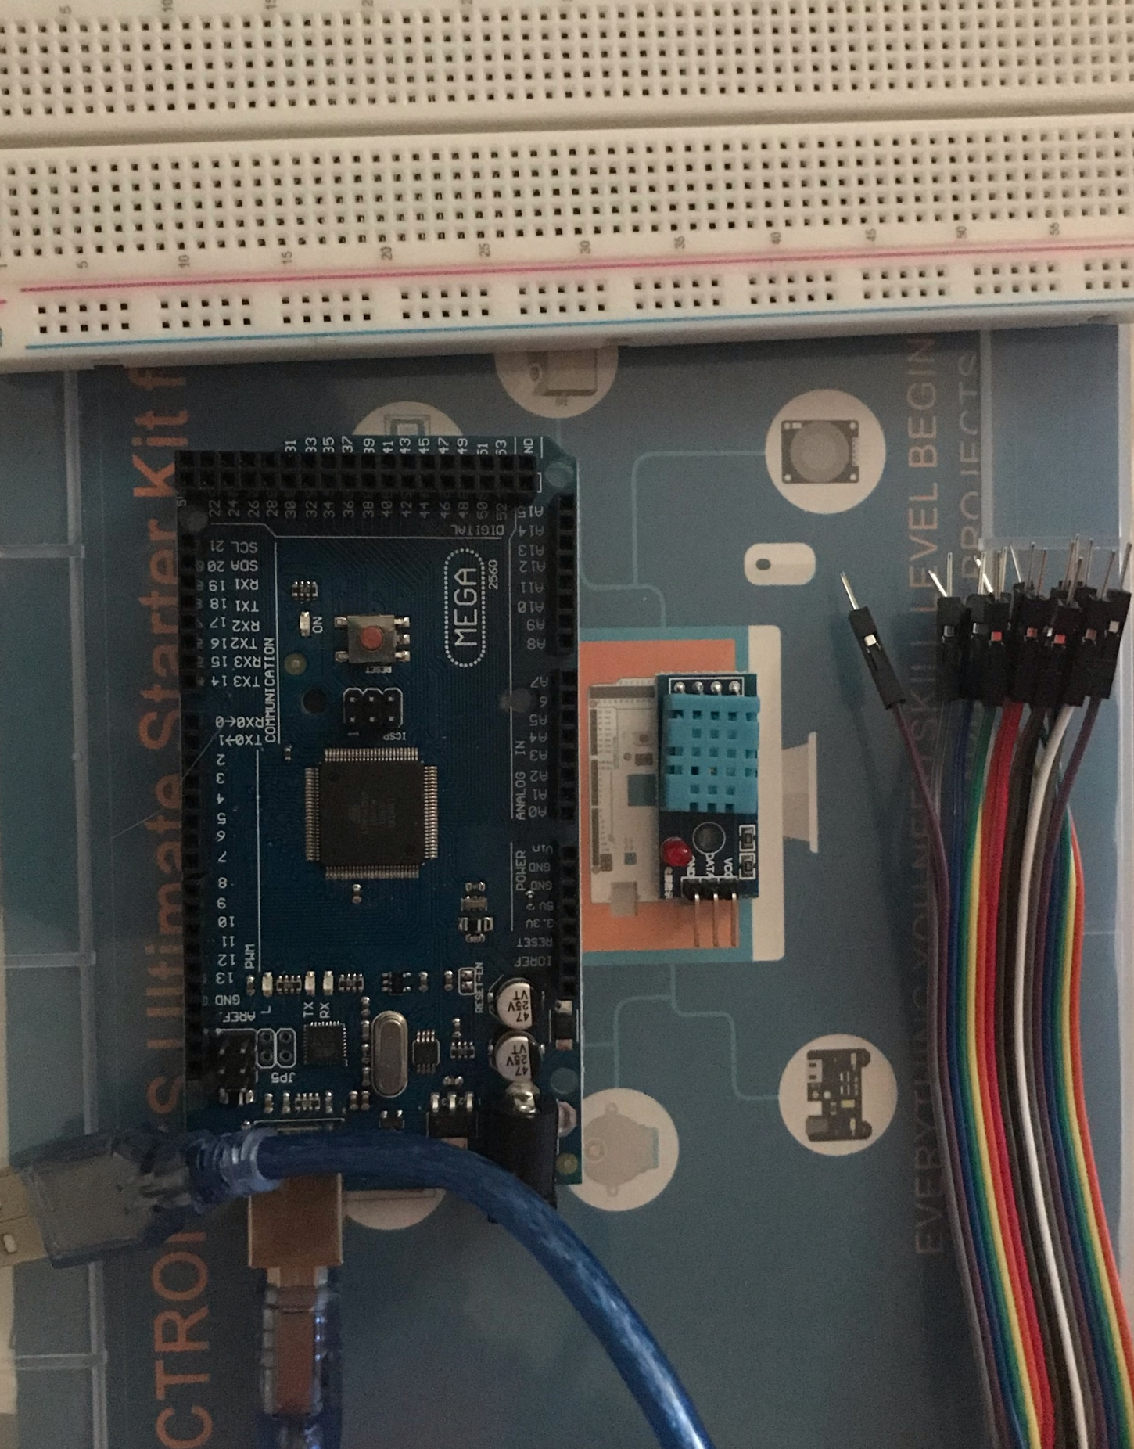
Inventory (Picture)
Arduino Mega board
Breadboard
Wire(s)
DHT11 Temperature and Humidity sensor
Cable to connect Arduino to computer

Slide 4

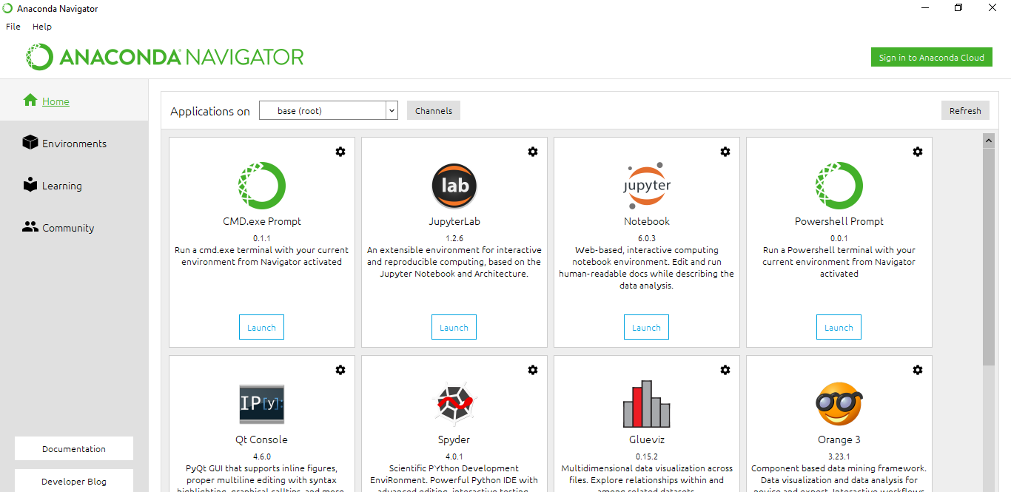

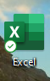
Software Inventory
Arduino IDE
Python- Anaconda/ Spyder
Excel

Slide 5
After gathering all necessary material and programs, we build a flowchart to guide us and install necessary programs.

Slide 6
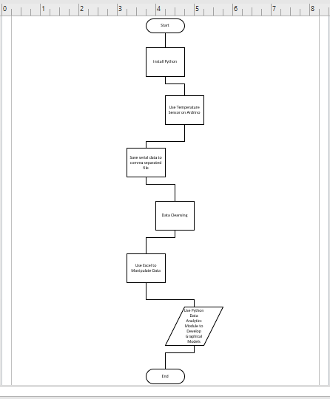
Flowchart
Includes the following processes:
Install python
Use Temperature/Sensor on Arduino to monitor temperature and humidity
Save serial data to a comma separated file with python
Cleanse data from Arduino
Use Excel to manipulate data
Use python data analytics modules to develop graphical models

Slide 7
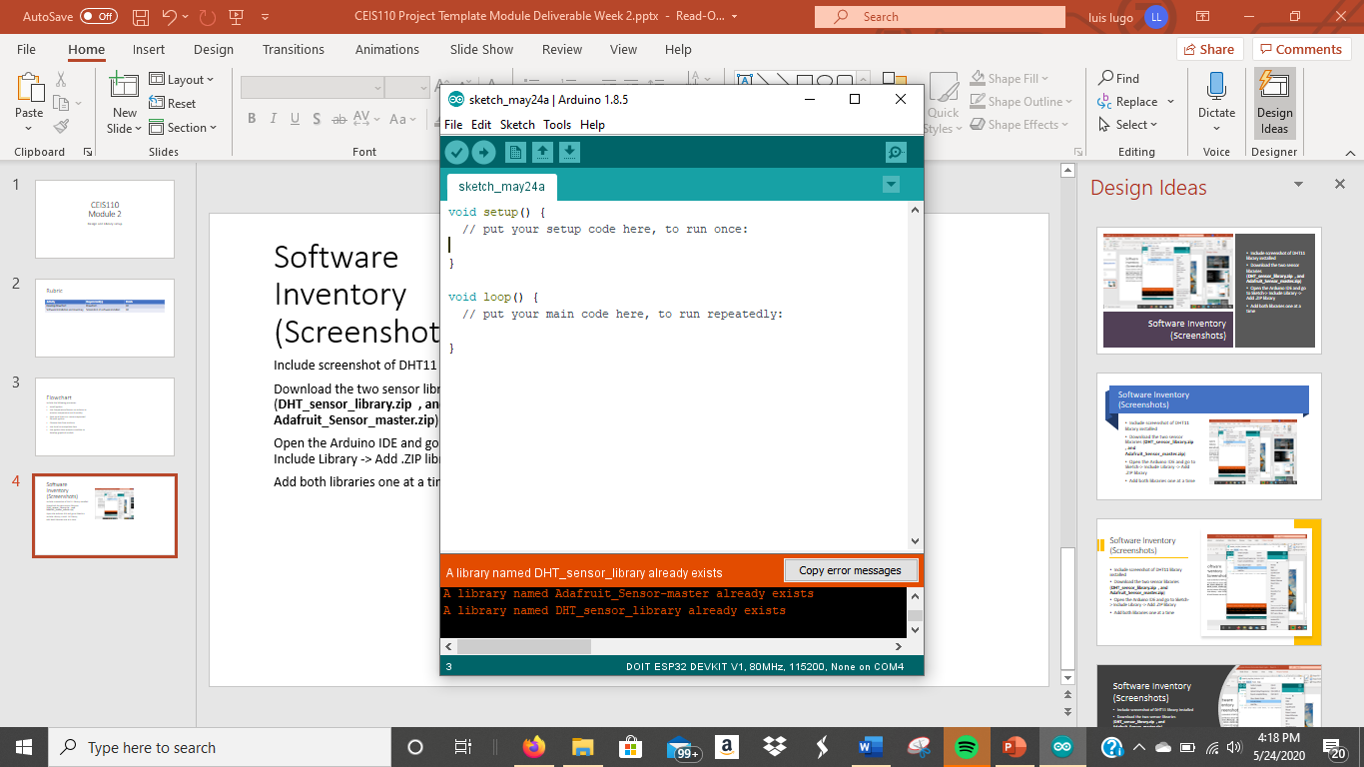
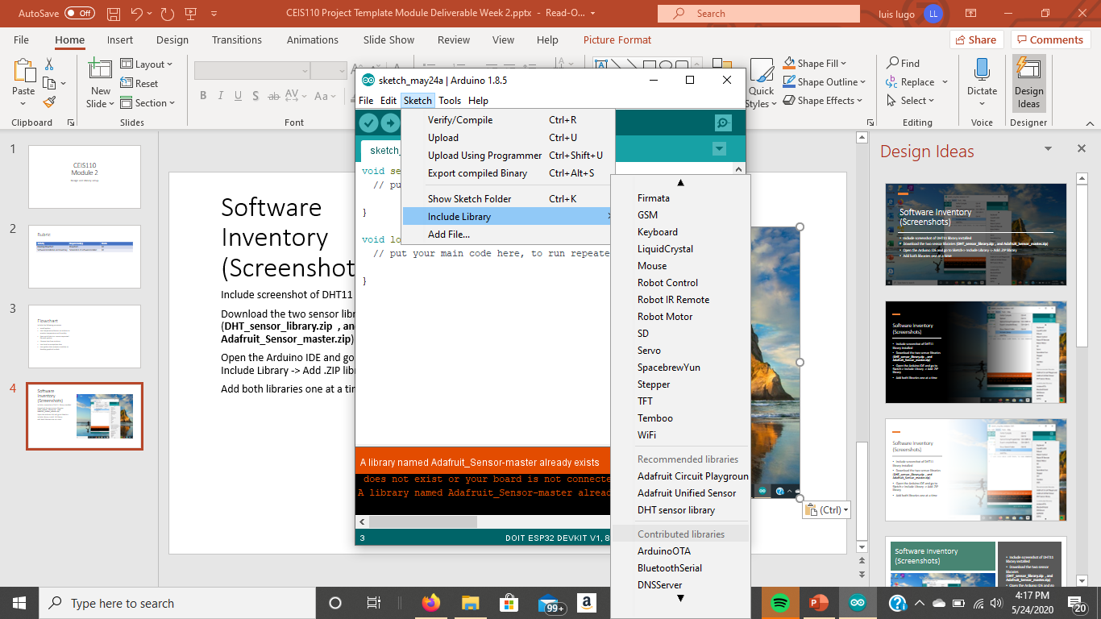
Software Inventory
screenshot of DHT11 library installed
(DHT_sensor_library.zip , and Adafruit_Sensor_master.zip)

Slide 8
We build our circuit and run our code to gather information and use the serial monitor to confirm proper execution.

Slide 9
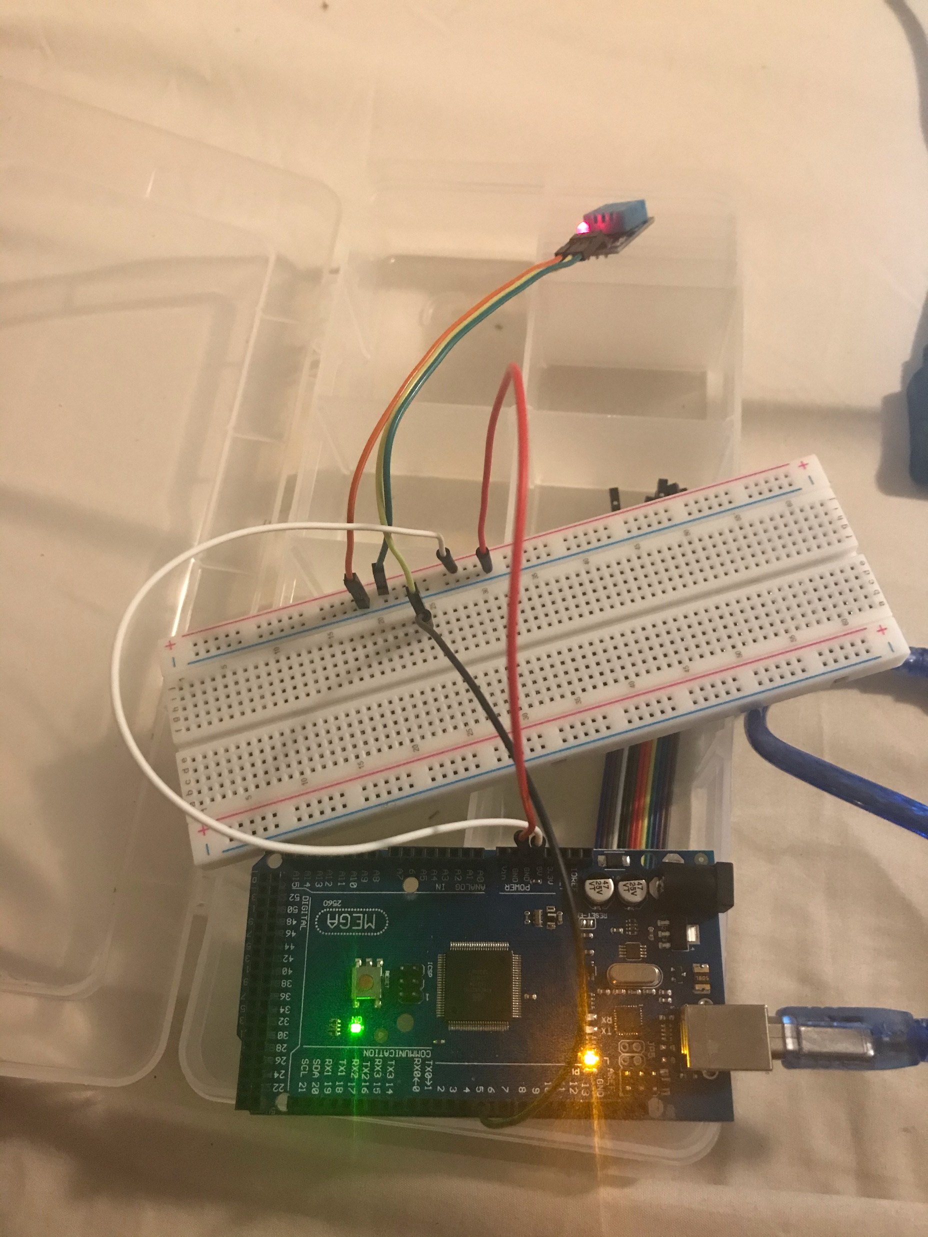
Circuit
Arduino Mega board
Breadboard
Wire(s)
DHT11 Temperature and Humidity sensor

Slide 10
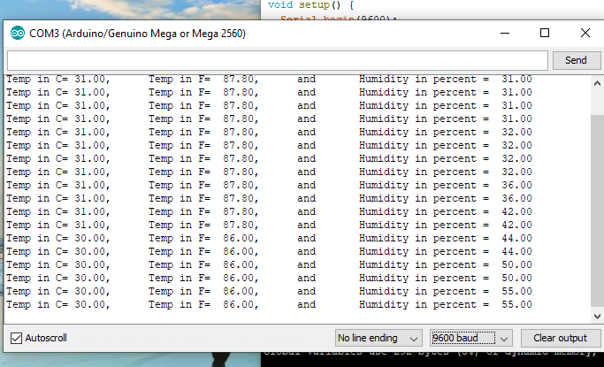
Serial Monitor
Screenshot of serial monitor showing temperature and sensor output data

Slide 11
Using code, we save the data received into a txt file and using other code, we convert the text file into csc file and save it as an excel file to be read.

Slide 12
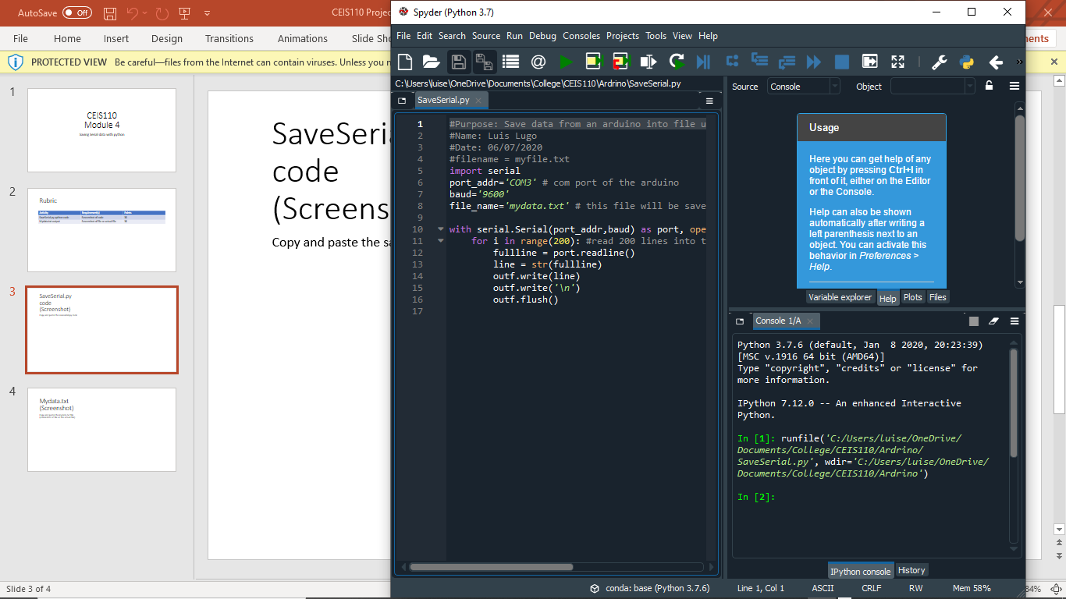
SaveSerial.py code
#Purpose: Save data from an arduino into file using python
#Name: Luis Lugo
#Date: 06/07/2020
#filename = myfile.txt
import serial
port_addr='COM3' # com port of the arduino
baud='9600'
file_name='mydata2.txt' # this file will be saved in the same location as the py file
with serial.Serial(port_addr,baud) as port, open(file_name,"w+", 256) as outf:
for i in range(200): #read 200 lines into the file
fullline = port.readline()
line = str(fullline)
outf.write(line)
outf.write('\n')
outf.flush()

Slide 13
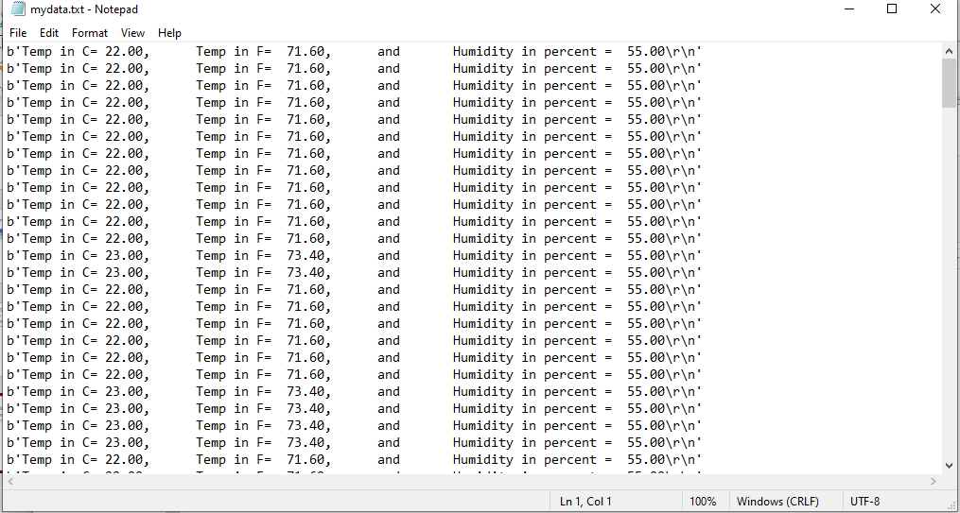
Mydata.txt
This is the Text file I created from using the SaveSerial.py

Slide 14
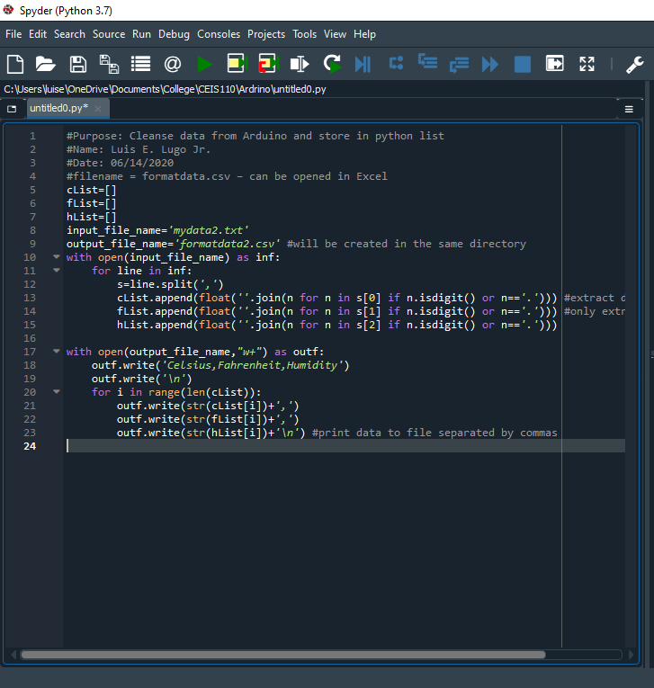
Python code
#Purpose: Cleanse data from Arduino and store in python list
#Name: Luis E. Lugo Jr.
#Date: 06/14/2020
#filename = formatdata.csv – can be opened in Excel
cList=[]
fList=[]
hList=[]
input_file_name='mydata.txt'
output_file_name='formatdata.csv' #will be created in the same directory
with open(input_file_name) as inf:
for line in inf:
s=line.split(',')
cList.append(float(''.join(n for n in s[0] if n.isdigit() or n=='.'))) #extract data to lists
fList.append(float(''.join(n for n in s[1] if n.isdigit() or n=='.'))) #only extract numbers
hList.append(float(''.join(n for n in s[2] if n.isdigit() or n=='.')))
with open(output_file_name,"w+") as outf:
outf.write('Celsius,Fahrenheit,Humidity')
outf.write('\n')
for i in range(len(cList)):
outf.write(str(cList[i])+',')
outf.write(str(fList[i])+',')
outf.write(str(hList[i])+'\n') #print data to file separated by commas

Slide 15
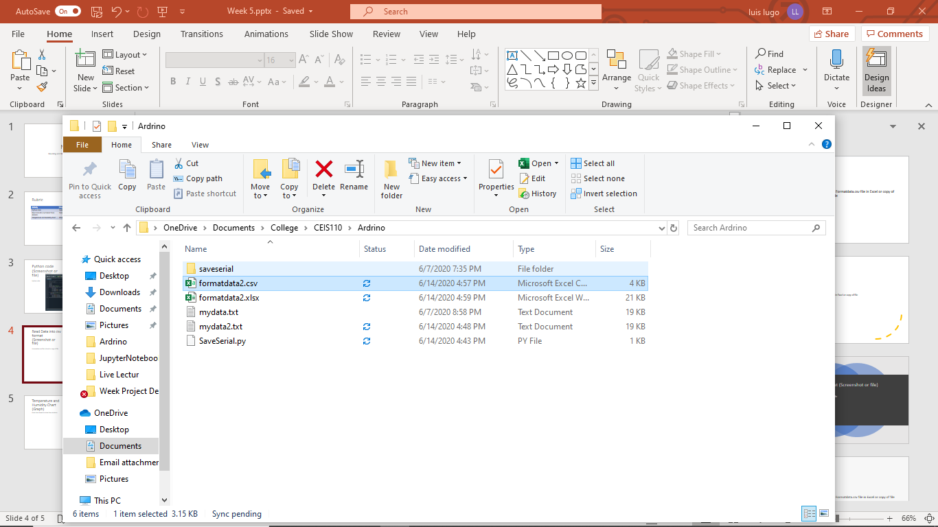
Read Data into csv format (Screenshot)
Formatdata.csv file in Excel

Slide 16
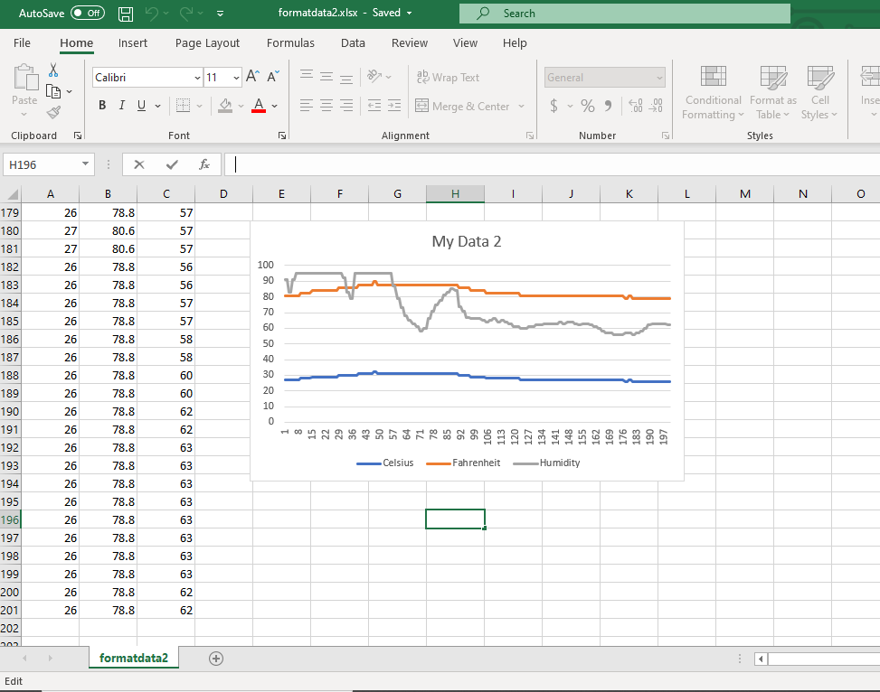
Temperature and Humidity Chart
(Graph)
Excel chart based on data from Arduino

Slide 17
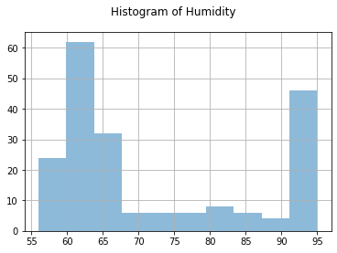
Plot #1
Python Code
#Purpose: Create a histogram of humidity data from the second trial
#Name: Luis Lugo
#Date: 06/26/2020
import pandas as pd
import matplotlib.pyplot as plt
df1 = pd.read_csv("formatdata.csv")
df2 = pd.read_csv("formatdata2.csv")
df2['Humidity'].hist(bins=10, alpha=0.5); plt.suptitle('Histogram of Humidity')
plt.show()

Slide 18
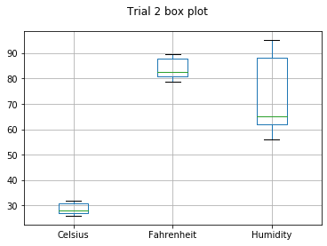
Plot #2
Python Code
#Purpose: Create box plot for trial 2 data
#Name: Luis Lugo
#Date: 06/25/2020
import pandas as pd
import matplotlib.pyplot as plt
df2 = pd.read_csv("formatdata2.csv")
df2.boxplot(); plt.suptitle('Trial 2 box plot')
plt.show()

Slide 19
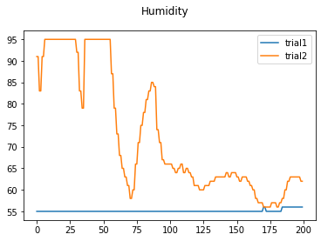
Analysis
What was the humidity difference between the two trials?
Python Code
#Purpose: Create Humidity plot comparing trial 1 and trial 2
#Name: Luis Lugo
#Date: 06/25/2020
import pandas as pd
import matplotlib.pyplot as plt
df1 = pd.read_csv("formatdata.csv") #baseline data is trial 1
df2 = pd.read_csv("formatdata2.csv") #data with variation such as finger over sensor and blowing on sensor is trial2
plt.figure(); df1.Humidity.plot(label = 'trial1'); df2.Humidity.plot(label = 'trial2'); plt.legend(loc='best'); plt.suptitle('Humidity')
plt.show()

Slide 20
Prediction
Develop a prediction based on the data. How would the data be different if you simply blew on the sensor without touching it? How would it be different if you gathered the data on a rainy or dry day?
  Based on the data received from when I placed and lifted my finger on the sensor and blew on the sensor. Placing my finger and blowing on the sensor would both cause a spike in humidity. If I did this on a rainy day, the humidity sensor would have a higher baseline point. Heat from both my breath and finger, affect humidity.

Slide 21
Challenges
There were not many moments that I faced any real challenges. Working with python and ardrino was very simple. I was guided very well by the professors and for the moments where I may have hit a hiccup, a little ingenuity helped, something simple as restarting the program or reading my code to discover I accidentally deleted a closing bracket, or giggling a wire to reestablish a positive connection.

Slide 22
Career Skills
Using Python to write code
Reading and analyzing code, looking for errors
Cleaning up Code to use
Collecting data and converting it into readable charts

Slide 23
Conclusion
This project has taught me the fundamentals of programing by building a circuit with ardrino to collect data and converting the information into a readable spreadsheet and charts.

