Slide 1
CEIS106 – Introduction to operating systems
Luis E. Lugo Jr.

Slide 2
Introduction
This PowerPoint will display my journey of installing a virtual machine on my laptop, installing Linux OS (Ubuntu) on the virtual machine and running an Arduino breadboard with a blinking LED through the virtual machine program.

Slide 3
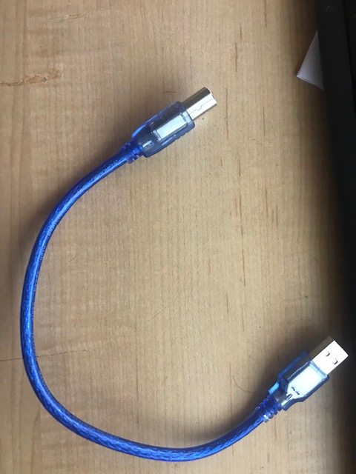
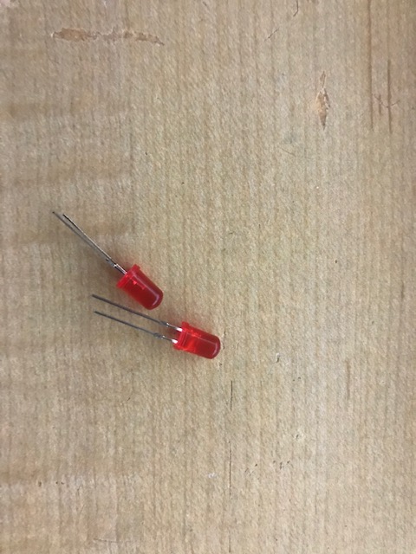
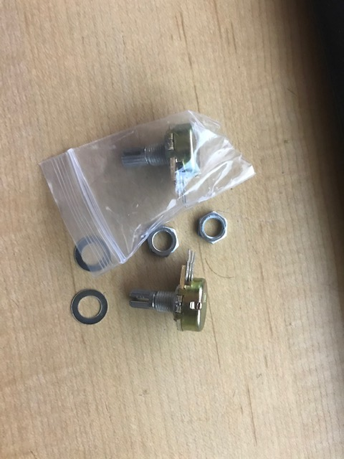
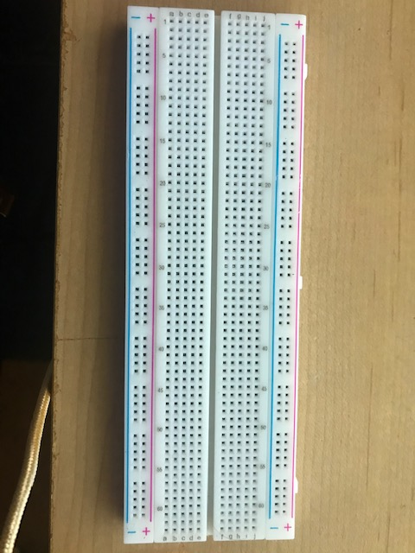
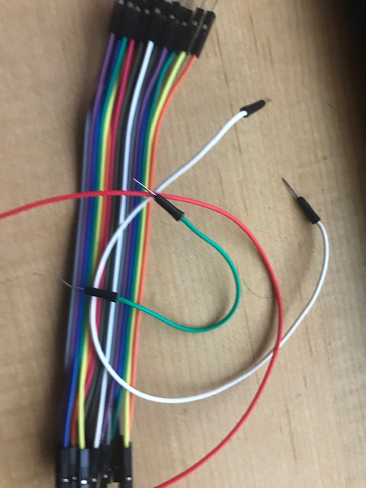
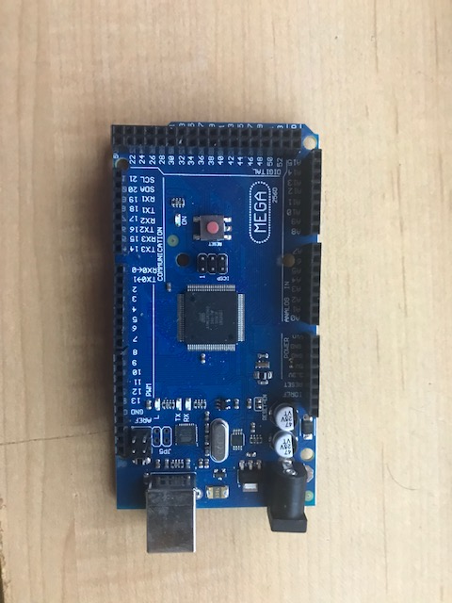
Inventory (Picture)
Potentiometer
Arduino Mega Board
Wires
LED
Breadboard

Slide 4
How do you access your BIOS?
Research how to access the BIOS on your computer
What keys/combination do you need to access the BIOS on your computer?
Answer here:
Start > Settings > update & security > Recovery > Advance Setup > Restart Now > Troubleshoot > Advance Options > UEFI Firmware Settings > restart > F10 (BIOS)
Do you have virtualization enabled on your laptop?
Answer here:
Not by default but now I do, enabled through the BIOS system

Slide 5

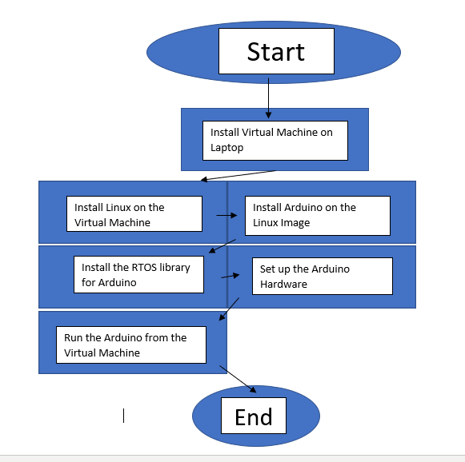
Flowchart
Flowchart with the following steps:
Install Virtual machine
Install Linux on the VM
Install Arduino on the Linux image
Install the RTOS library for Arduino
Set up the Arduino hardware
Run the Arduino from the VM

Slide 6
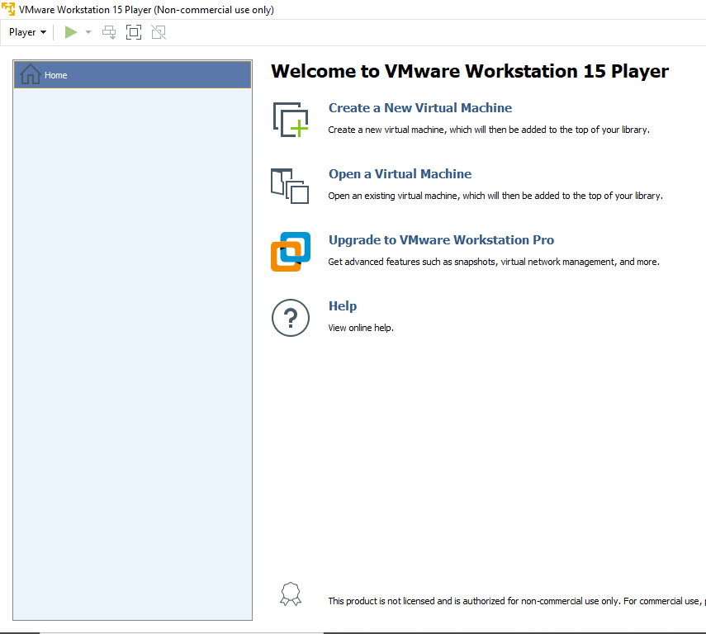
VMWare
Screenshot of VMWare installed

Slide 7
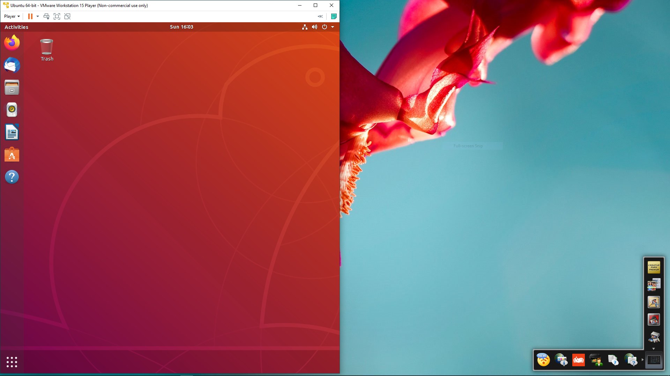
Install Linux ISO
Screenshot showing Ubuntu Linux installed

Slide 8

Explore the Linux Desktop
Explore the Linux Desktop and answer the following questions
How do you open a terminal window?
Answer here: ctrl + Alt + T, or through the search bar in applications
Name a browser and Office software you see in Ubuntu:
Answer here: Firefox and Thunderbird Mail, LibreOffice Writer
How would you compare the Linux desktop to other OS’s you have used (Windows, Mac)?
Answer here: Linux is very similar function wise to Windows, but also it comes with programs that windows would charge for and seems a bit easier to figure out while using, over first time using windows due to all the bloatware windows now includes and some you can not uninstall. I do not see any bloatware programs on linux.

Slide 9
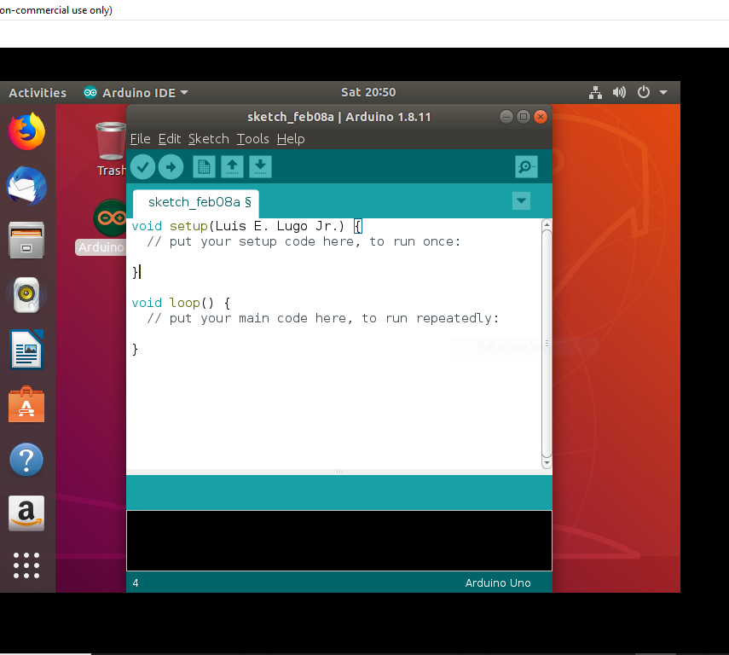
Install Arduino IDE
Screenshot showing Arduino IDE installed on Ubuntu

Slide 10
Questions about Installing files
Answer the following questions
What is a tar file?
Answer here: A tar file is an archive/backup made using the tar command (tar –options)
What is the sudo command?
Answer here: It allows you to perform commands as another use, grants admin permission.
How would you compare installing software on Linux versus Windows or Mac?
Answer here: With windows, I would of clicked on the install program or typed into the file search whatever program install. Linux actually seemed easier. With windows, I tend to have a delay or multiple screens I have to go through such as installing the install wizard, before I can even start.

Slide 11
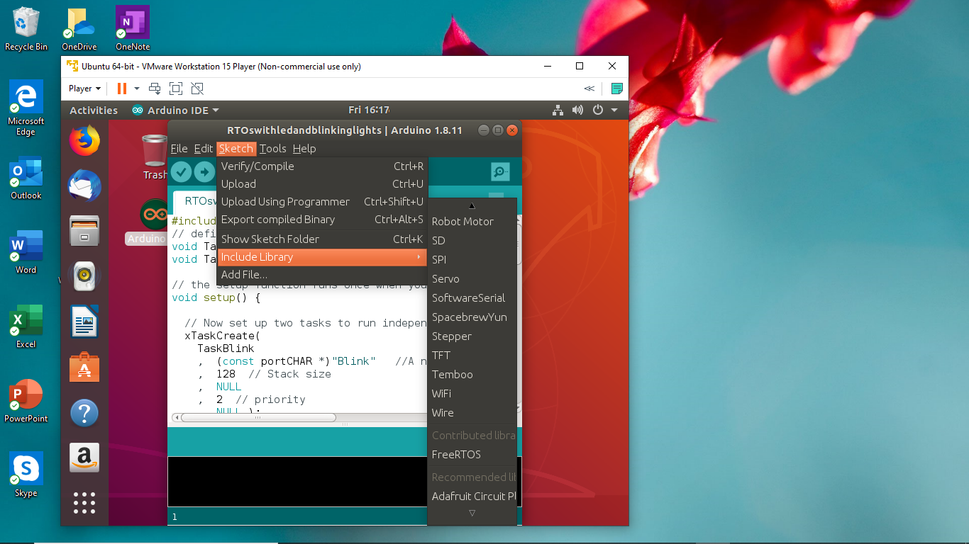
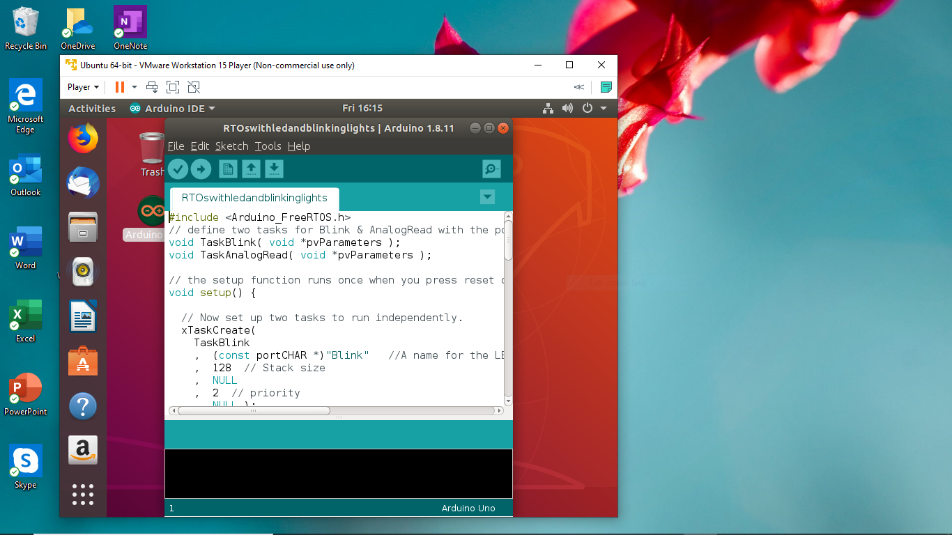
Install RTOS
Screenshot showing code in Arduino IDE

Slide 12
Questions about RTOS
Answer the following questions
What does RTOS mean?
Answer here:
Real Time Operating System
Why is RTOS important in IoT?
Answer here:
It’s important because it processes data in nano seconds so the outputs are delivered in “real-time” as opposed to regular programs that have delays in the output.

Slide 13
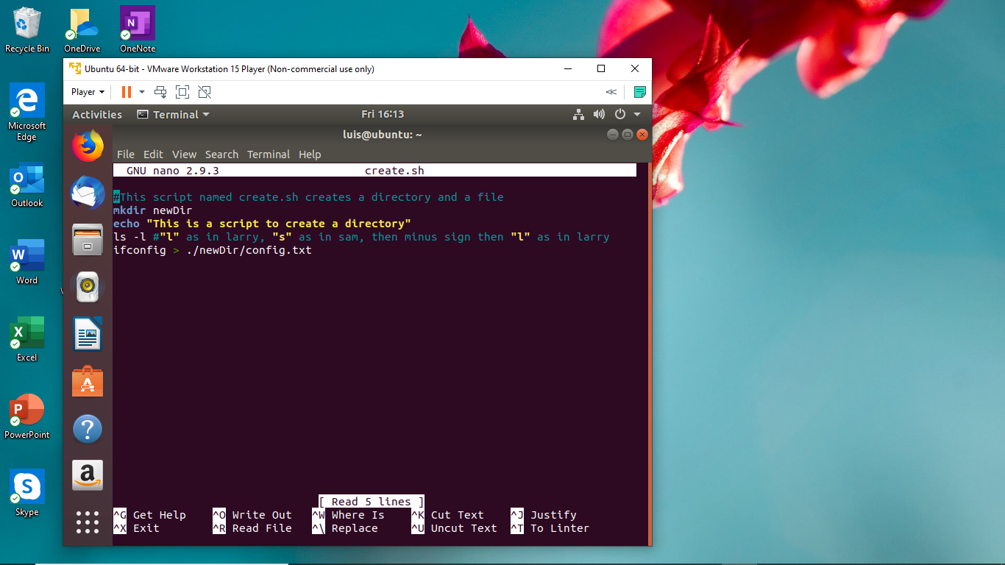
Scripts
Screenshot of config.txt file generated by the script and create.sh

Slide 14
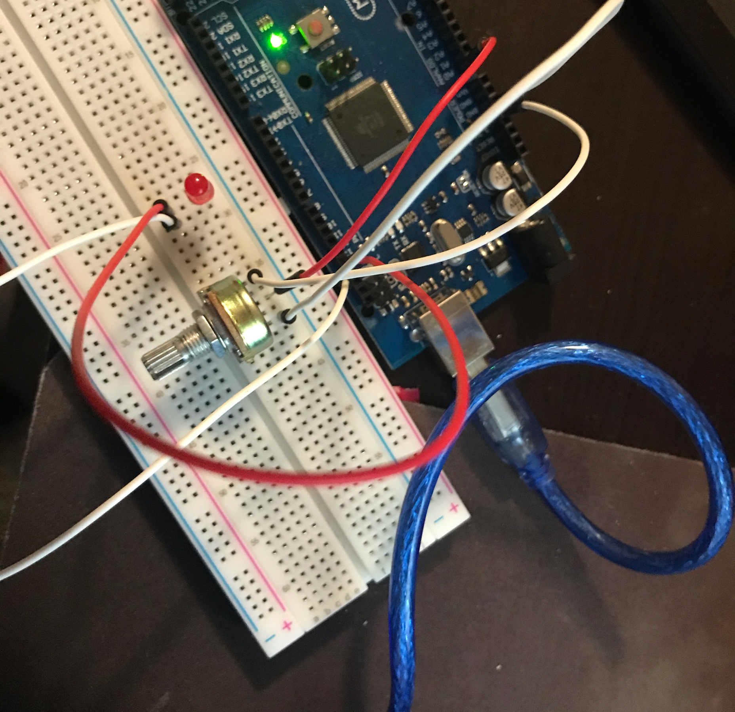
Hardware
Picture or video showing Arduino connected to breadboard with potentiometer and LED

Slide 15
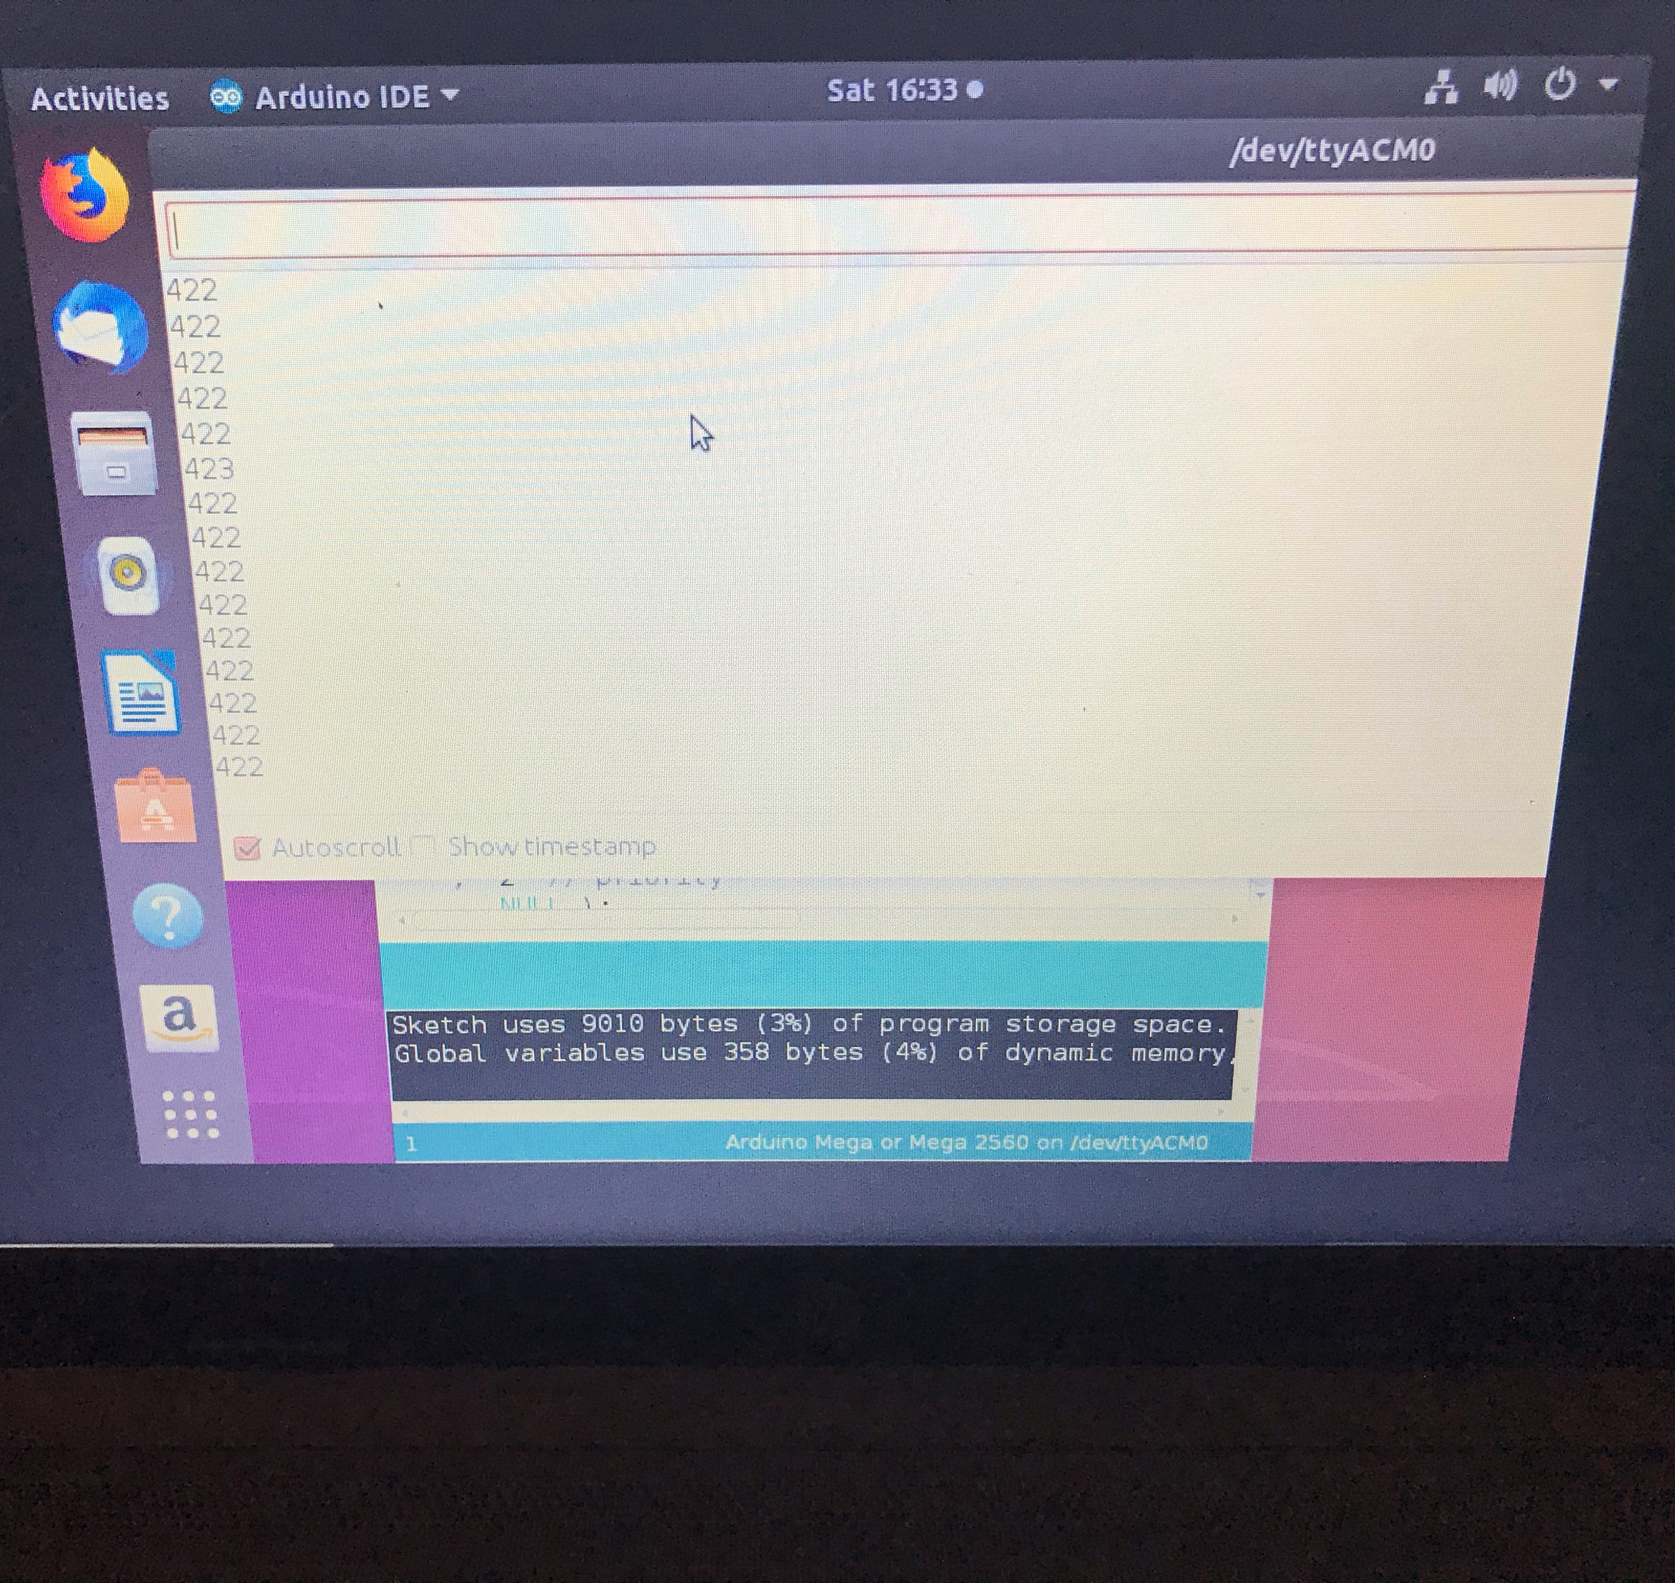
Serial Monitor
Serial Monitor showing potentiometer values Tools-> Serial Monitor

Slide 16
Explanation of command
What command did you use to change the permissions of the port?
Sudo usermod –a –G (username)
Why did you have to do this?
Plugging in the Arduino it connects directly to the laptop, you input the code to redirect the plug-in to connect with the virtual machine.

Slide 17
Conclusion
Linux and running a virtual machine are very useful in both personal and professional life. For its levels of customization and security lead to endless opportunities.

Slide 18
Career Skills Obtained
Virtual Machine Utilization
Linux OS
Basic Arduino Coding

