Slide 1
Luis E Lugo jr
CEis101 final project

Slide 2
Inventory and Organization
Organizing the materials

Slide 3
What is the point
Every great builder first lays out their tools and determins what they’ll need for the job. No project can succeed smoothly without the proper tools quickly on hand and in a place that is easily accessible. Here I pulled what I’ll need and organized it so that they won’t get lost and I can immediately grab what I need to keep the flow.

Slide 4
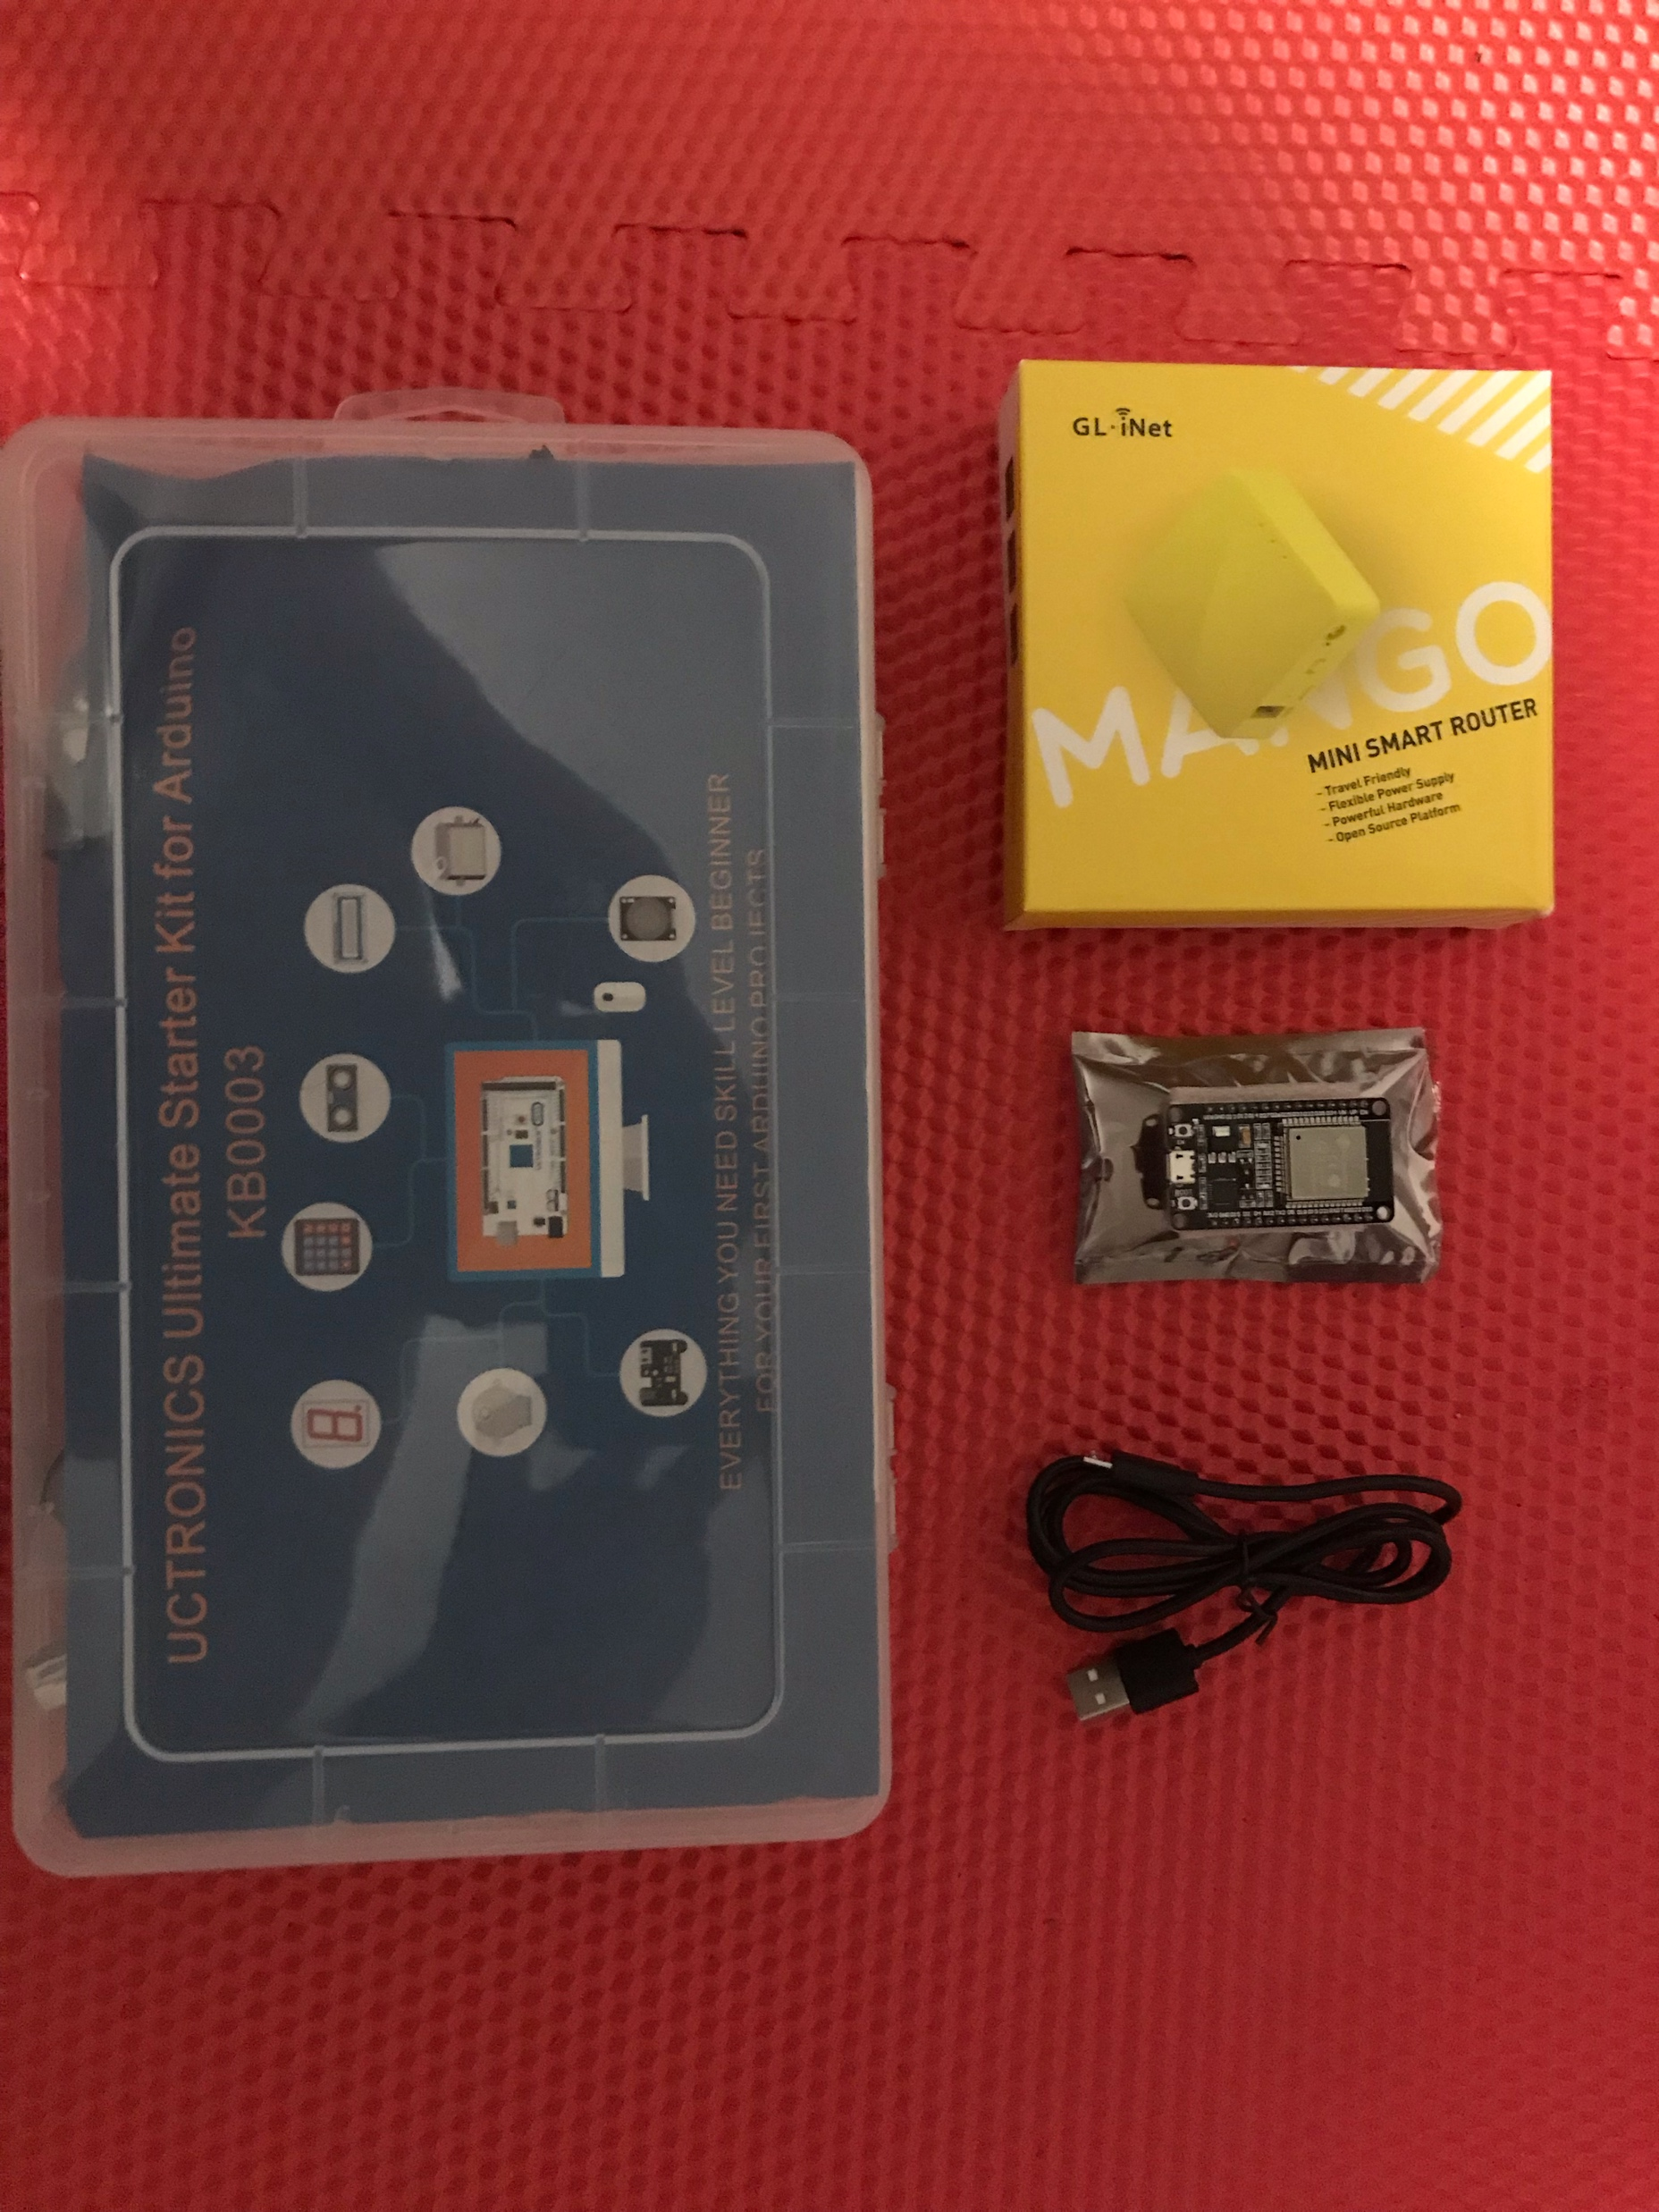
Inventory
Arduino Starter Kit
Mini-Smart Router
USB-microUSB Cable
Esp32 Board

Slide 5
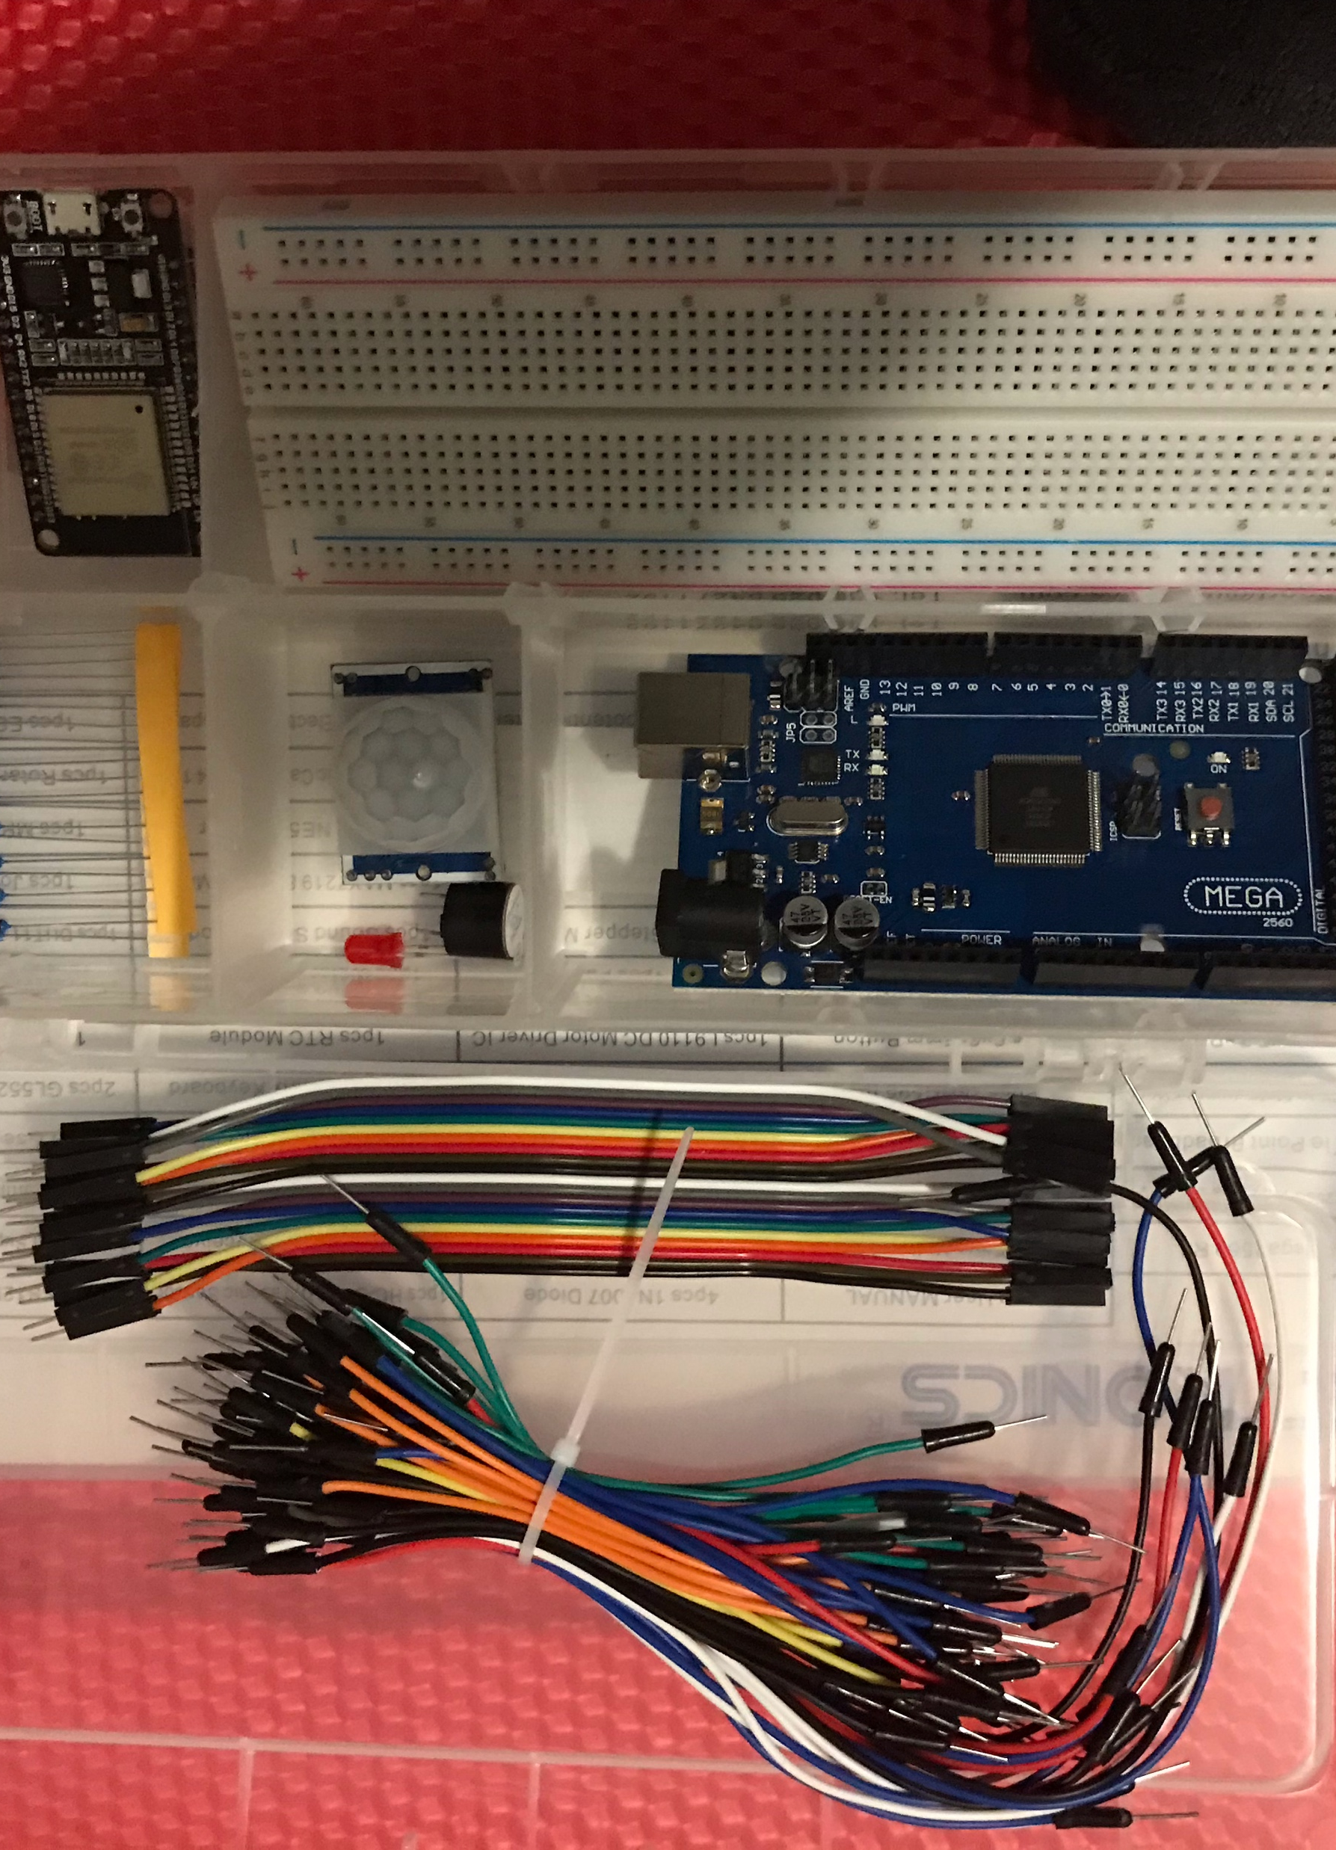
Organization
Arduino Megaboard
Resistor - 220Ω
LED
Breadboard
Motion Sensor
Wire(s)
Buzzer
Esp32 Board

Slide 6
Planning and design
Using a flowchart for the planning and design

Slide 7
Who uses Flowcharts
Research flowcharts
What companies use flowcharts?
Software, Sales, really any company and almost every company can use a flowchart.
Why might they use flowcharts?
A flow chart show a plan or process. When a certain input happens the a certain output happens and it goes from step to step. It’s organizing a process or system.

Slide 8
Input – Processing - Output
Fill out the following chart
Input | Process | Output
Motion | Detect Motion | Buzzer and Light

Slide 9
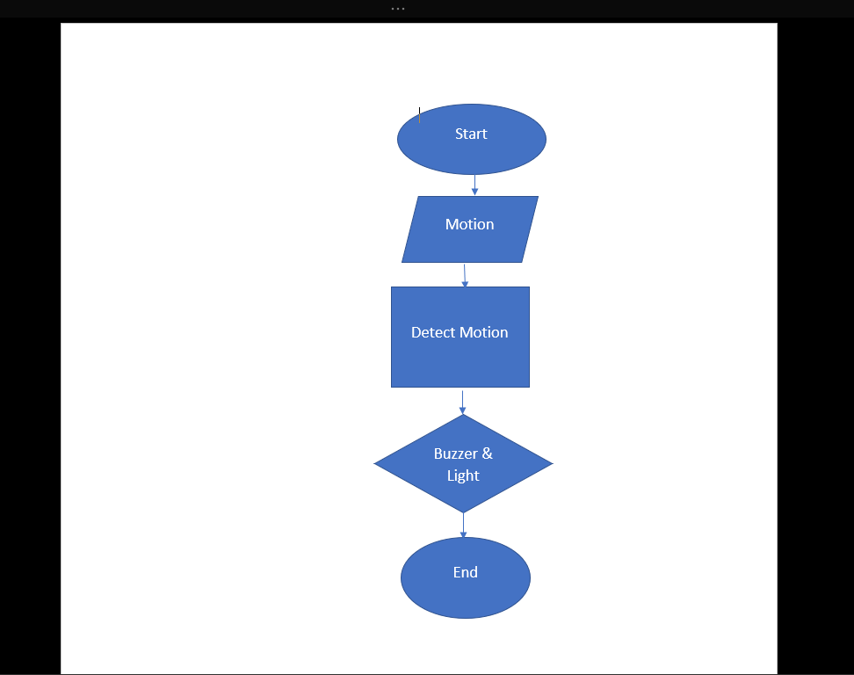
Flowchart
Flowchart with planning shapes

Slide 10
Exact plan not followed
So I found my time restricted and failed to follow my exact flow chart. Instead of adding both a light and buzzer, I chose to just go with the buzzer.

Slide 11
Installing the Arduino ide and running the blink code
Here I installed the Arduino ide and ran the blink code

Slide 12
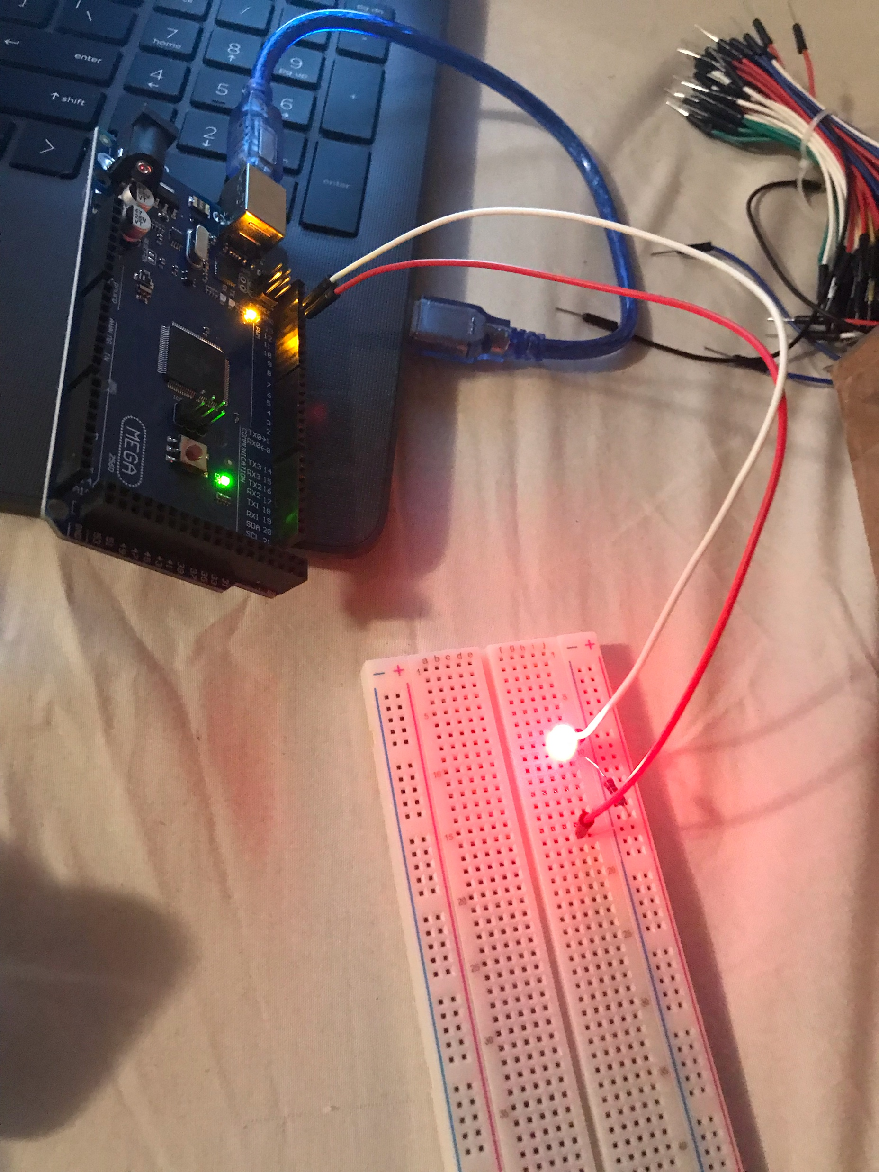
Circuit
Arduino and breadboard with LED connected to breadboard

Slide 13
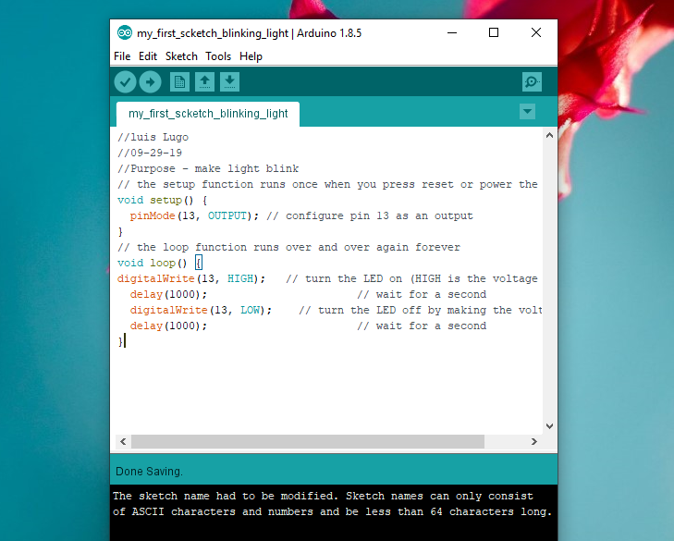
Code
Screenshot of code in Arduino IDE

Slide 14
Setting up the home security system with a motion sensor
Setting Up the Home Security System With a Motion Sensor

Slide 15
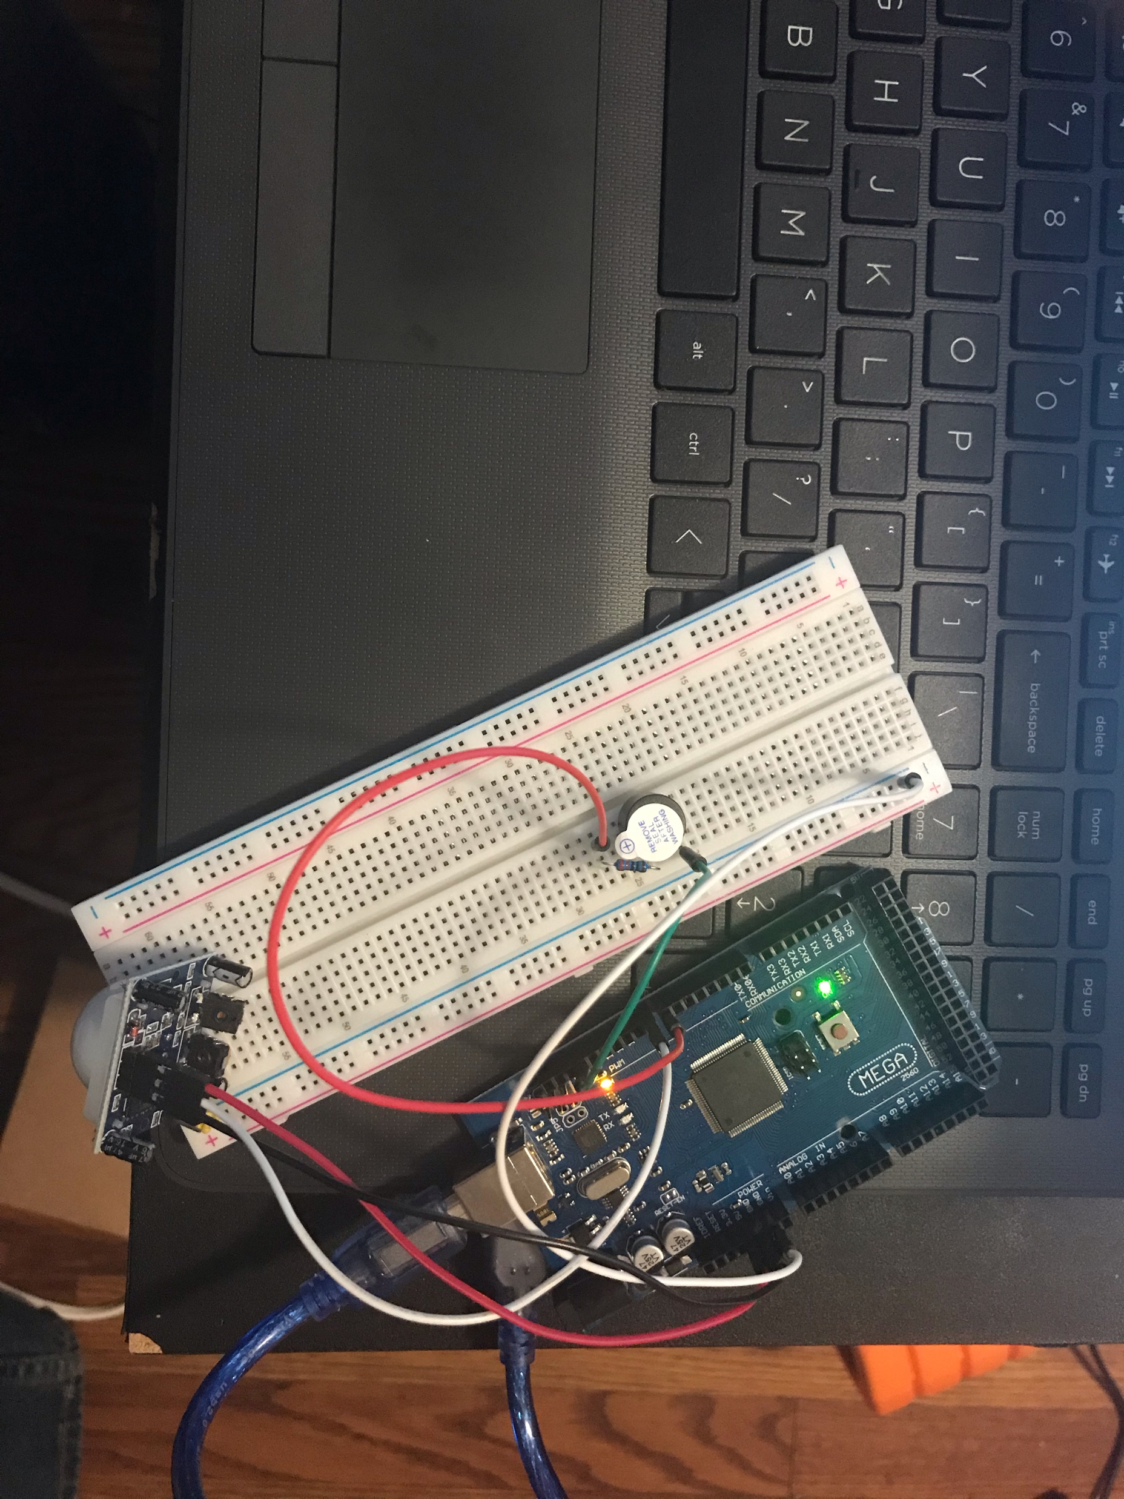
Circuit
Arduino with breadboard including motion sensor

Slide 16
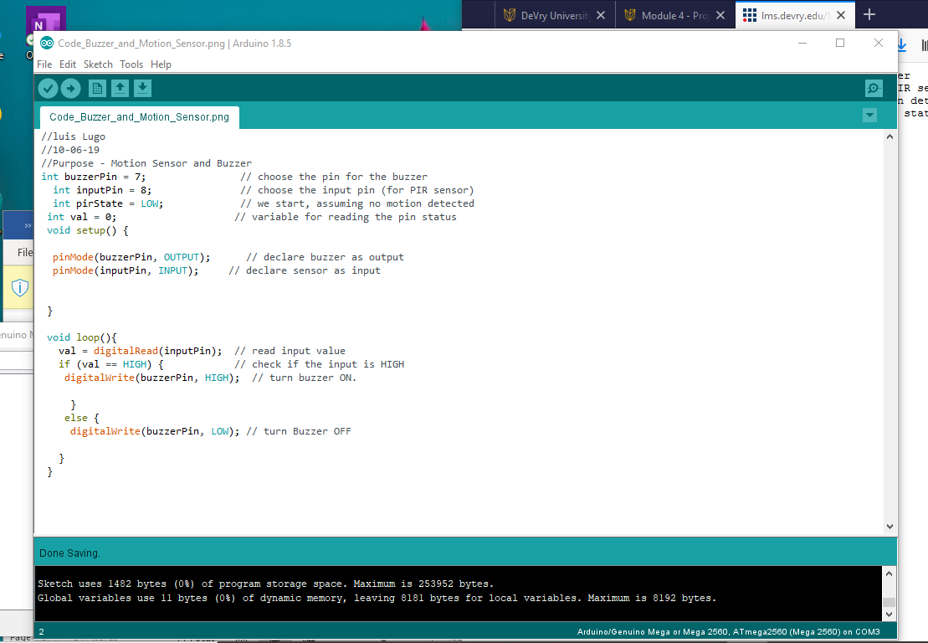
Code
Screenshot of code in Arduino IDE

Slide 17
Code explanation
Review the code
What pin is the input pin? What pin is the output pin? How do you know?
Answer here: Pin 8 is input and pin 7 is output. I know because the process goes motion is detected (input) buzzer sounds (output) it’s also in the code int inputpin = 8; and by default unlabeled pins are output so buzzerPin = 7 is the output tho it’s not clearly labeled.
How many times does the Arduino IDE setup() function run?
Answer here: Once

Slide 18
Networking and security
Networking and Security

Slide 19
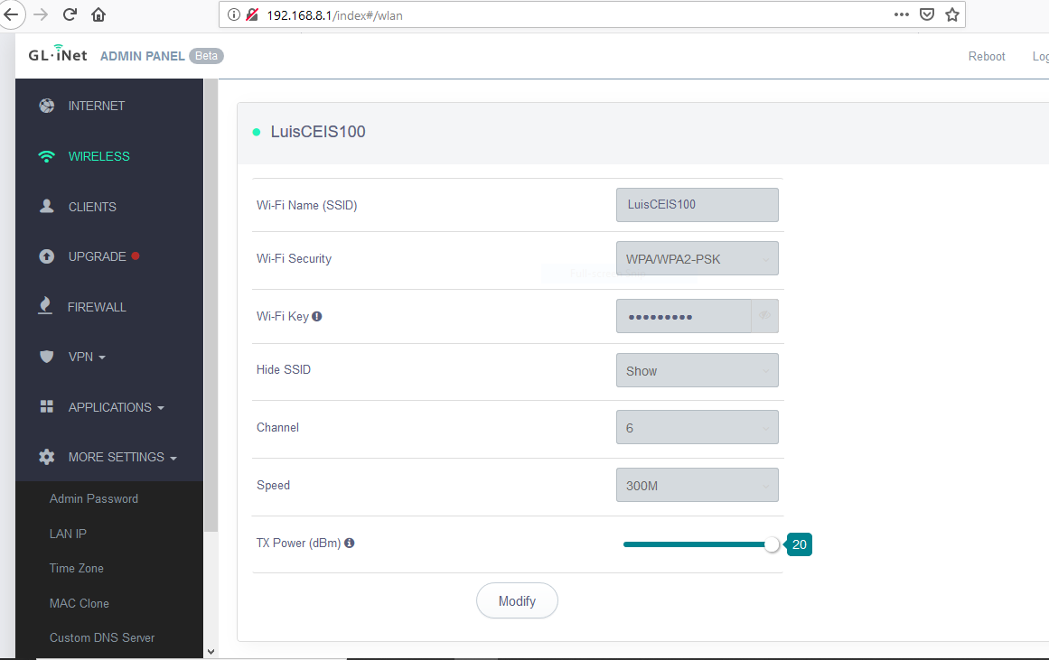
Router setup page
Screenshot of router setup page

Slide 20
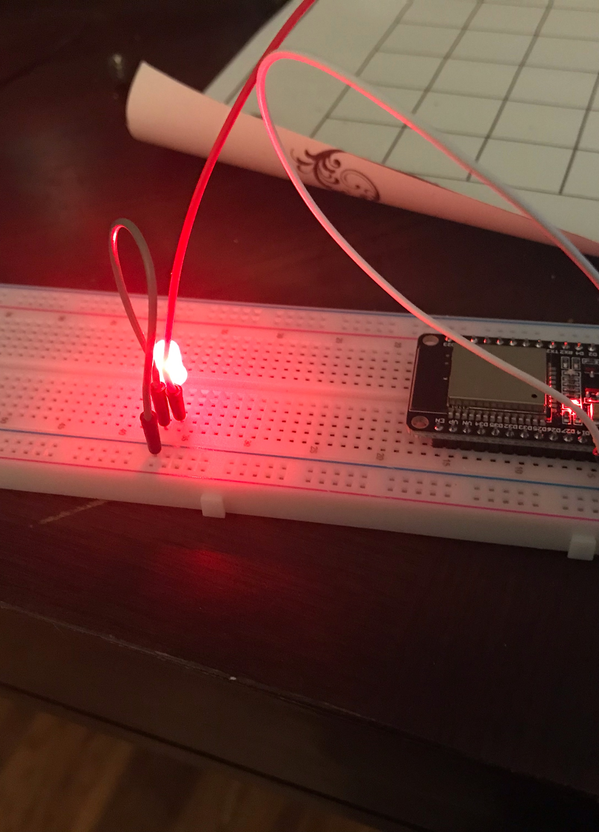
Circuit
Picture of circuit with ESP32 board on breadboard with LED

Slide 21
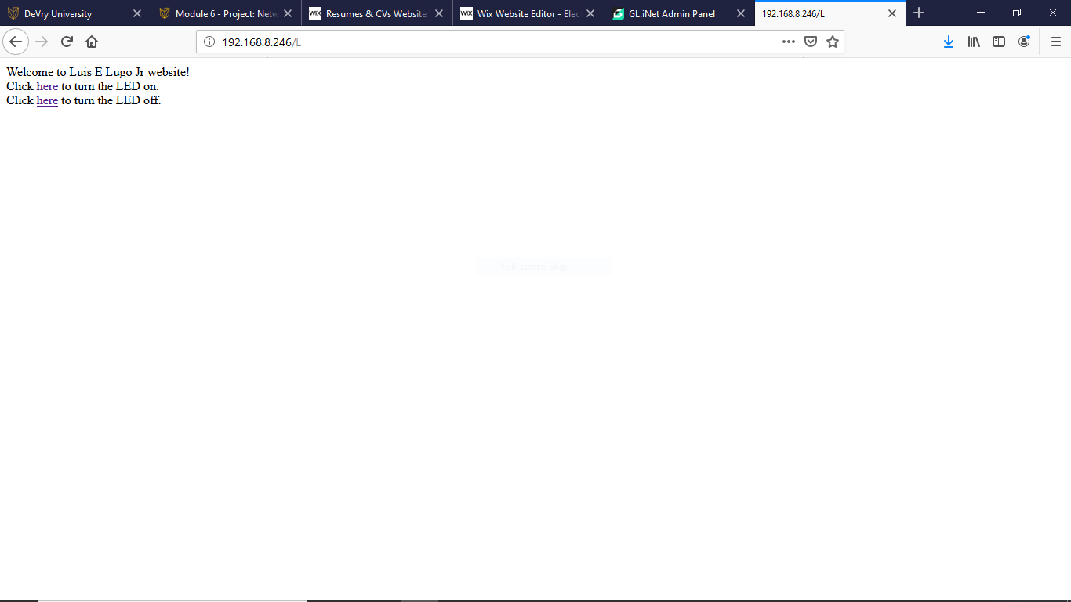
Web page
Web server screenshot showing turning on and off the light from the web.

Slide 22

challenges
Now I did find the final portion a bit difficult before I used the model videos, it was a bit complicated but yet fulfilling when I accomplished each little step of setting up the webpage and getting the code running.

