Slide 1

SEc285 – final Project
Luis E. Lugo Jr.
08/28/2022

Slide 2
Table of Content
Asymmetric Key Encryption
Stateful Firewall
Bring Your Own Device (BYOD) Security Policy
Multi Factor Authentication (MFA)
Vulnerability Assessment

Slide 3
Asymmetric Key Encryption
What is Asymmetric Key Encryption
  This is encryption that uses two keys, Encryption key and Decryption key
  Ideal for small data encryption like websites

Slide 4
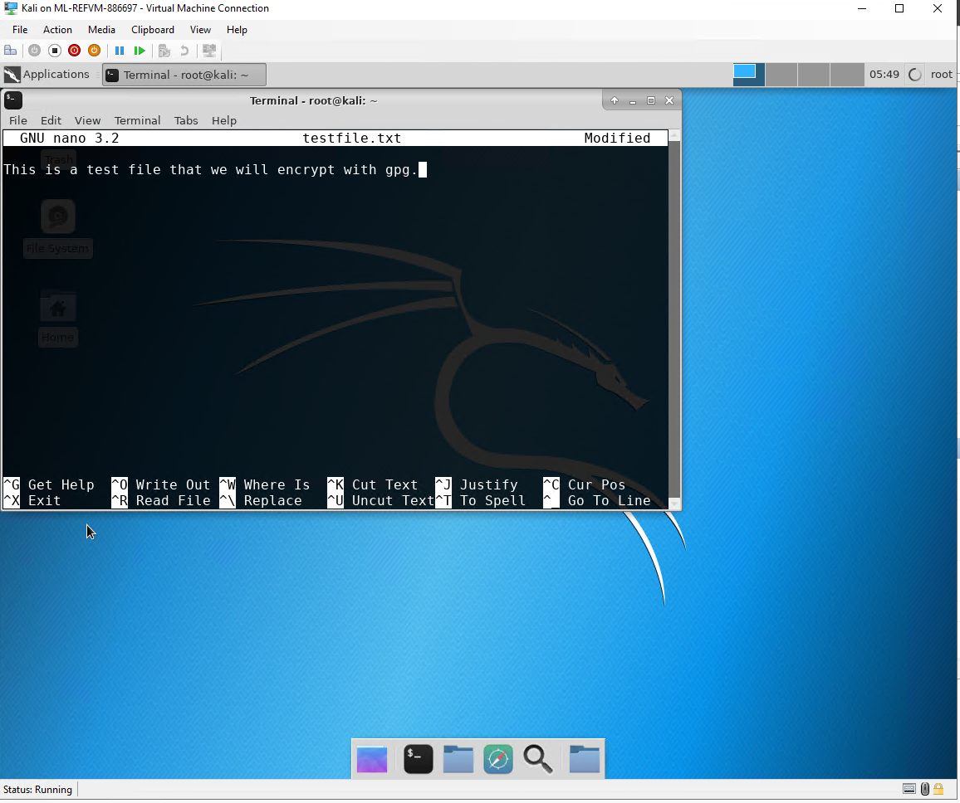
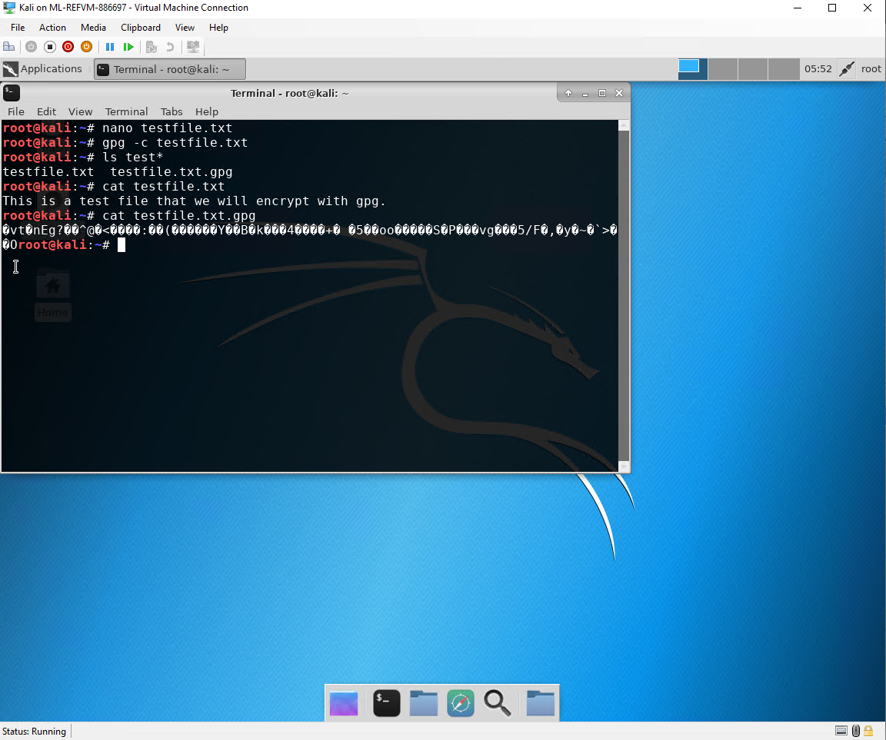
File Encryption
Content of the plaintext file
Here you see a screenshot of what the contents of the file in plain text and again contents of the file after encryption
Content of the encrypted file

Slide 5
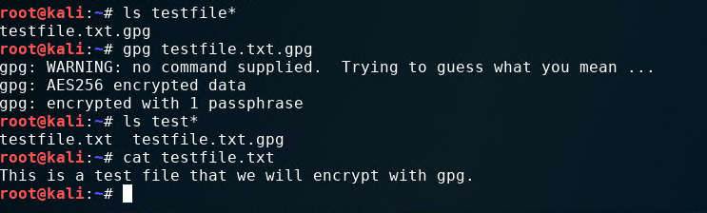
File Decryption
This screenshot shows the following.
The encrypted file being listed by itself
The decrypting process
Both the encrypted file and the original plaintext file being listed

Slide 6
Tech Requirements
Network
Satellite
Link

Slide 7
Question
What effect does the sudo iptables --policy INPUT DROP command have on the access to computing resources?
Answer here: The effect that Sudo iptables –policy INPUT DROP will have on access to computing resources is that it will not let through incoming data packets
References:
Iptables Tutorial - Beginners Guide to Linux Firewall. (2019, November 29). Hostinger Tutorials. https://www.hostinger.com/tutorials/iptables-tutorial

Slide 8
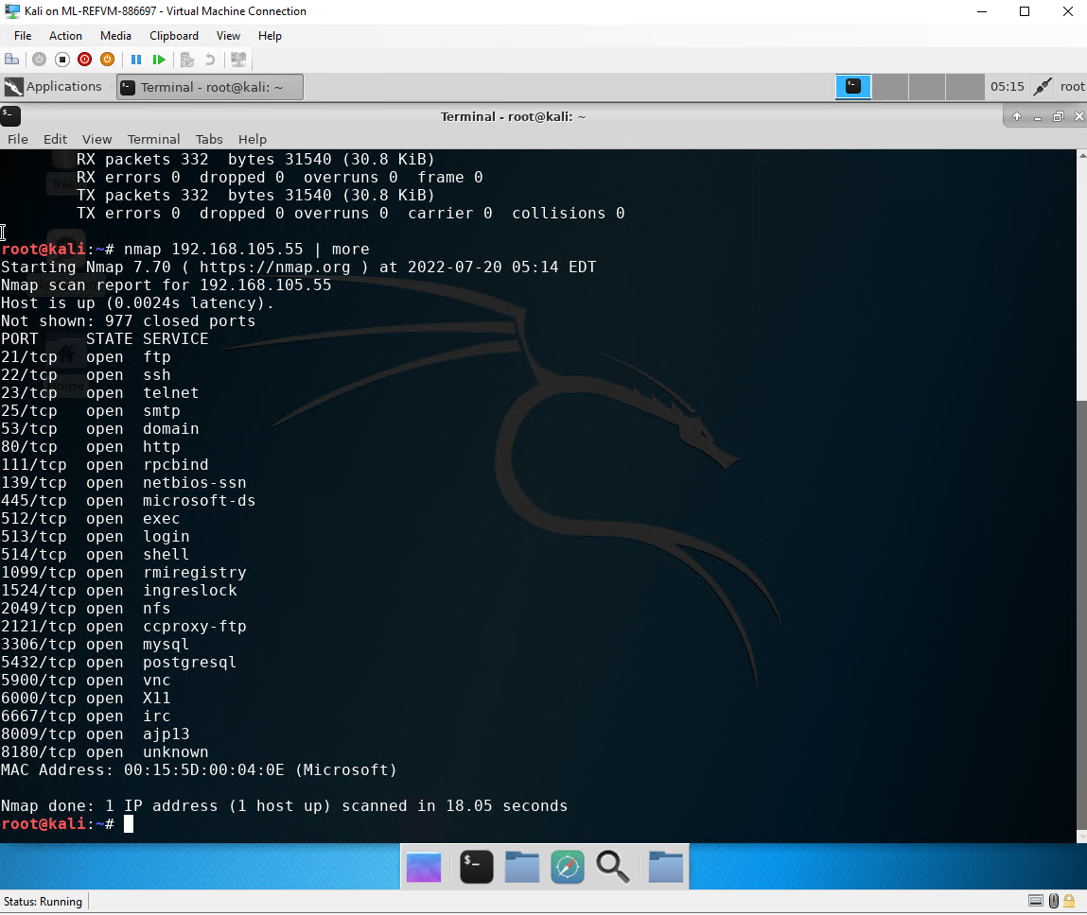
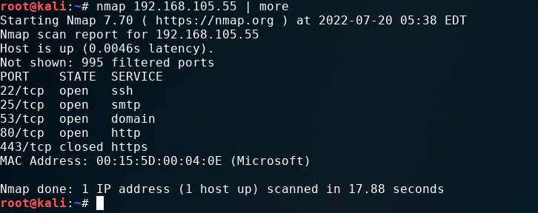
Nmap Scan
This screenshot should show the Nmap scan result of the Linux Server VM.

Slide 9
BYOD Security Policy
This slide should have the complete security policy template inserted as an object.

Slide 10
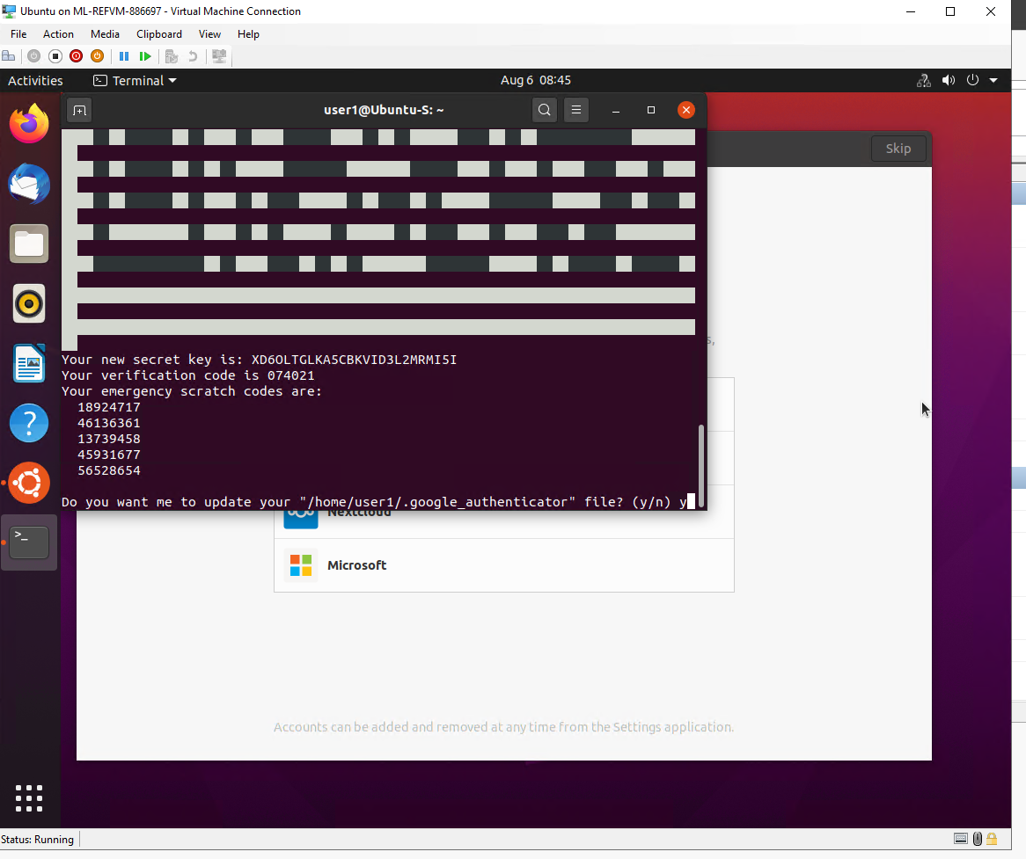
Common-auth Configuration File
This screenshot should show the entry that indicates the use of the Google Authenticator module.

Slide 11
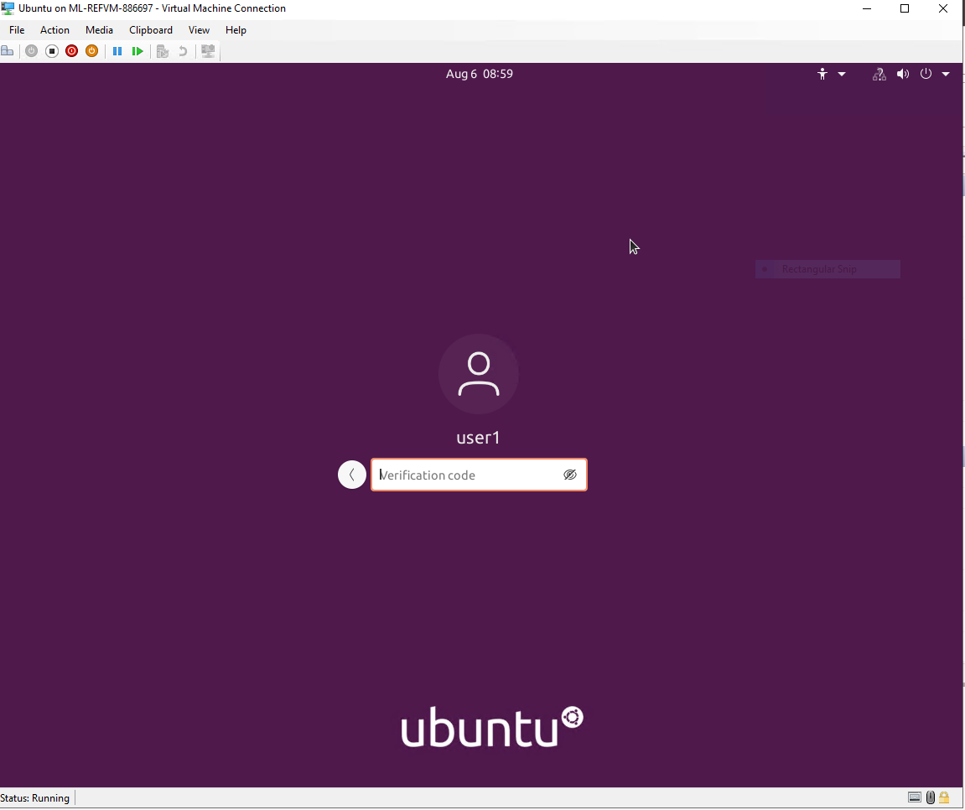
MFA Logon Screen
This screenshot should show the logon screen where a verification code is required.

Slide 12
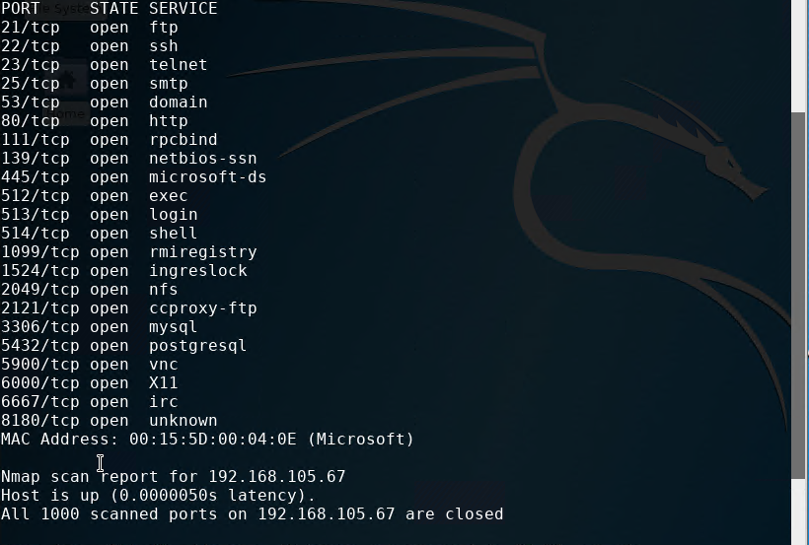
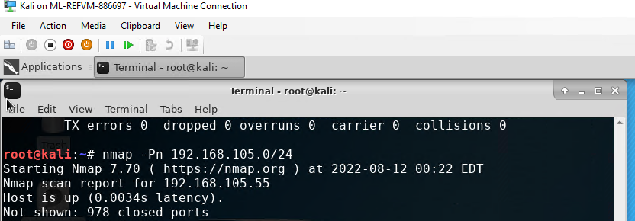
Nmap
This screenshot should include the scan result showing both the Kali and Linux Server VMs.

Slide 13
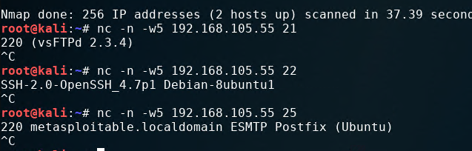
NetCat
This screenshot should include the scan result showing both the Kali and Linux Server VMs.

Slide 14
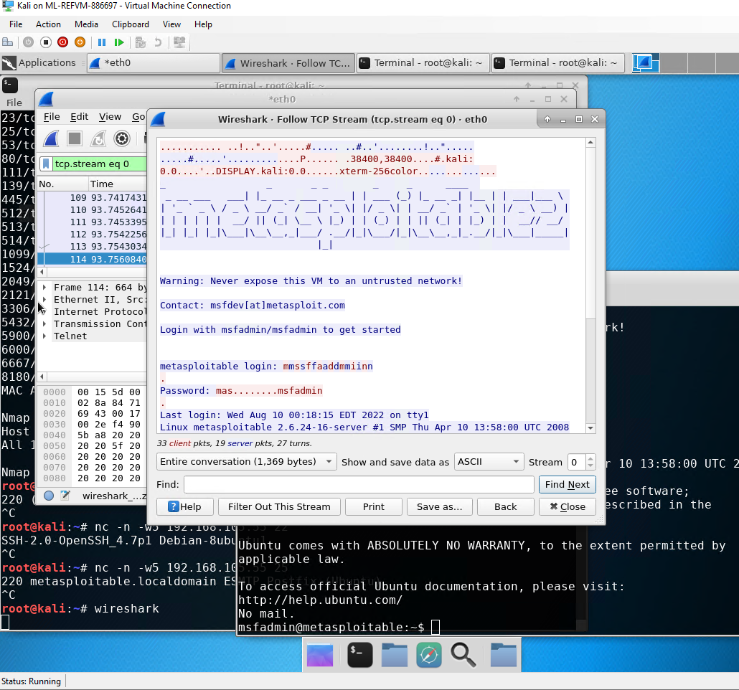
Wireshark
This screenshot should include the Wireshark—Follow TCP Steam window showing the Telnet username and password.

Slide 15
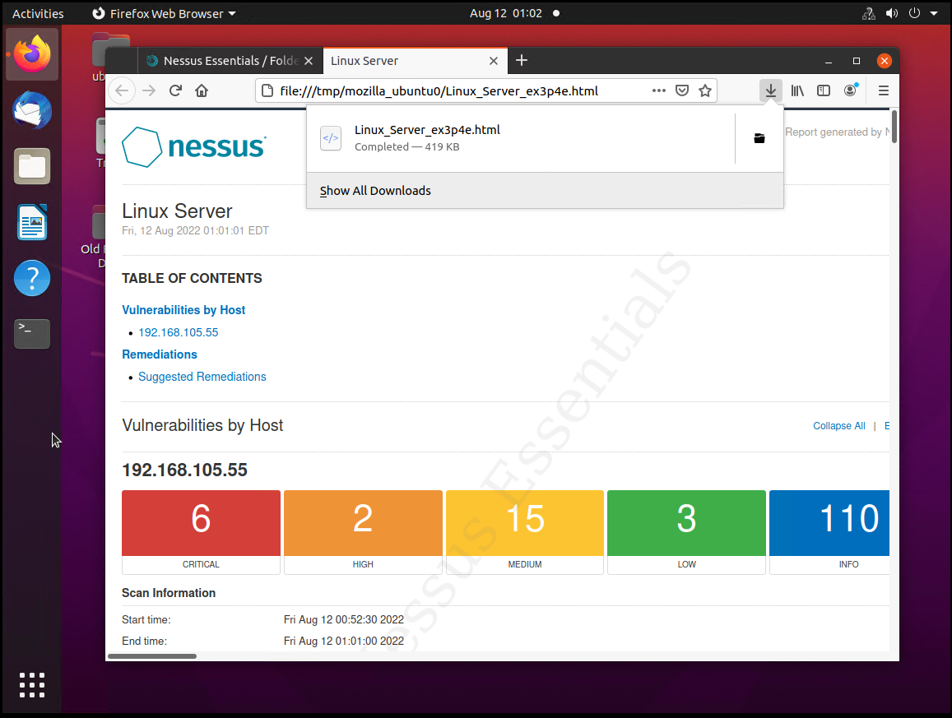
Nessus
This screenshot should include the high-level view of the Nessus vulnerability scan report (showing categories of vulnerability in different colors).

Slide 16

Digital Communications
Cloud
Local
Hybrid

Slide 17

Thank You
someone@example.com

