Slide 1
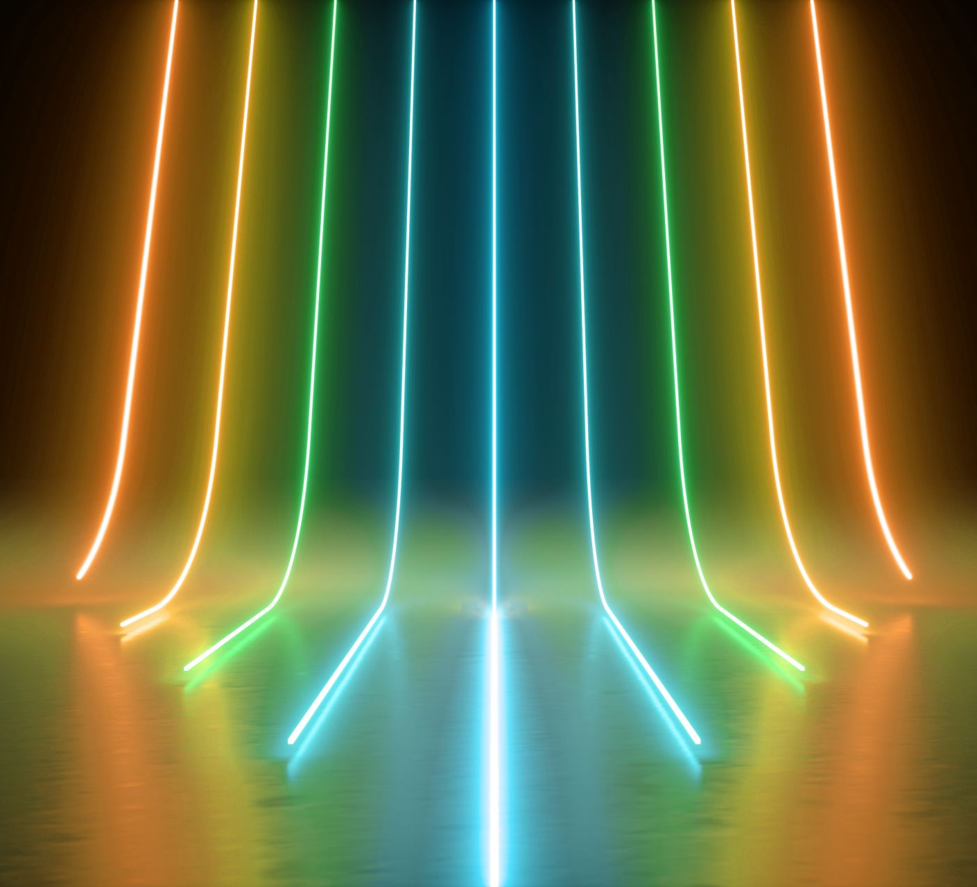
PHYS204
Luis E. Lugo Jr.
Final Project

Slide 2


PHYS204
Module 1
Materials List

Slide 3
Module 1: Objectives
Organize the parts needed to conduct four experiments that will investigate the fundamental laws of physics covered in the course

Slide 4
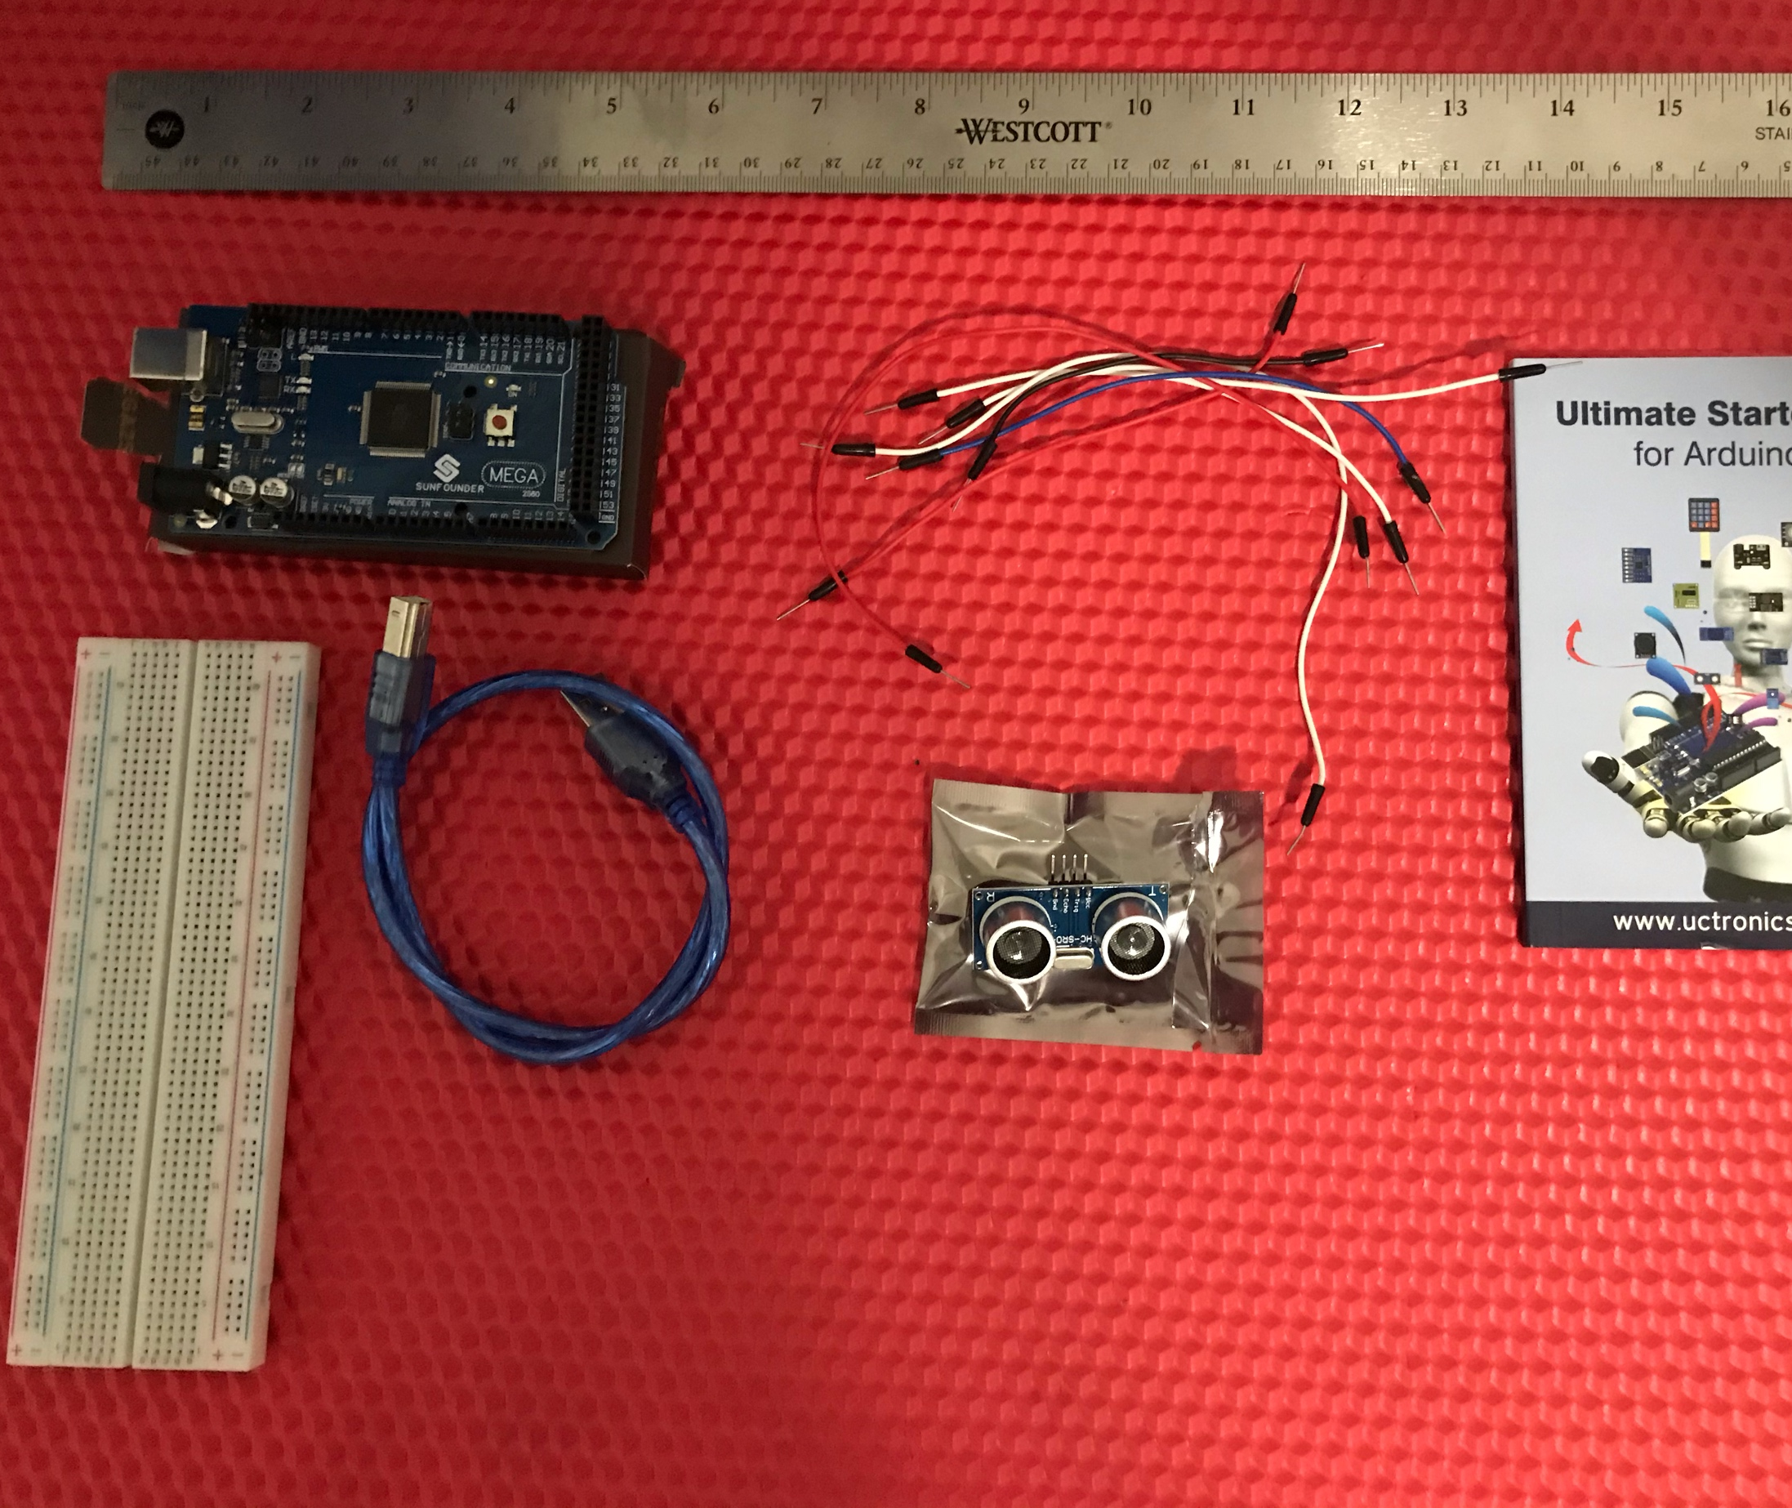
Materials List & Picture
Experiment One & Two
Mega 2560 Board
Ultrasonic sensor HC-SR04
Male to Male Wires
Breadboard
USB cable
Ruler or tape measurer
Object to act as obstacle and/or undergo free-fall
Ruler
Mega 2560 Board
Male to Male Wires
Object to act as obstacle and free-fall
USB Cable
Ultrasonic Sensor
Breadboard

Slide 5
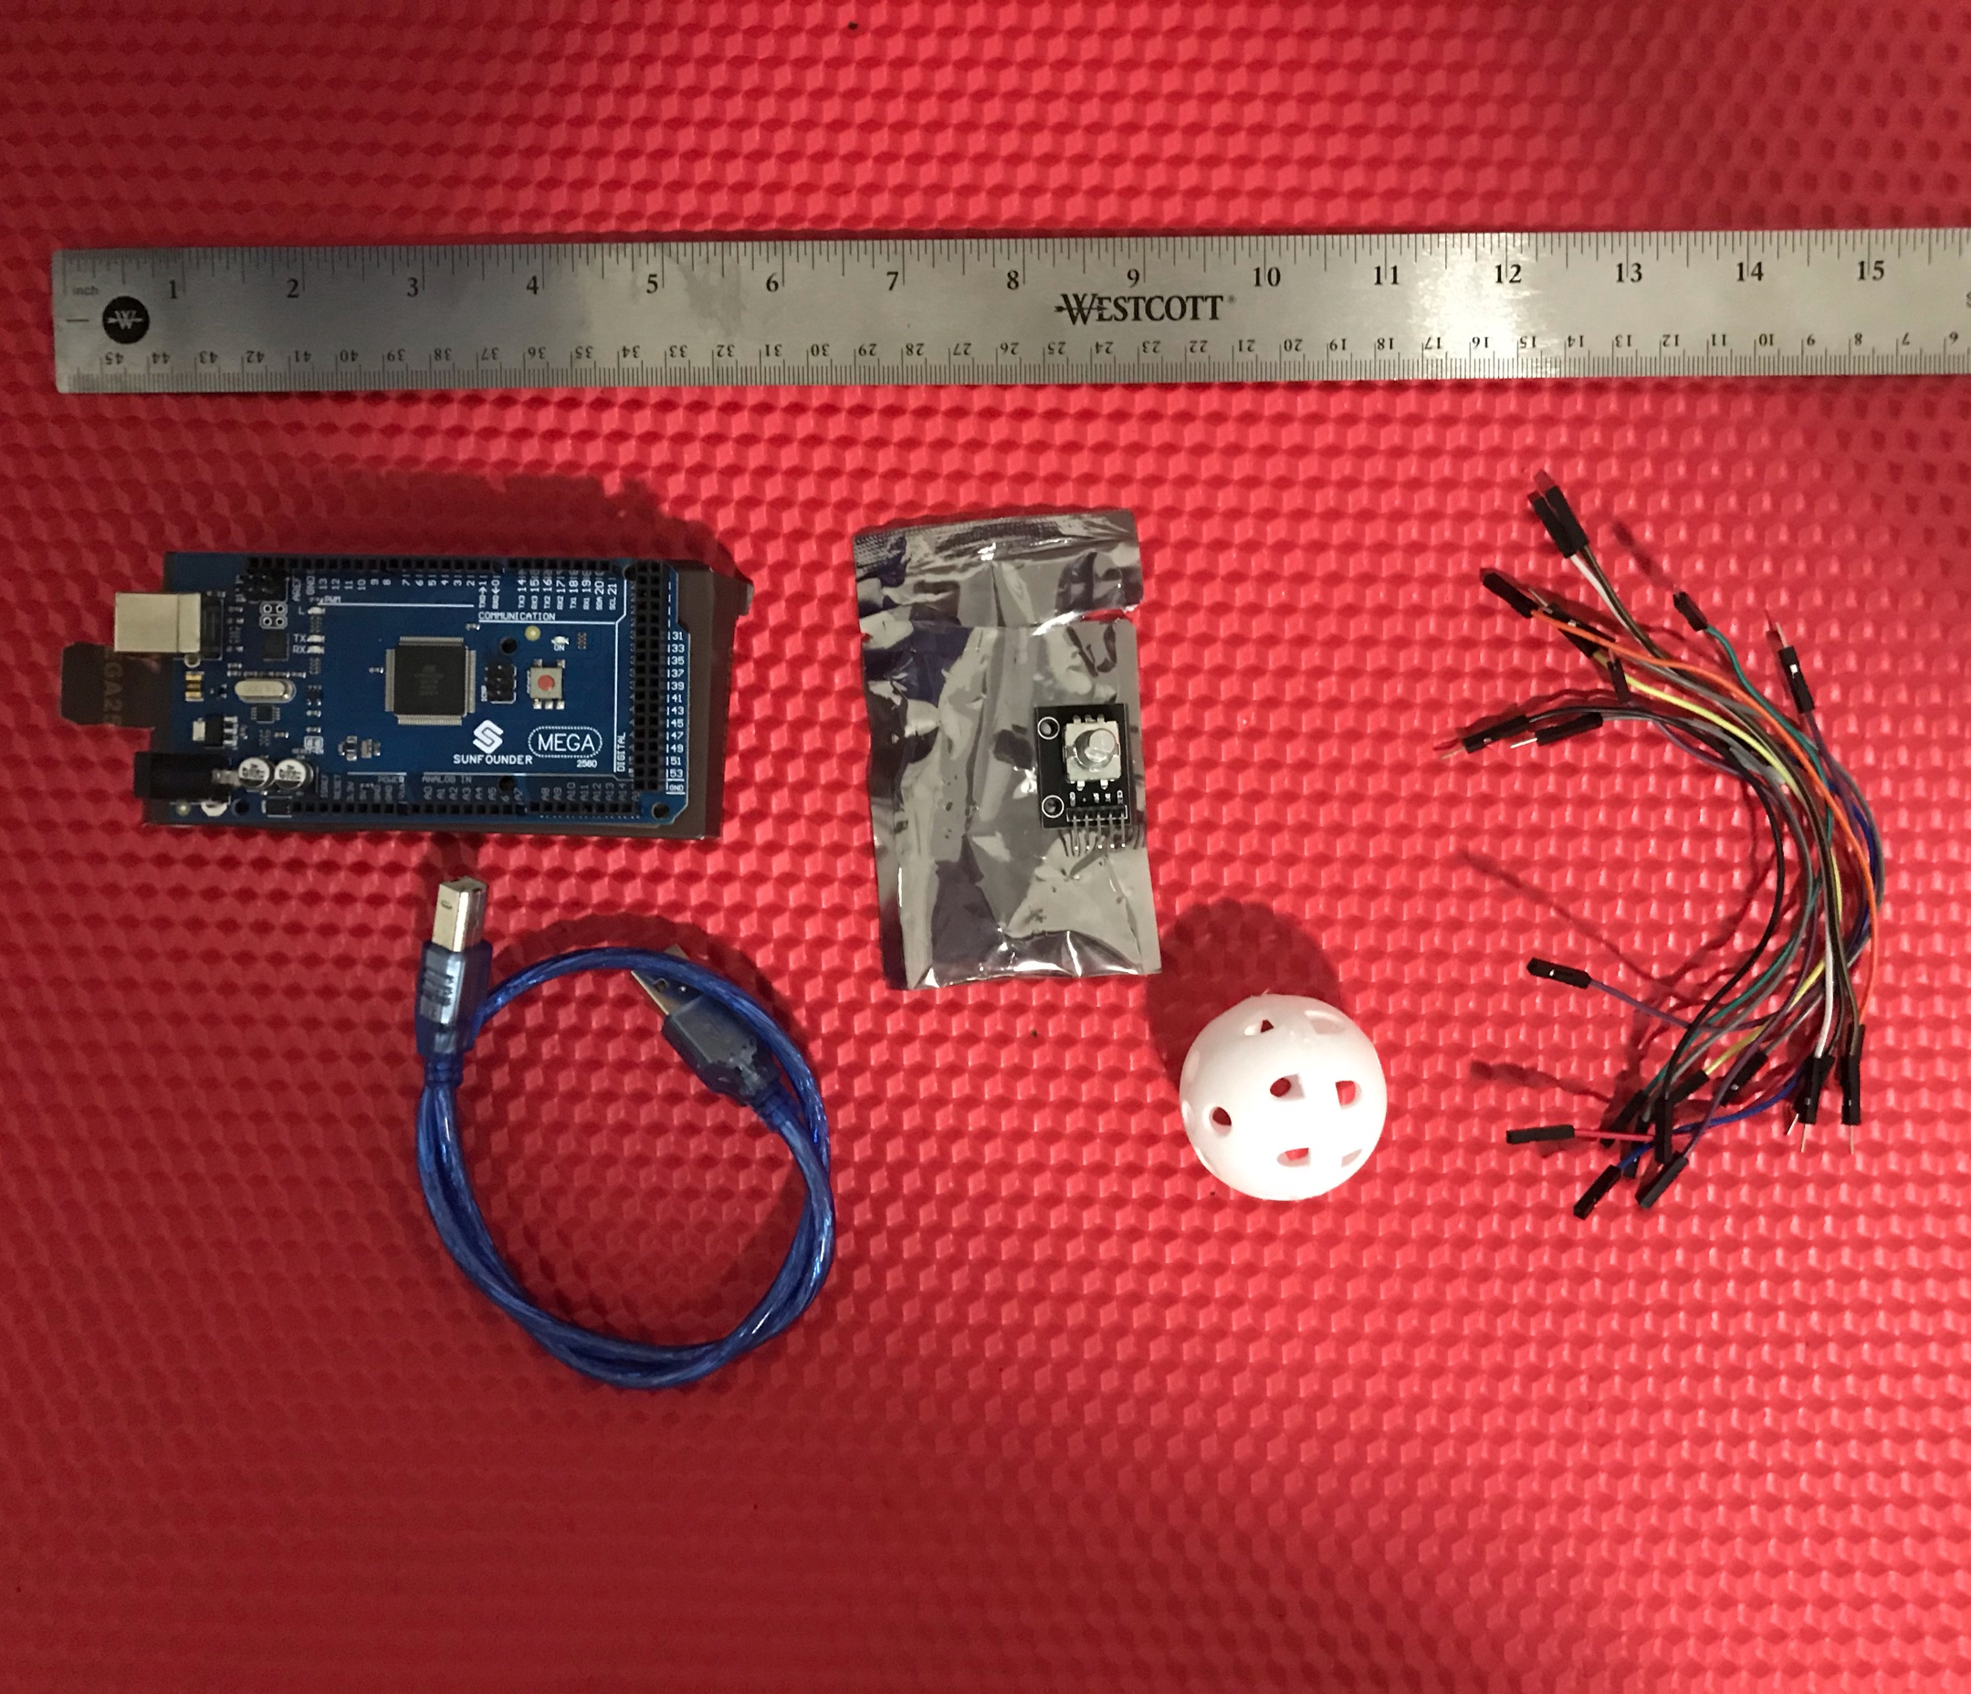
Materials List & Picture
Experiment Three
Mega 2560 Board
Rotary Encoder Module KY-040
Male to Female Wires
USB cable
Object to attach onto rotary encoder
Ruler or tape measurer
Ruler
Mega 2560 Board
Rotary Encoder
Male to Female Wires
Object to attach to Rotary Encoder
USB Cable

Slide 6
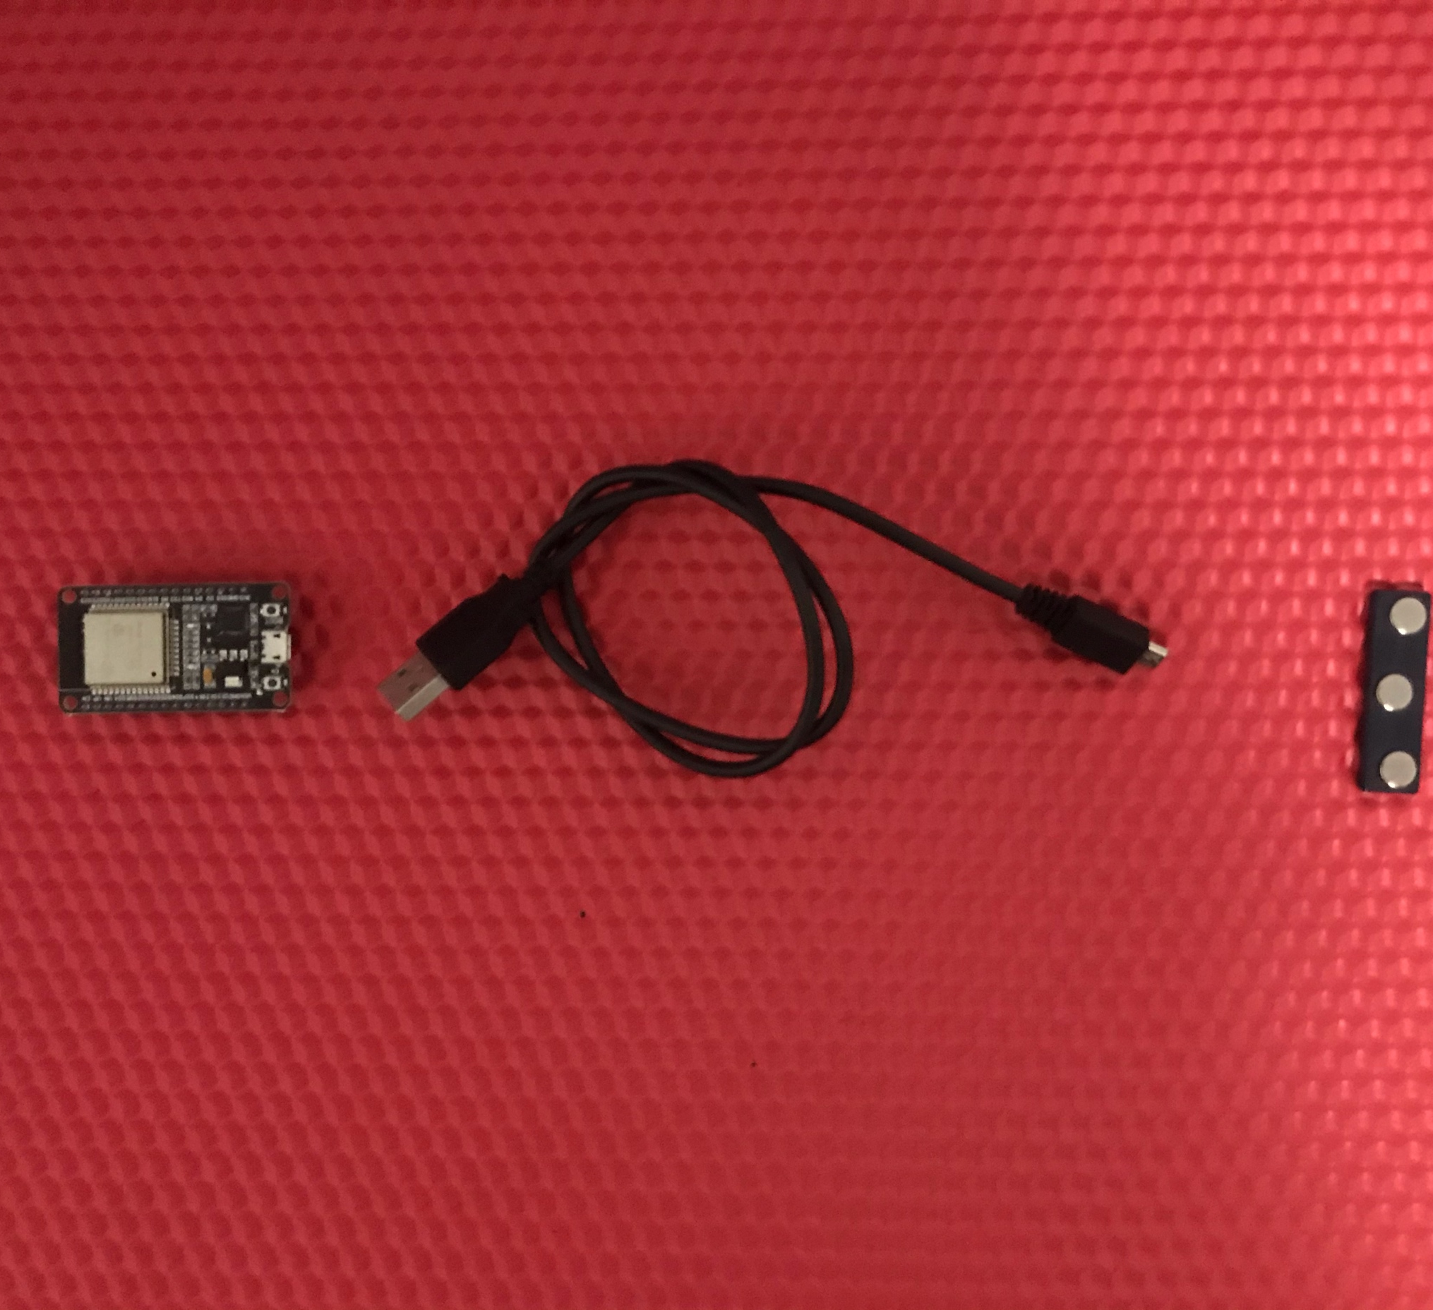
Materials List & Picture
Experiment Four
ESP32 microprocessor
Micro-USB to USB cable
Magnet
Micro-USB Cable
ESP32 Microprocessor
Magnet

Slide 7
PHYS204
Module 2
Precision of the Ultrasonic Sensor

Slide 8
Module Two: Objectives
Experiment One
Generate Experimental set up to observe the laws of physics
Test the precision of the ultrasonic sensor
Train in scientific method of observation
Acquire experience handling of electronics equipment
Collect Scientific Data
Compute Reliable Results and Draw valid Conclusions from Data

Slide 9
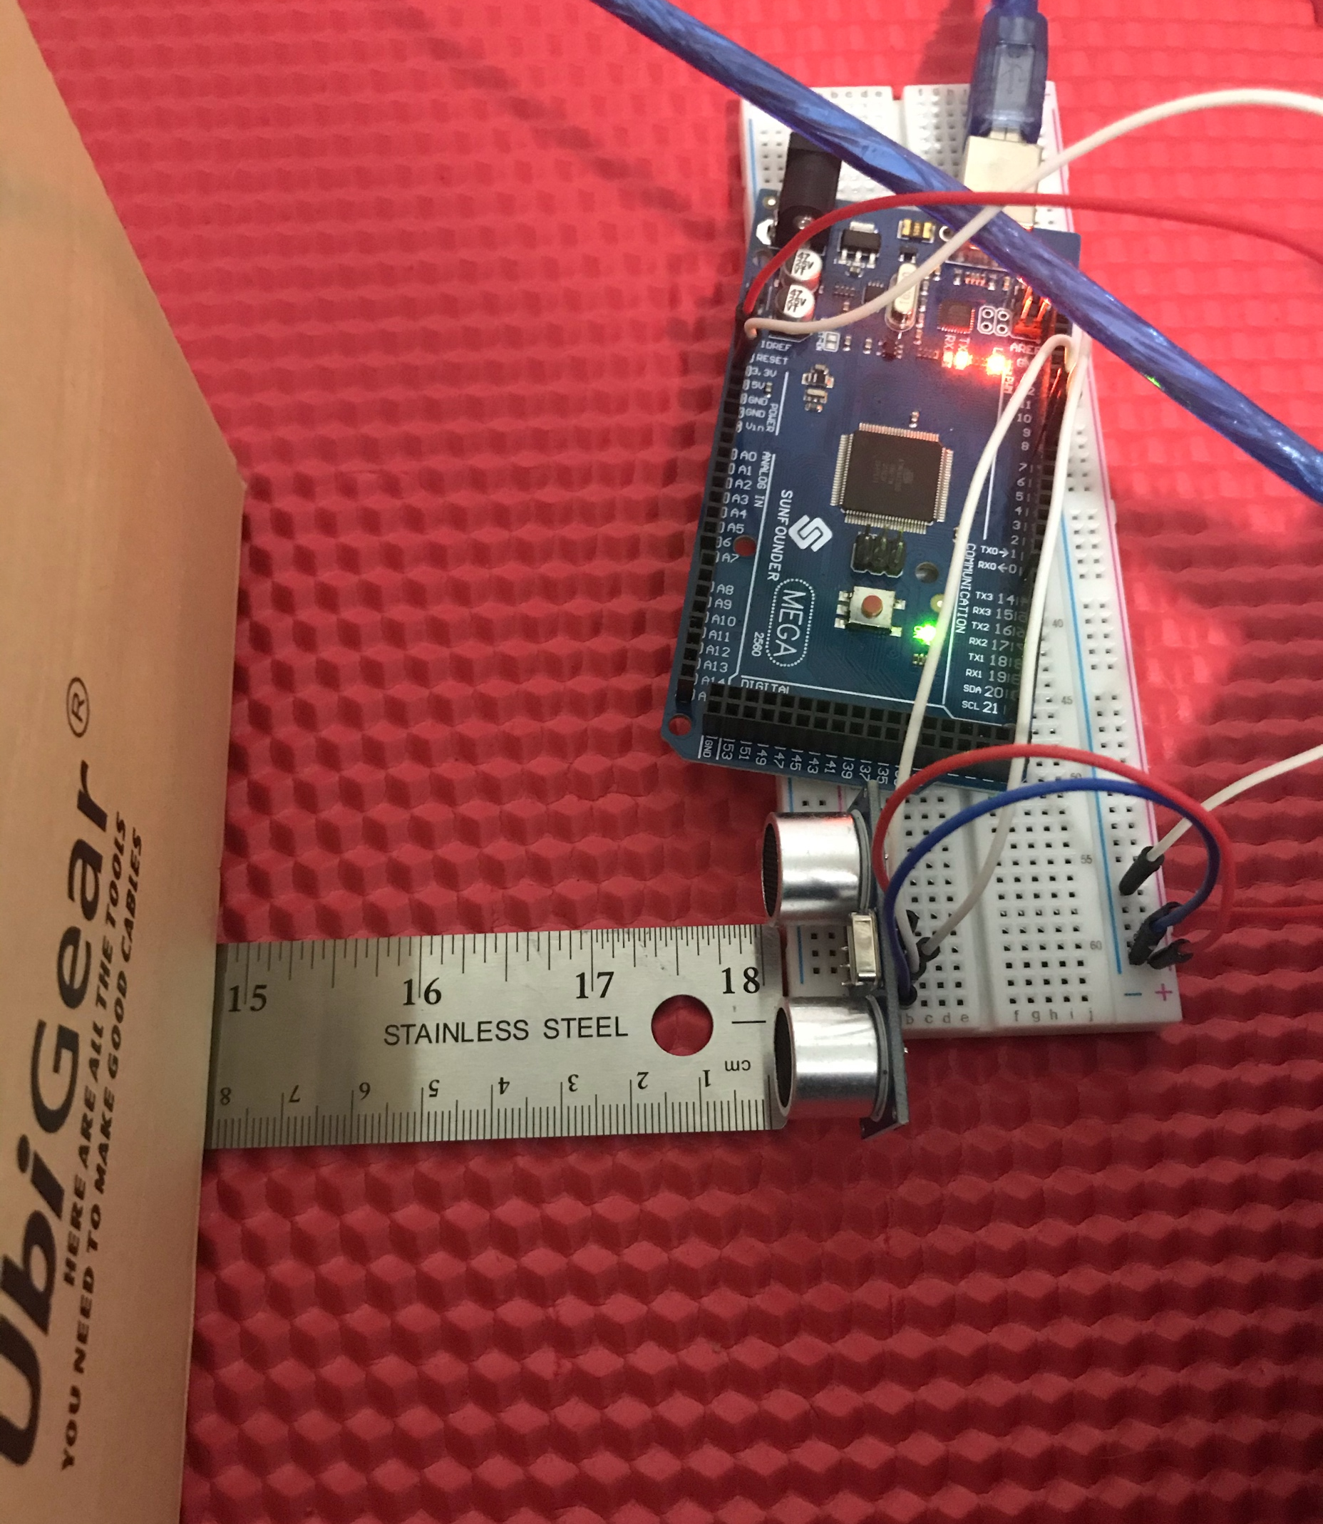
Experimental Set-up Picture
Experiment One
Materials List:
Mega 2560 Board
Ultrasonic sensor HC-SR04
Male to Male Wires
Breadboard
Ruler or tape measurer
Object to act as obstacle

Slide 10
Data Collection
Experiment One
Trial | Ruler Distance (cm) | Total Roundtrip Distance (m) | Time from Serial Monitor (microseconds) | Roundtrip time (s) | Velocity = distance/time (m/s)
1 | 8 | .16 | 412 | 0.000412 | 388
2 | 10 | .20 | 551 | 0.000551 | 363
3 | 6 | .12 | 332 | 0.000332 | 361
4 | 19 | .38 | 1082 | 0.001082 | 351
5 | 4 | .08 | 223 | 0.000223 | 359

Slide 11



Data Analysis
Experiment One
Average velocity from table
Percent difference where $v_{sound}=343 m/s$
$v_{avg}= \frac{388+363+361+351+359}{5}=$ 364
$Percent difference = \frac{\left|364 −343\right|}{343}×100\%=$6.12%

Slide 12
Conclusions
Experiment One
Discuss the results and comment on the source of errors.
  I would say the error comes from the rounding, the more numbers the more precisive the measurement.
Why is it important to determine the precision of sensors?
  It is import so that we can calculate for the error. Small errors can cause huge problems, say something must move within milliseconds but the measurement was half a millisecond off, with each millisecond that passes, the error gap will compound eventually leading to a critical error in the measurement.

Slide 13
PHYS204
Module 3
Gravitational Acceleration

Slide 14
Model Three: Objectives
Experiment Two
Generate an Experimental Set Up to Observe the Laws of Physics
Determine the Value of the Acceleration Due to Gravity of a Free-Falling Object
Train in Scientific Method of Observation
Acquire Experience Handling of Electronics Equipment
Collect Scientific Data
Compute Reliable Results and Draw Valid Conclusions from Data

Slide 15
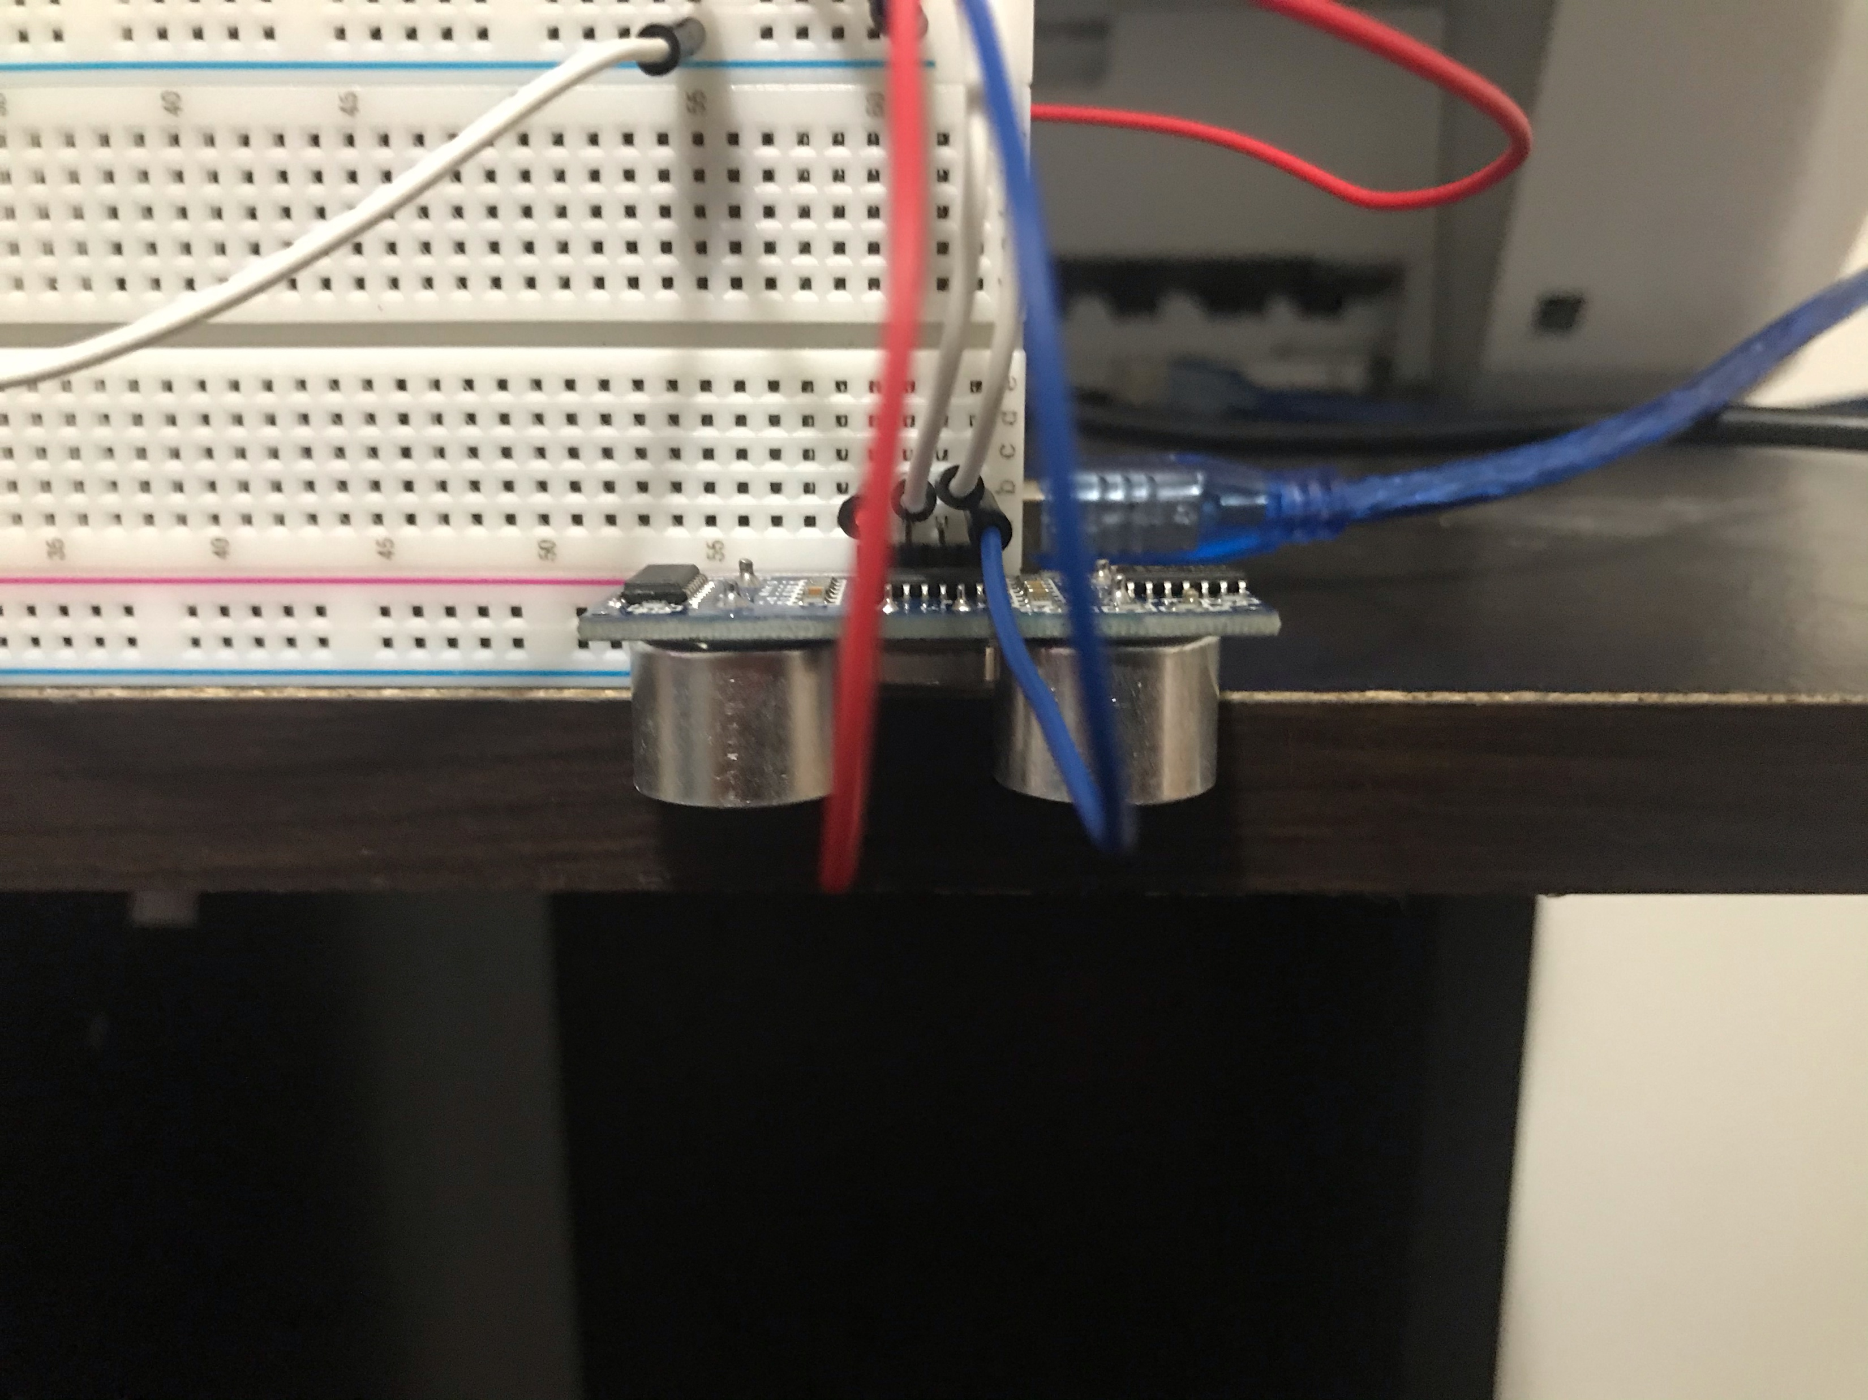
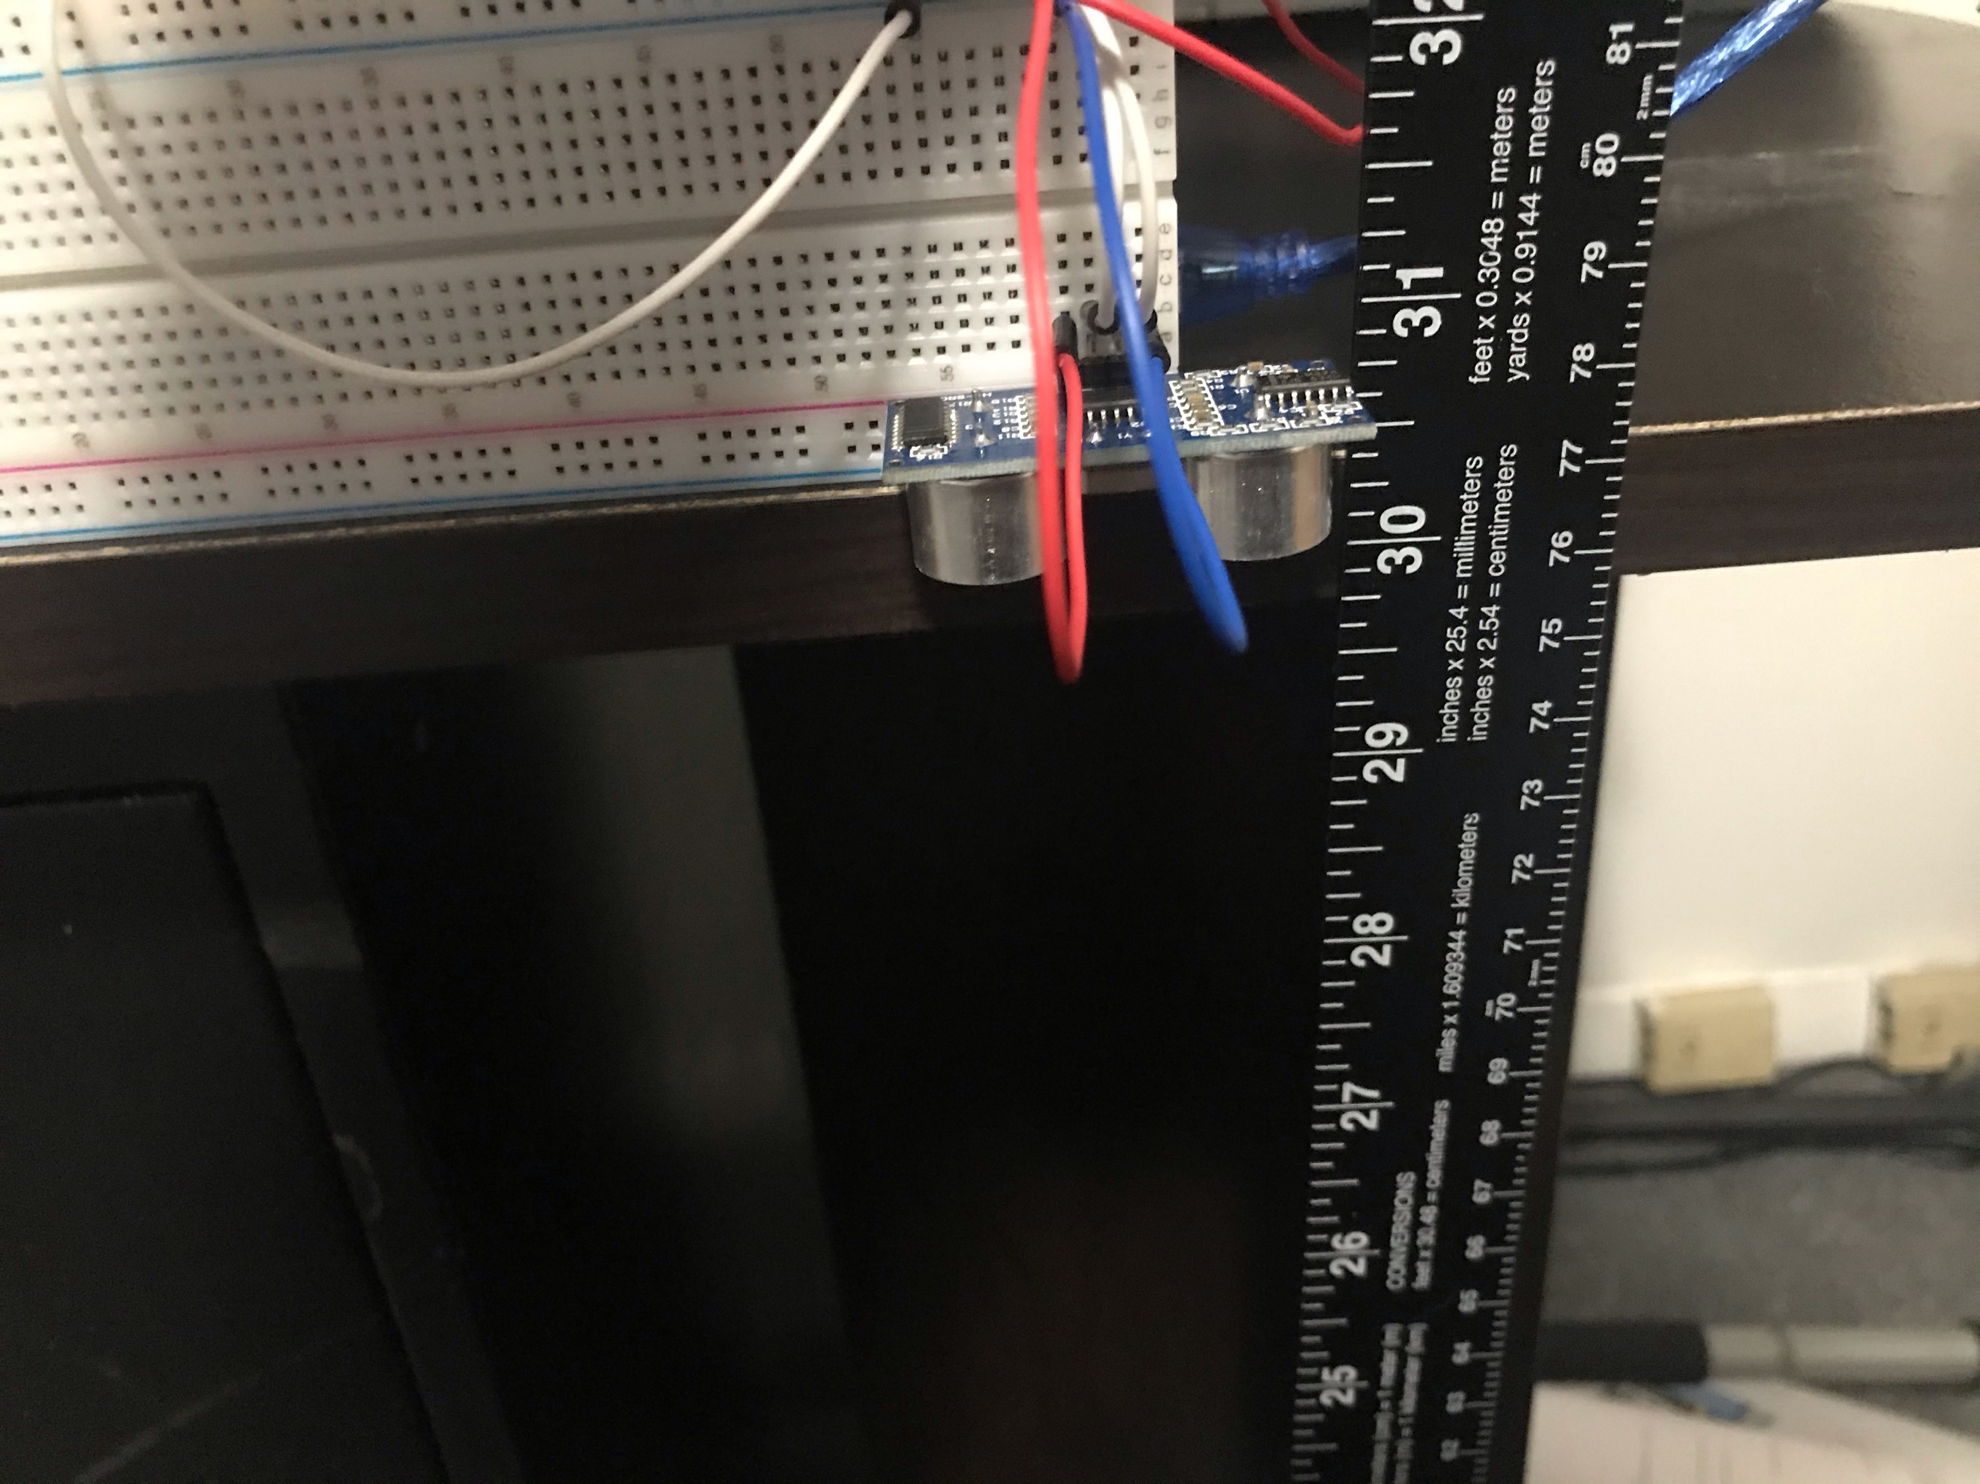
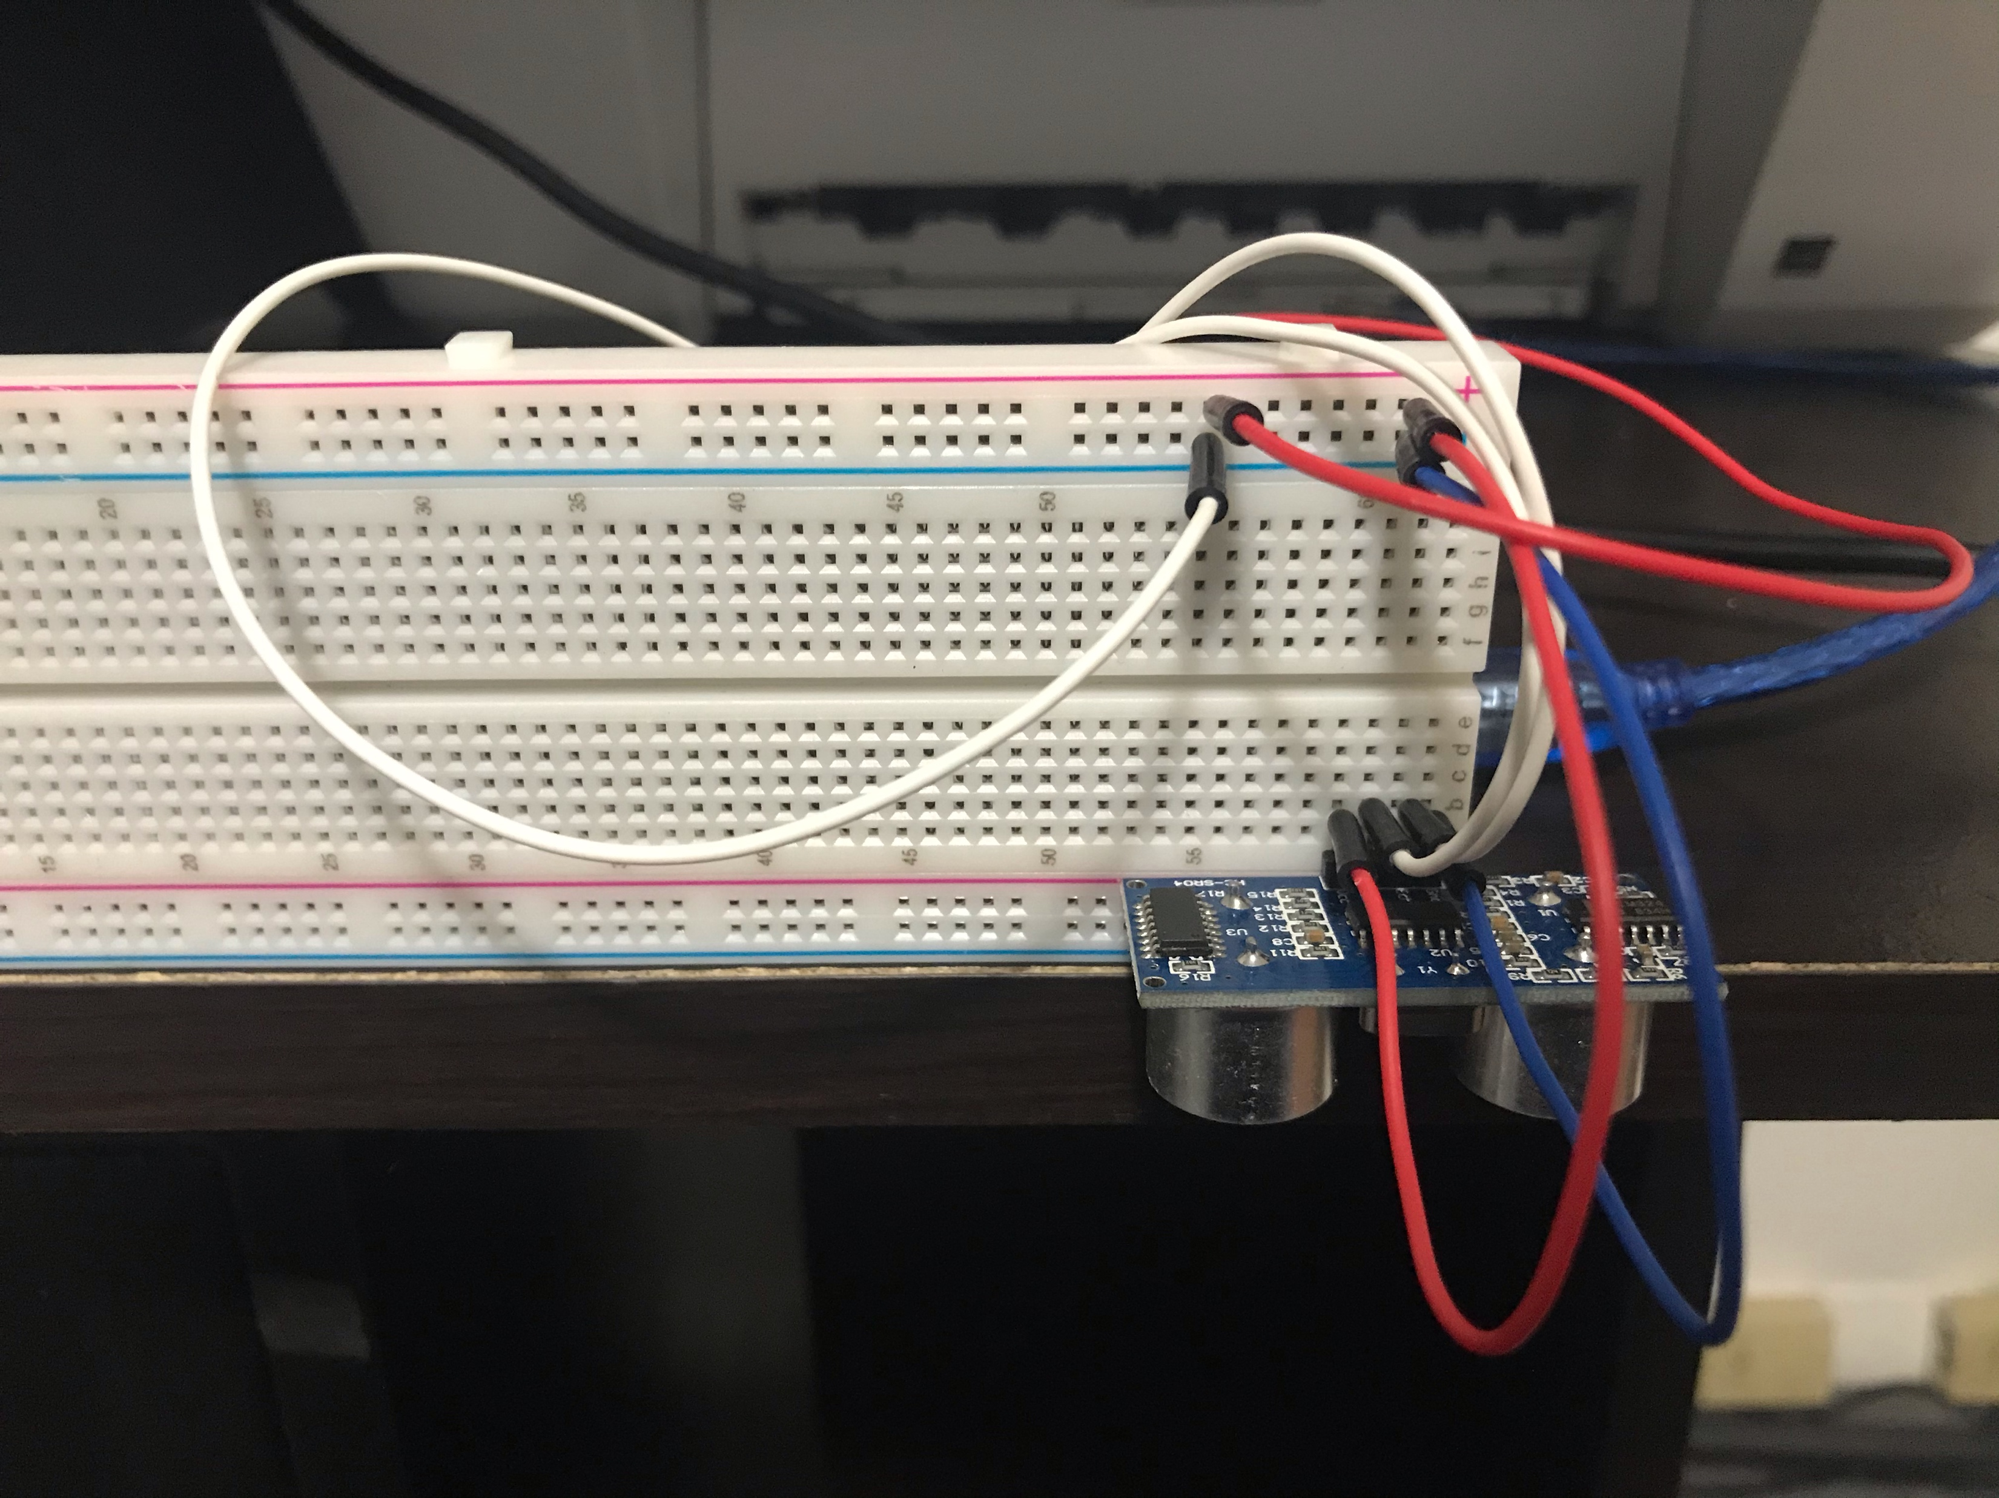
Experimental Set-up Picture
Experiment Two
Materials List:
Mega 2560 Board
Ultrasonic sensor HC-SR04
Male to Male Wires
Breadboard
Ruler or tape measurer
Object to undergo free fall motion

Slide 16
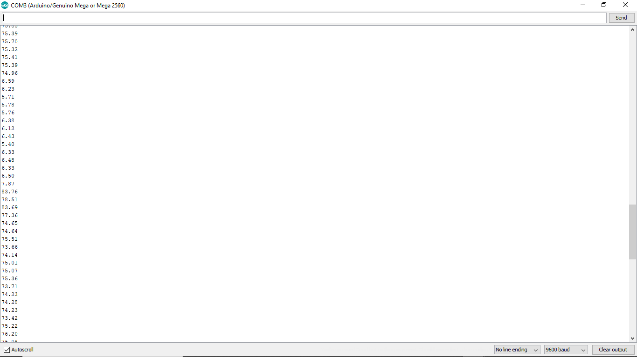
Serial Monitor Screenshot
Experiment Two
Screenshot of raw data showing the start of the fall and end of the fall of one trial.
This data will be used for the next experiment related to the conservation of energy.

Slide 17
Data Collection
Experiment Two
Initial height (m) =
Trial | Time to hit ground (s) | Acceleration (m/s²)
1 | .4 | 4.38
2 | .3 | 16.67
3 | .2 | 25
4 | .3 | 14.44
5 | .3 | 12.22

Slide 18



Data Analysis
Experiment Two
Average acceleration from table
Percent difference with $g=9.8 m/s^{2}$
$a_{avg}= \frac{4.38+16.67+25+14.44+12.22}{5}$ = 14.54
$$Percent difference =\frac{\left|14.54−9.8\right|}{9.8}×100\%=48.39\%$$

Slide 19
Conclusions
Experiment Two
Indicate the line of code that outputs the distance. What does the 0.0343 represent? Why is the equation divided by 2?
  Distance = duration*0.0343/2.; // Calculate one way distance traveled in cm
    What the .0343 that is the speed of sound then it divided by 2 is because the sound goes back and forth so it travels one distance and returns the same distance.
  Serial.println(distance); // Display distance on the serial monitor
    So the line of code that does the calculation is the distance=duration*0.0343/2
  The line of code Serial.printIn(distance) is what makes it display in the serial monitor
How much variation is there from trial to trial? What does this indicate about the uncertainty of the result?
  There was about a 49 percent error. There are a number of factors that would contribute to the error, one certainly being my object not falling at an even rate, another being that the object would sway while falling.

Slide 20
PHYS204
Module 4
Conservation of Energy

Slide 21
Module Four: Objectives
Experiment Two
Represent the Motion of an Object Through Graphs of Position and Velocity Versus Time
Observe the Changes in Potential Energy, Kinetic Energy, and Total Mechanical Energy of a Freely-Falling Body
Determine Both Theoretically and Experimentally Whether the Total Mechanical Energy of a Freely-Falling Body Remains Constant

Slide 22
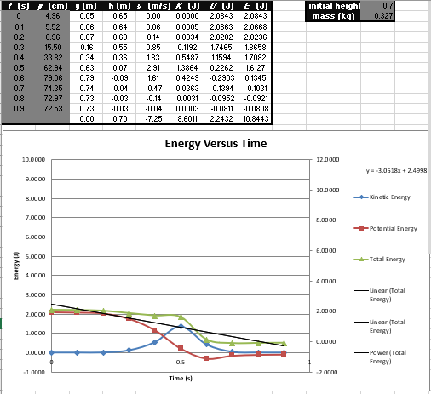
Data Analysis
Experiment Two

Slide 23




Data Validation
Experiment Two
Final velocity from experimental data
2.91m/s
Theoretical value of final velocity
Percent difference
$v_{experimental}$ =
$v_{f}=\sqrt{2gh}$ =
$\sqrt{2∗9.8∗(0.63−0.05)}=3.37$m/s
$$Percent difference =\frac{\left|3.37−2.91\right|}{3.37}×100\%=$$
13%

Slide 24
Conclusions
Experiment Two
Is the total mechanical energy conserved at all times? If yes, how well is it conserved?
  Answer: No, it is close to remaining constant but still varies.
Discuss the key characteristics of the plot.
  Answer: You can see the moment the book hits the ground through the kinetic energy, the kinetic and potential energy lines follow each other very close to the point of being similar opposites during the hit.

Slide 25
PHYS204
Module 5
Rotational Motion

Slide 26
Module Five: Objectives
Experiment Three
Generate an Experimental Set Up to Observe the Laws of Physics
Apply the Arc Length Formula to Measure Linear Displacement

Slide 27
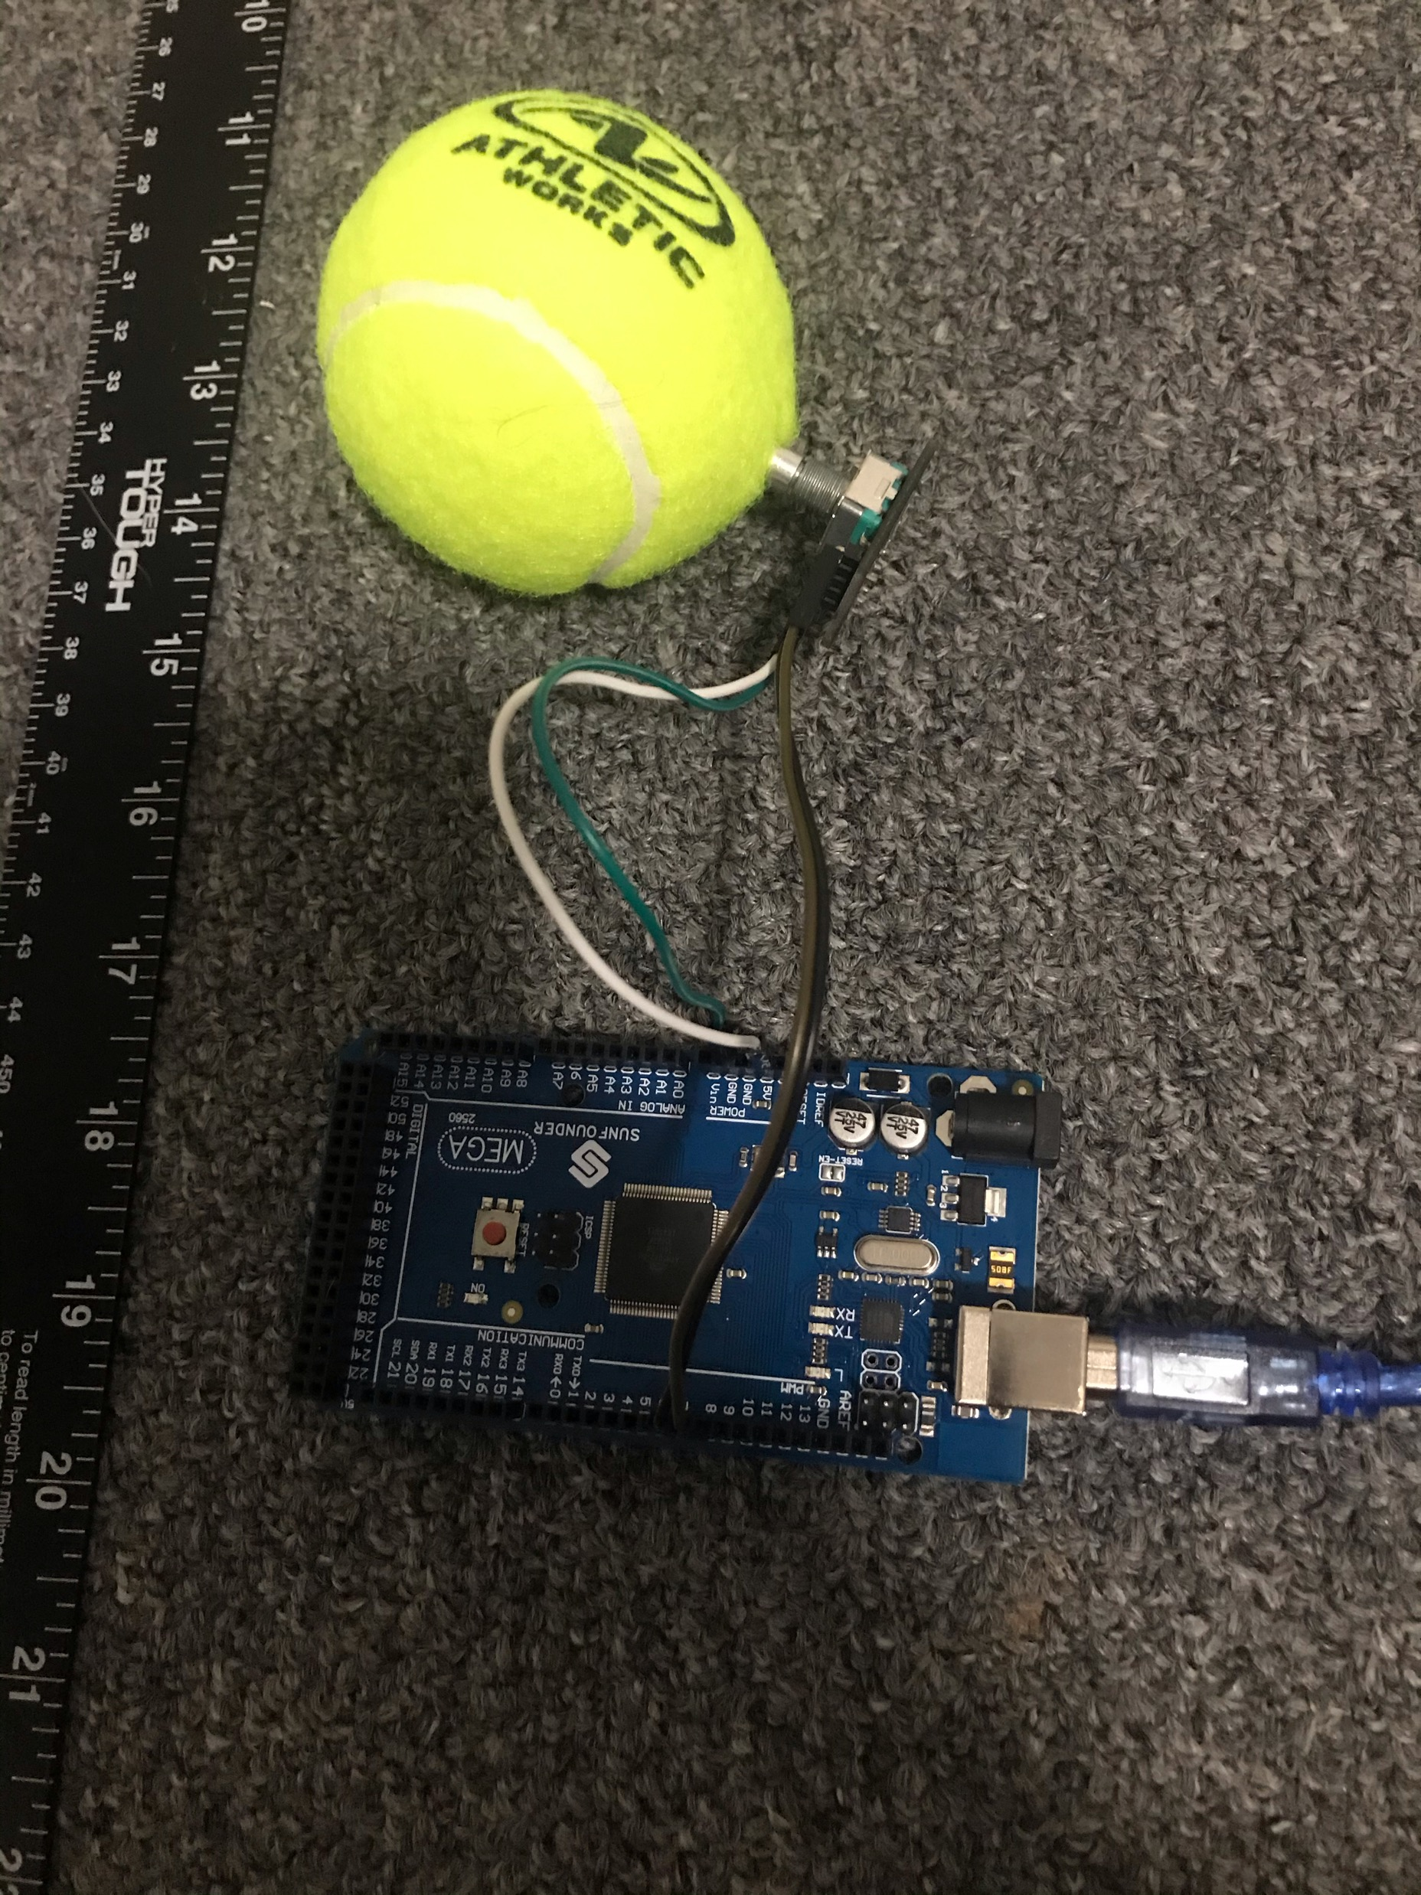
Experimental Set-up Picture
Experiment Three
Materials List:
Mega 2560 Board
Rotary Encoder Module KY-040
Male to Female Wires
Object to attach onto rotary encoder
(e.g. cork, bottle cap, ball)
Ruler or tape measurer

Slide 28
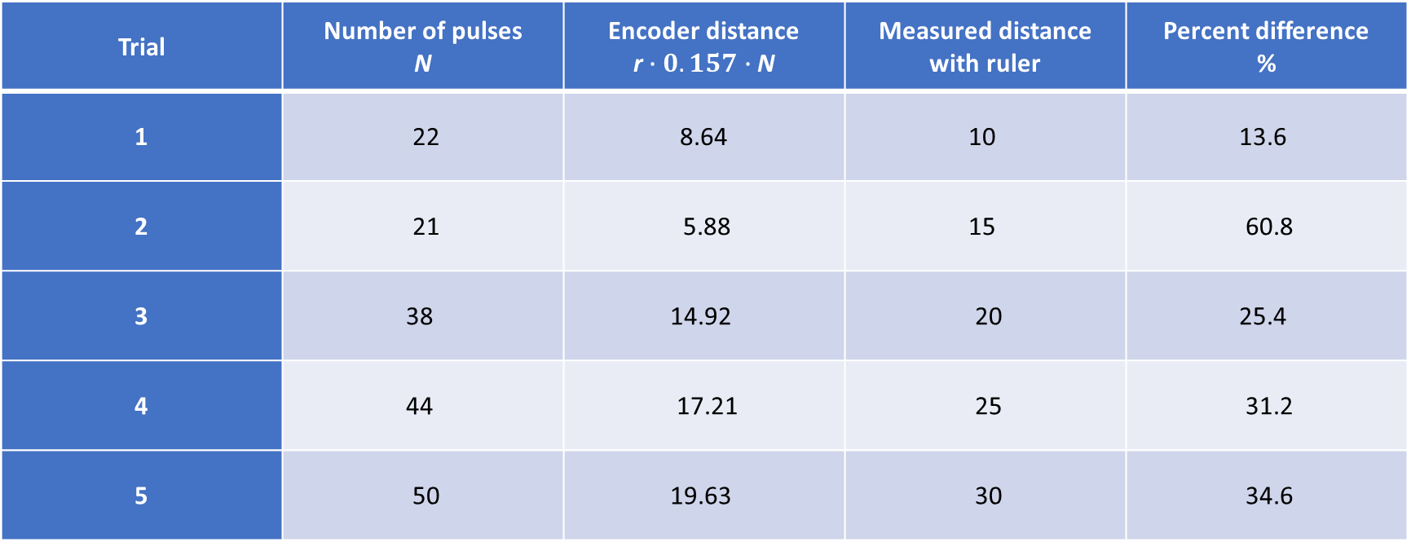
Data Collection and Analysis
Experiment Three
Object radius, r = 2.5cm
Trial | Number of pulses N | Encoder distance r$∙0.157∙$ N | Measured distance with ruler | Percent difference %
1 | 22 | 8.64 | 10 | 13.6
2 | 21 | 5.88 | 15 | 60.8
3 | 38 | 14.92 | 20 | 25.4
4 | 44 | 17.21 | 25 | 31.2
5 | 50 | 19.63 | 30 | 34.6

Slide 29
Conclusions
Experiment Three
Discuss the results and comment on the reasons for errors.
  My lowest percentage of error was with my first trial. There are a number of factors that contributed to my margin of error. One was lack of excellent friction, there may have been moments where my ball slid instead of perfectly rolling. A major error I was experiencing was connection, if I position my finger in the wrong spot on the ardrino board it shorted a connect or the wires were not holding strongly in place or the wire I used to connect the ardrino to the laptop was not establishing a strong connection, I would have to repeat the program multiple times before I would see that it would properly recognize a change in direction or not slip between two numbers. The farther the distance the more likely I was to experience some kind of technical difficulty. Also a lack of precision when measuring the diameter of my ball.
What are some applications of this measuring technique? Could this measuring system be used to measure surfaces that are not flat?
  This experiment is similar to the tool the measuring wheel which is a stick with a wheel at the end and a counter that measures x amount of wheel rotations converts to whatever measuring distance being used for that tool. One wheel rotation could be one meter on that tool. I could see using this experiment using some kind of automated robotic to travel along the ground to measure a distance for lay cable or a non-invasive walking path that follows the natural flow of the land.

Slide 30
PHYS204
Module 6
Hall Effect

Slide 31
Module Six: Objectives
Experiment Four
Generate an Experimental Set up to Observe the Laws of Physics
Observe the Hall Effect as a Relationship Between Voltage and Magnetic Field

Slide 32
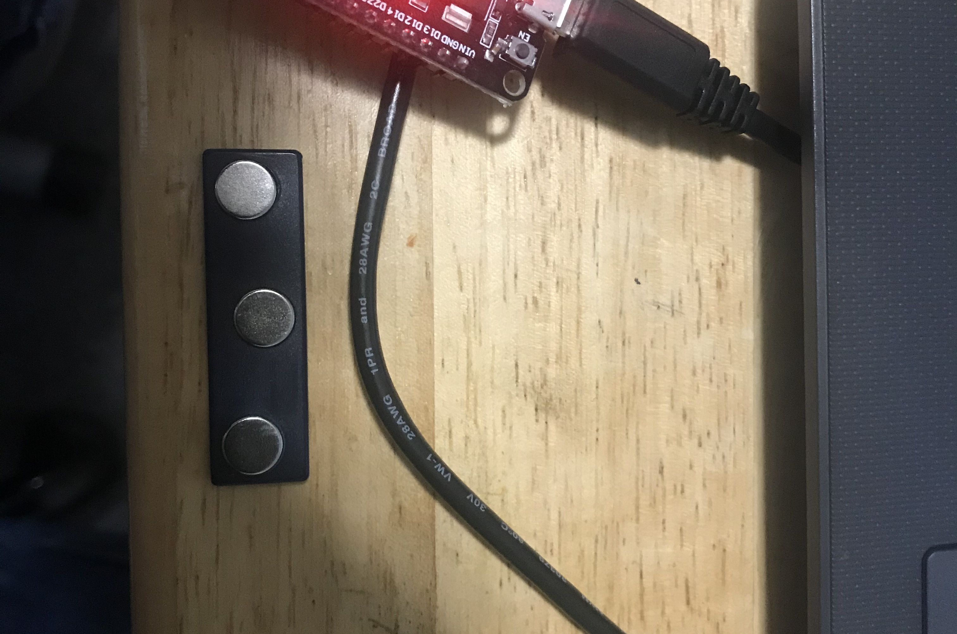
Experimental Set-up (Picture)
Experiment Four
Materials List:
ESP32 microprocessor
Micro-USB cable
Magnet

Slide 33
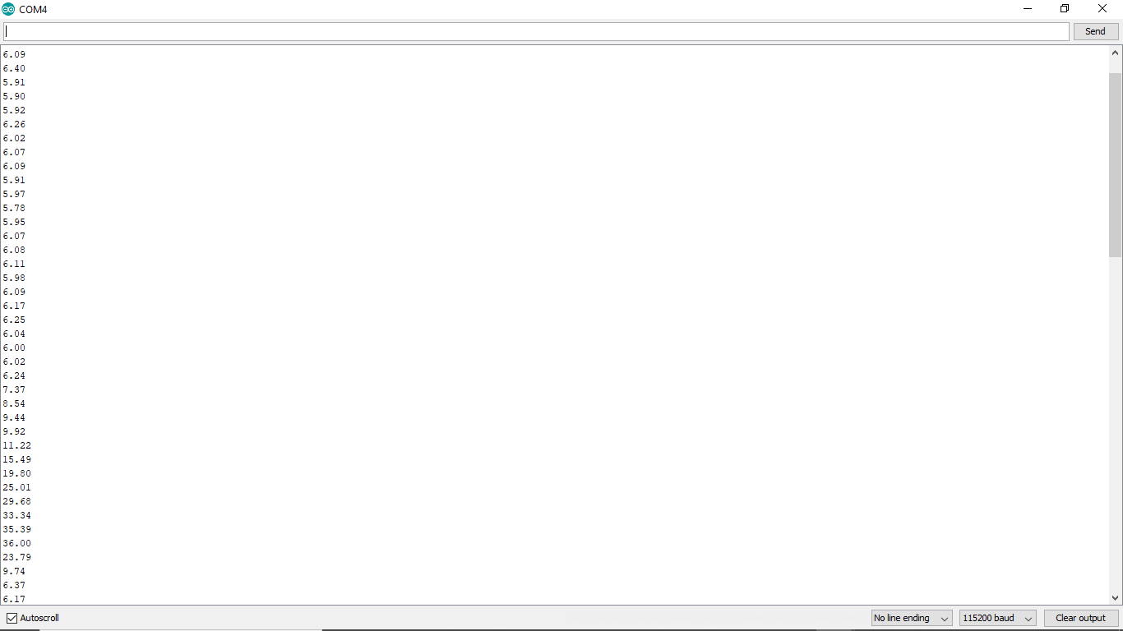
Data Collection
Experiment Four

Slide 34
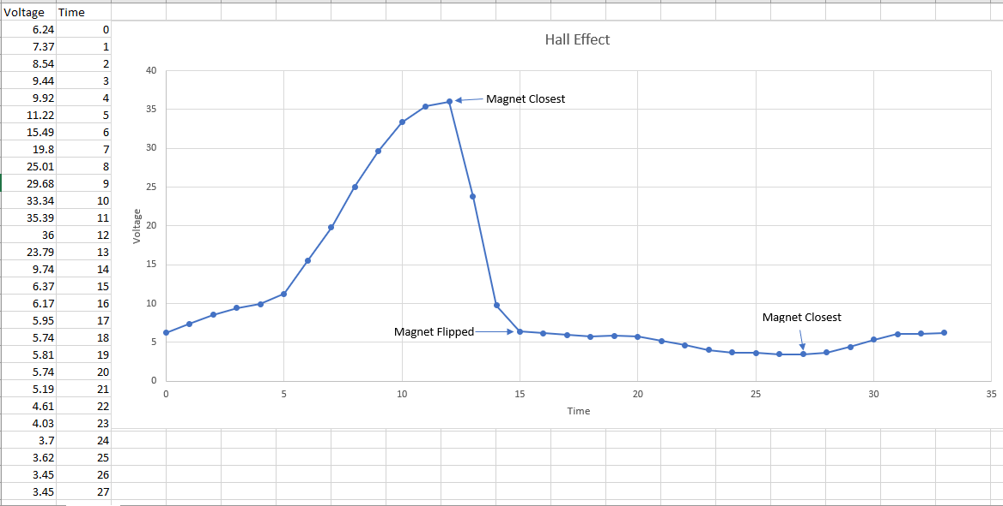
Data Analysis
Experiment Four

Slide 35
Conclusions
Experiment Four
How does the Hall sensor work?
  When placed into a magnetic field, electrons or deflected to the sides of the conductive material and the change in voltage is measured.
What are some applications for the Hall effect sensor?
  Can be used in cars for sensing seat and safety belt position for airbags, anti-lock brakes, balance on washer machines.

Slide 36
Skills Developed
Problem Solving
Scientific Measuring
Assessing Errors
Patience

Slide 37
Total Conclusion
Physics plays a role in our entire everyday life through its laws.
Physics plays an important part when it comes to the development of IoT devices.
Without an understanding of the fundamentals of physics, we could not advance our understanding and progress with electronics.

